Slide 1


Student Engagement and Equity Consciousness
Palmer Lake Elementary • Fair Oaks Elementary
23 October 2020
Robert Seth Price
www.eggplant.org • robert@eggplant.org
National Urban Alliance
www.nuatc.org
Notes:
Linda welcomes Board

Slide 2
Today: 23 Oct 20
Community
Key Vocabulary Prediction
Powerful
Questions
Read – Talk
Map
Write
Belief
Belonging
Priming
Interest
Interest
Knowledge
Listening
Comprehension

Slide 3


HOPs
High Operational Practices of the Pedagogy of Confidence support and enhance equity:
Identifying and activating student strengths
Eliciting high intellectual performance
Integrating prerequisites for academic learning
Situating learning in the lives of students
^{Building relationships}
^{Providing enrichment}
^{Amplifying student voice}
Belief and Belonging
Notes:
Understanding from research and data, doing with practical models and strategies by practicing for expertise and mastery

Slide 4
CLEAR
Cultural
emphasizes purpose of
what is
being learned
in relationship
to one’s
own culture
Learning
choices in
content &
assessment
based on own experiences
values, needs
and strengths
Equitable
with learning
environments
where students
racial & ethnic
diversity is
valued which
contributes to
successful
outcomes
Achievement
in multiple ways
to represent knowledge and skills allowing for attainment of outcomes at
different points of time
Responsive
to positive relationships, rigorous learning experiences and higher order thinking to address the world in a relevant action oriented manner

Slide 5
3 Phases of Learning
Retaining for
Understanding
Priming
Processing
Getting
Ready
to Learn
Unpacking
Meaning
Holding on
to Learning
Notes:
2 maps in use — sequencing and categorical
even a cause and effect

Slide 6
3 Phases of Learning
Retaining for
Understanding
Priming
Processing
Getting
Ready
to Learn
Unpacking
Meaning
Holding on
to Learning
Steps of Collaboratively Implementing
Priming
Lessons
Sustaining
The Why
The How
Teacher’s Doing
NUA Modeling
Peer to Peer Coaching
Qualitative
Notes:
2 maps in use — sequencing and categorical
even a cause and effect

Slide 7

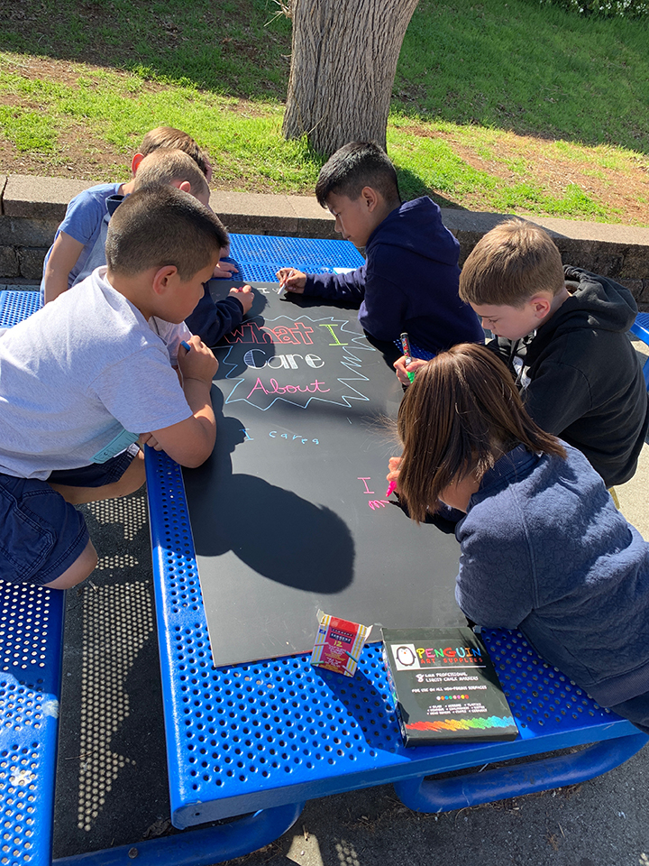
Community Building
Take a poll
How
High Operational Practices of the Pedagogy of Confidence support and enhance equity:
Notes:
The tools———of HOPs for critical thinking EQUITY

Slide 8
Key
Vocabulary
Prediction
Text
Video
Song Lyrics
Audio Story

Slide 9
Key
Vocabulary
Prediction
Text
Video
Song Lyrics
Audio Story
Why?
—Vocabulary
—Interest
—Prediction
—Collaboration
How?
—Whole Class
—Pairs
—Small Groups
—Collaboration

Slide 10
Key
Vocabulary
Prediction
reach
decision
flexible
prey
bent
die
change
process
knocks
rebirth

Slide 11
reach
decision
flexible
prey
bent
die
change
process
knocks
rebirth
Discuss the vocabulary whole group and/or small groups first with predictions, then whole group sharing.
Use the vocabulary in writing. Write several sentences to use all the vocabulary.
Inductive categorization (better with 12+ words/phrases) sorting the vocabulary into categories.
Draw an image representing your prediction of the vocabulary meaning.
Key
Vocabulary
Prediction

Slide 12

Powerful
Questions
Why?
—Priming
—Schema
—Interest
—Collaboration

Slide 13
Powerful
Questions
Why?
—Priming
—Schema
—Interest
—Collaboration
With?
—Object
—Photo
—Drawing
—Concept

Slide 14
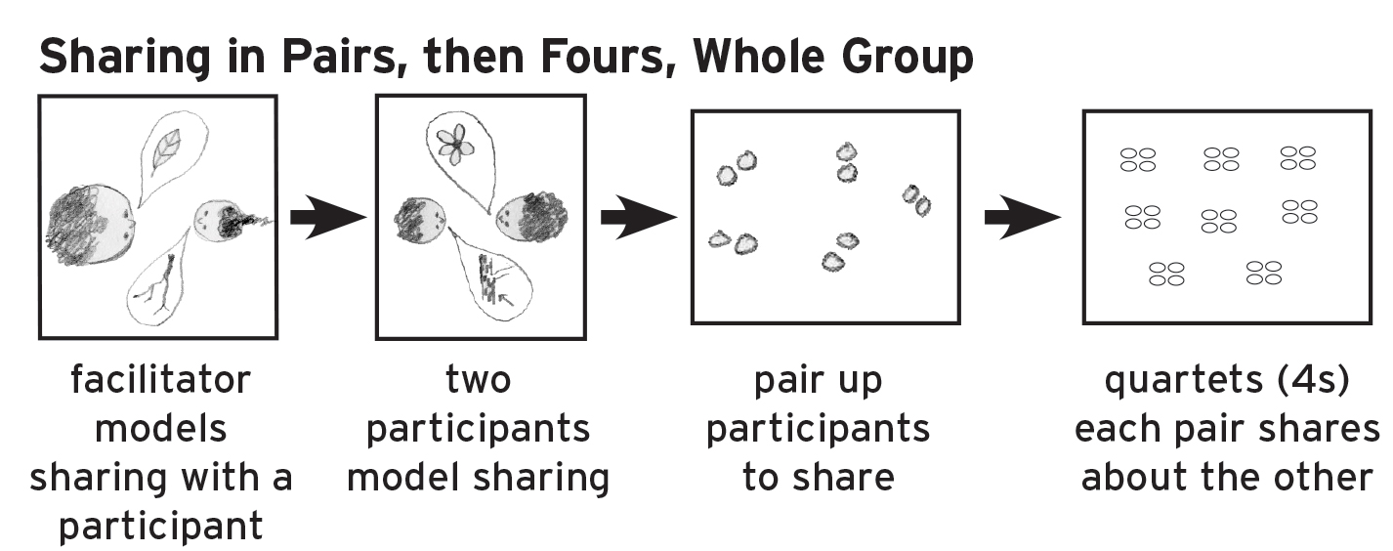
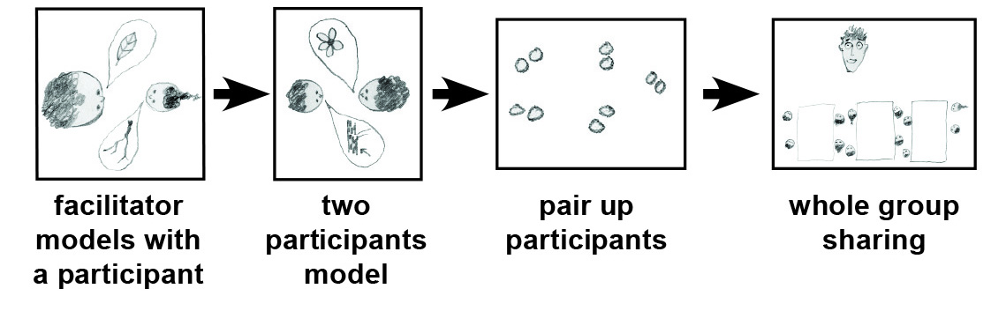
Powerful
Questions
Why?
—Priming
—Schema
—Interest
—Collaboration
With?
—Object
—Photo
—Drawing
—Concept
How?

Slide 15
Powerful
Questions
Why?
—Priming
—Schema
—Interest
—Collaboration
With?
—Object
—Photo
—Drawing
—Concept
Shared Inquiry
Socratic Seminar

Slide 16
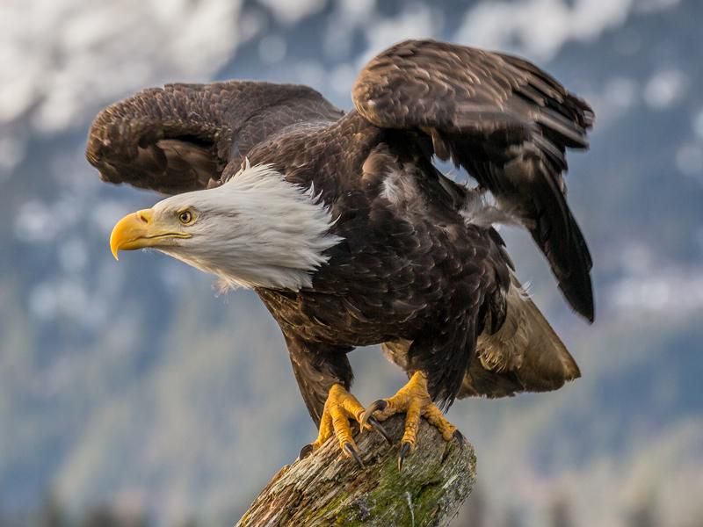

Slide 17

Defining in Context - Brainstorming
Circle Map
Describing in Context
Brainstorming
key events
Frame: examples,
Evidences, and/or why
Pictures and/or words
talons
beak
Eagle
Analogies
Relationships
feathers
Describing in Context
Brainstorming
Notes:
All do a circle map.

Slide 18
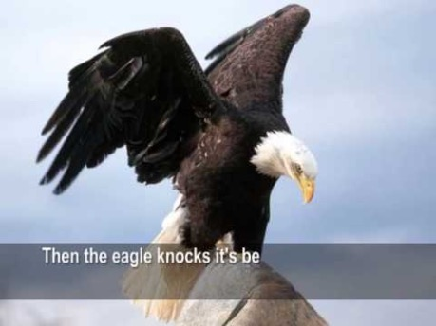

Slide 19
Comprehension Talk
Read — Talk — Map
Watch — Talk — Map
Listen — Talk — Map

Slide 20
Comprehension Talk
Read (Watch) — Talk — Map
How?
Why?
—Listening
—Comprehension
—Interest
—Collaboration

Slide 21

Defining in Context - Brainstorming
Circle Map
Describing in Context
Brainstorming all about
Pictures and/or words
talons
beak
Eagle
Analogies
Relationships
feathers
Describing in Context
Brainstorming
Notes:
All do a circle map.

Slide 22
Defining in Context - Brainstorming
Circle Map
Describing in Context
Brainstorming all about
Pictures and/or words
talons
beak
Eagle
Analogies
Relationships
feathers
Describing in Context
Brainstorming
Notes:
All do a circle map.

Slide 23
Defining in Context - Brainstorming
Circle Map
Describing in Context
Brainstorming all about
Frame: examples,
Evidences, and/or why
Pictures and/or words
grab onto prey
eat food
clean feathers
talons
beak
Eagle
Analogies
Relationships
feathers
fly successfully
Describing in Context
Brainstorming
evidences, examples and/or why
Notes:
All do a circle map.

Slide 24

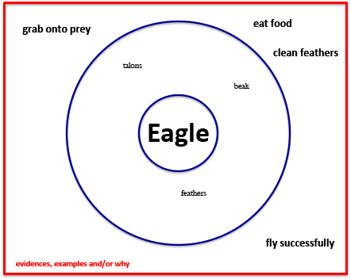
An important thing I know about the eagle
is _________________________________.
I also know ______________________________.
And __________________________________.
In addition I know ______________________.
And very importantly I know _______________.
Now you know something that I know about ____________________________.

Slide 25
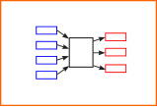
Cause and Effect
Multi Flow Map
Cause and Effect
Pictures and/or words
cause
effect
Eagle
Decision
At
40 Years
Of Age

Slide 26
Cause and Effect
Multi Flow Map
Cause and Effect
Frame: examples,
Evidences, and/or why
Pictures and/or words
cause
effect
Eagle
Decision
At
40 Years
Of Age
evidences, examples and/or why

Slide 27
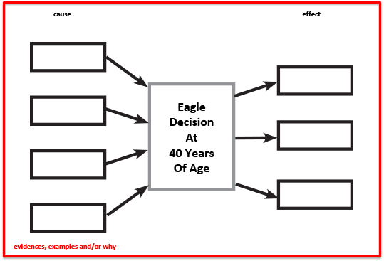
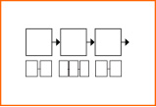
Multi Flow Map – Cause and Effect
Flow Map - Sequencing
Introduction
Life at 40
causes
effect
Conclusion

Slide 28
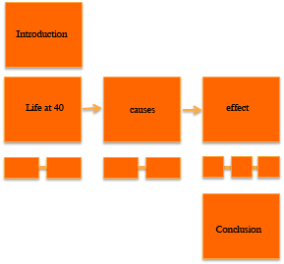
Introduction:
Paragraph 1:
Paragraph 2:
Paragraph 3:
Conclusion:

Slide 29
Strategy Review Chart
Name & Primitive | Cognitive Process/ Function | Remember | Priming, Processing, Retaining for Mastery | Source | Notes

Slide 31
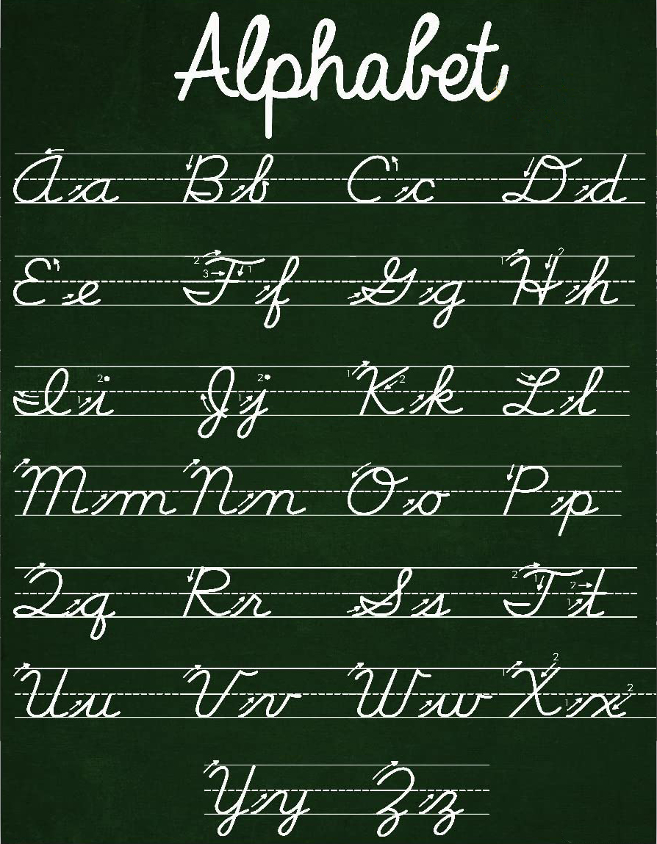
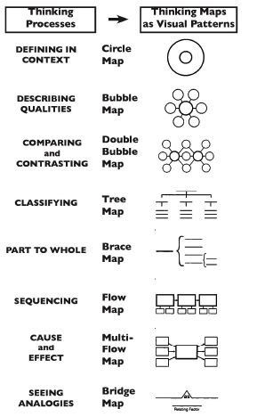
Thinking Maps
Notes:
Back to thinking with Thinking Maps — organizing thinking. Circle map for brainstorming — then organize…

Slide 32
Thinking Maps
A Visual Language
for
Communicating
and
Organizing
Thinking
Notes:
Back to thinking with Thinking Maps — organizing thinking. Circle map for brainstorming — then organize…

Slide 33
Thinking Maps as a Language
Describing in Context
Brainstorming
Comparing
& Contrasting
Categorizing
Describing
Sequencing
Cause and Effect
Whole / Part
Analogies
Relationships
To Organize Thinking – Student Centered
Notes:
Back to thinking with Thinking Maps — organizing thinking. Circle map for brainstorming — then organize…

Slide 34
Community Building
Take a poll
How
High Operational Practices of the Pedagogy of Confidence support and enhance equity:
Notes:
The tools———of HOPs for critical thinking EQUITY

Slide 35

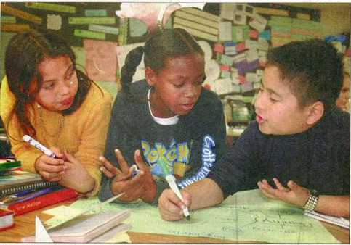



Slide 36
Thank You
Robert Seth Price
www.eggplant.org • robert@eggplant.org
National Urban Alliance
www.nuatc.org

Slide 38
Priming
Powerful Questions

Slide 39
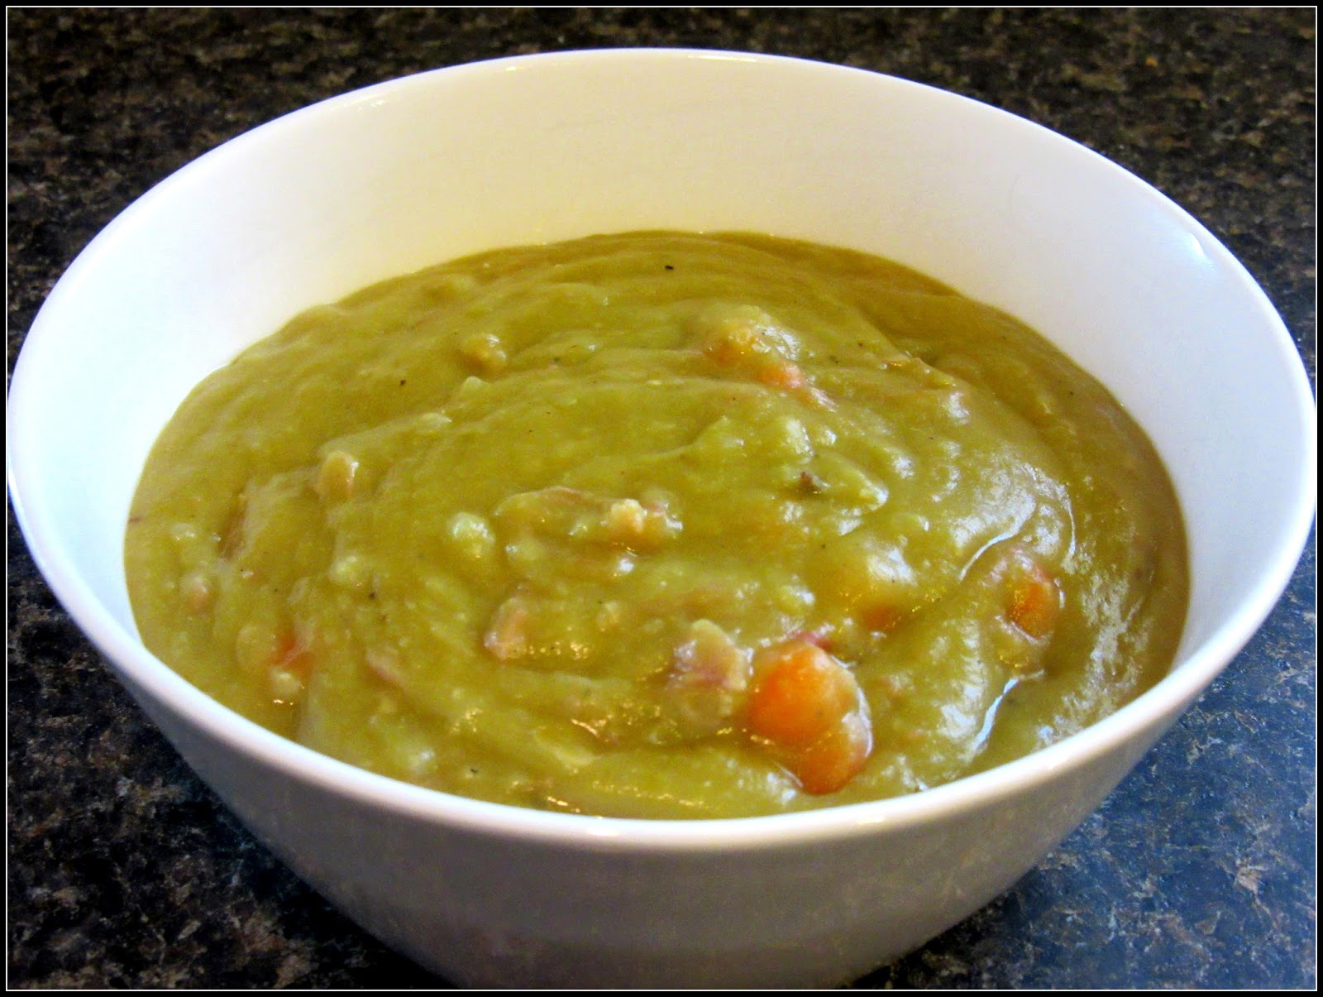

Slide 40
hate
bowls
loafers
table
relief
awful
friends
pots
Key
Vocabulary
Prediction

Slide 41

George and Martha
Story Number One: Split Pea Soup
by James Marshall

Slide 42
Martha was very fond of making split pea soup. Sometimes she made it all day long. Pots and pots of split pea soup.
If there was one thing George was not fond of, it was split pea soup.
As a matter of fact, George hated split pea soup more than anything else in the world. But it was so hard to tell Martha.
One day after George had eaten ten bowls of Martha’s soup, he said to himself,
“I just can’t stand another bowl, not even another spoonful.”
So while Martha was out in the kitchen, George carefully poured the rest of his soup into his loafers under the table. “Now she will think I have eaten it.”

Slide 43
cause
EVENT
effect
prediction
George
puts the
pea soup
in his
shoe

Slide 44
But Martha was watching from the kitchen.
“How do you expect to walk home with your loafers full of split pea soup?” she asked George.
“Oh dear,” said George. “You saw me.”
“And why didn’t you tell me that you hate my split pea soup?”
“I didn’t want to hurt your feelings,” said George.
“That’s silly,” said Martha. “Friends should always tell each other the truth. As a matter of fact, I don’t like split pea soup very much myself. I only like to make it. From now on, you’ll never have to eat that awful soup again.”
“What a relief!” George sighed.

Slide 45
cause
effect
George
puts the
pea soup
in his
shoe

Slide 46
Martha was very fond of making split pea soup. Sometimes she made it all day long. Pots and pots of split pea soup.
If there was one thing George was not fond of, it was split pea soup.
As a matter of fact, George hated split pea soup more than anything else in the world. But it was so hard to tell Martha.
One day after George had eaten ten bowls of Martha’s soup, he said to himself,
“I just can’t stand another bowl, not even another spoonful.”
So while Martha was out in the kitchen, George carefully poured the rest of his soup into his loafers under the table. “Now she will think I have eaten it.”

Slide 47
Defining in Context - Brainstorming
Circle Map
Describing in Context
Brainstorming
key events
Frame: examples and/or
why
George and Martha
Split Pea Soup.
Pictures and/or words
hurting
feelings
ate pea soup
George &
Martha
Split Pea
Soup
Analogies
Relationships
made split
pea soup
poured soup
in shoe
Describing in Context
Brainstorming
evidences, examples and/or why
Notes:
All do a circle map.

Slide 48
But Martha was watching from the kitchen.
“How do you expect to walk home with your loafers full of split pea soup?” she asked George.
“Oh dear,” said George. “You saw me.”
“And why didn’t you tell me that you hate my split pea soup?”
“I didn’t want to hurt your feelings,” said George.
“That’s silly,” said Martha. “Friends should always tell each other the truth. As a matter of fact, I don’t like split pea soup very much myself. I only like to make it. From now on, you’ll never have to eat that awful soup again.”
“What a relief!” George sighed.

Slide 49

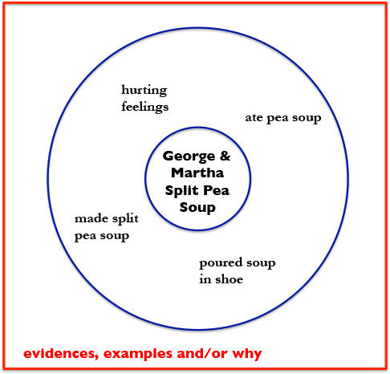
Write everything you remember
about the story——

Slide 50
Three key events of the story

Slide 51
Three key events of the story
George put pea soup in his shoe
George ate pea soup
Martha made pea soup

Slide 52
Sequencing
Martha made pea soup
George put pea soup in his shoe
George ate pea soup

Slide 53
Sequencing
Martha made pea soup
George put pea soup in his shoe
George ate pea soup

Slide 54
Martha made pea soup
George ate pea soup
George put pea soup in his shoe
George put pea soup in his shoe
Martha made pea soup
George ate pea soup

Slide 55
Sequencing
introduction
Martha made pea soup
George put pea soup in his shoe
George ate pea soup
Conclusion

Slide 56
Sequencing
introduction
Martha made pea soup
George put pea soup in his shoe
George ate pea soup
Conclusion

Slide 57
Introduction
Introduction
Martha made pea soup
George ate pea soup
George put pea soup in his shoe
Conclusion
George put pea soup in his shoe
Martha made pea soup
George ate pea soup
Conclusion

Slide 58
Multi-Flow Map: Cause and Effect
cause
effect
George
puts the
pea soup
in his
shoe

Slide 59
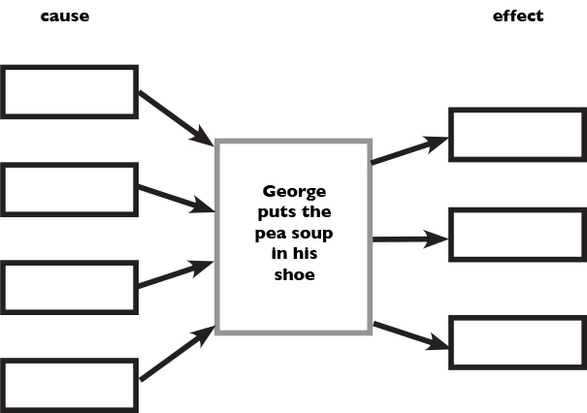
George put pea soup in his shoe
because __________________.
Causes
Effects
Conclusion with outcomes

Slide 60
Multi-Flow Map: Cause and Effect
cause
effect
George
puts the
pea soup
in his
shoe
evidences
evidences
Martha’s Feelings
George’s Feelings

Slide 61
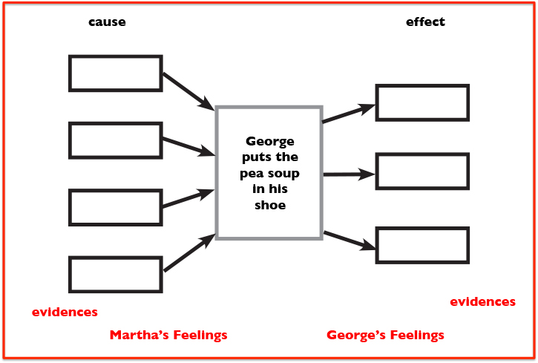
George put pea soup in his shoe
because __________________.
Martha’s feelings and actions
about friendship
George’s feelings and actions
about friendship
Outcomes for the pea soup
experience

Slide 63
ancestors
sacred objects
indigenous
America’s story
colonizers
knowledge
history
citizens
advanced technology
Key
Vocabulary
Prediction

Slide 64
Key
Vocabulary
Prediction
ancestors
sacred objects
indigenous
America’s story
colonizers
knowledge
history
citizens
advanced technology
Discuss the vocabulary whole group and/or small groups first with predictions, then whole group sharing.
Use the vocabulary in writing. Write several sentences to use all the vocabulary.
Inductive categorization (better with 12+ words/phrases) sorting the vocabulary into categories.
Draw an image representing your prediction of the vocabulary meaning.

Slide 65
Key
Vocabulary
Prediction
ancestors
sacred objects
indigenous
America’s story
colonizers
knowledge
history
citizens
advanced technology
Discuss the vocabulary whole group and/or small groups first with predictions, then whole group sharing.
Use the vocabulary in writing. Write several sentences to use all the vocabulary.
Inductive categorization (better with 12+ words/phrases) sorting the vocabulary into categories.
Draw an image representing your prediction of the vocabulary meaning.
Share on the Chat Feature, with Audio and/or in Breakout Rooms.

Slide 66
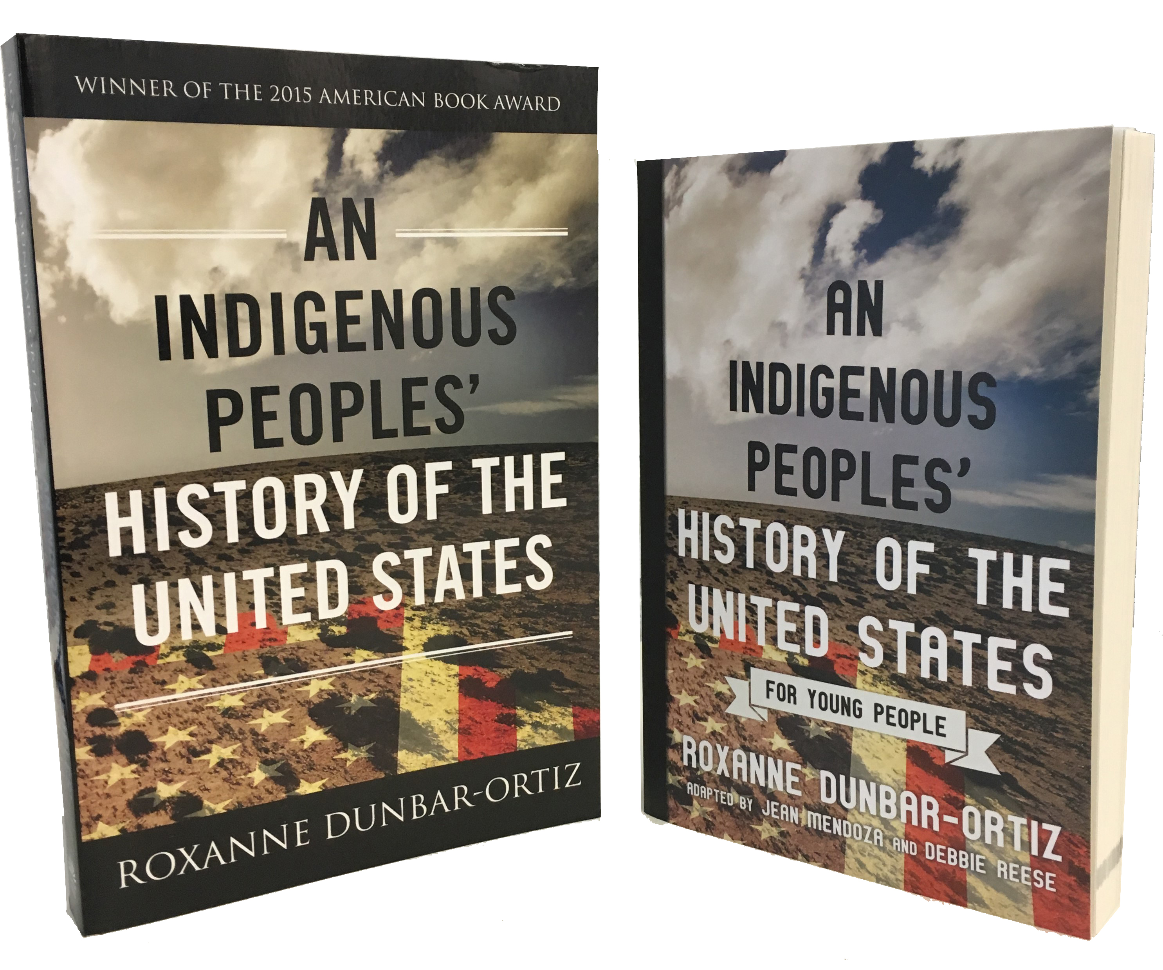
An Indigenous Peoples’
History of the United States
For Young People
excerpt – This Land, published 2019

Slide 67
This Land
Under the crust of that part of the earth called the United States of America are buried the bones, villages, fields, and sacred objects of the first people of that land—the people who are often called American Indians or Native Americans. Their descendants, also called Indigenous peoples, carry memories and stories of how the United States came to be the nation we know today. It is important to learn and know this history, but many people today lack that knowledge and understanding because of the way America's story has been taught.

Slide 68
Multi-Flow Map: Cause and Effect
causes
event
effects
The way
America’s
story has
been taught

Slide 69
Like most people, Americans want to think well of themselves, their ancestors, their history, and what they and their leaders do. As advanced technology makes the experiences of Indigenous peoples around the world more readily available, it is necessary that Americans learn to think more completely and more critically about their own history, because it can help them be better citizens of the world. Part of that critical thinking involves recognition that "America" is a name given to two land masses by European colonizers. indigenous peoples had, and have, words for the land in their own languages.

Slide 70
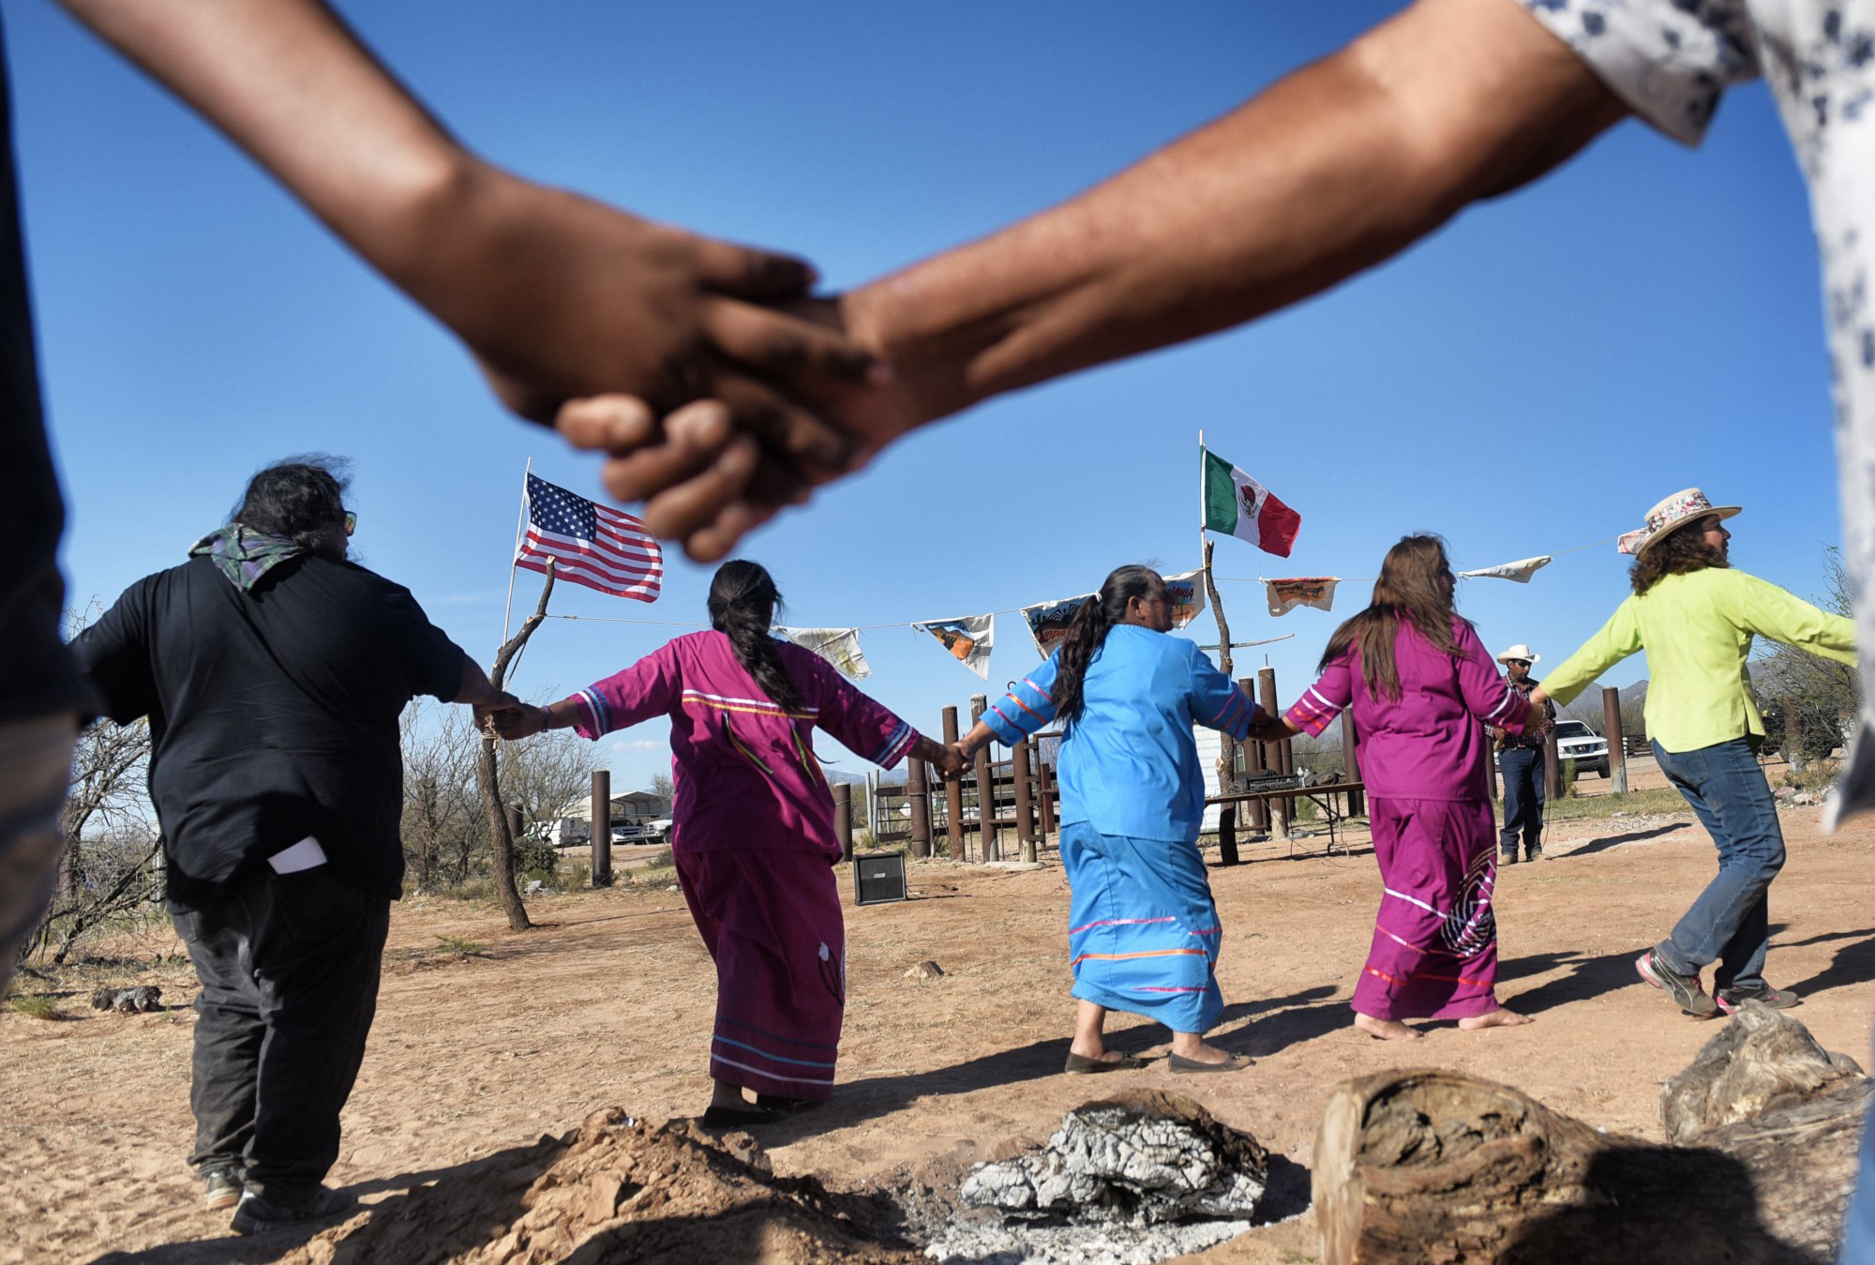

Slide 71
Indigenous People Are Tired of Being Pushed to the Sidelines
Tribal nations have had to fight for centuries against erasure
Ruth Hopkins, Zora, July 31, 2019
Dakota/Lakota Sioux writer
https://zora.medium.com
Indigenous people from the Tohono O’odham ethnic group dance and sing to protest against US President Donald Trump’s intention to build a new wall in the border between Mexico and United States.
Photo: Pedro Pardo/Getty Images

Slide 72
ancestors
sacred objects
indigenous
America’s story
colonizers
knowledge
history
citizens
advanced technology
Key
Vocabulary
Prediction

Slide 73
Thinking Maps Who Am I Guide
http://www.eggplant.org/pdf/WhoAmIStudentGuide-ThinkingMaps.pdf
NUA – OAS Critical Thinking Tools Guide
http://www.eggplant.org/pdf/Critical_Thinking_Guide_RSP_NUA_Osseo.pdf
Robert Seth Price
http://www.eggplant.org
PowerPoint of this meeting
http://www.eggplant.org/pp/Osseo_PLE_FOE_23Oct2020.pptx

Slide 74







Castaways film clip:
Inductive Categorization at a PD:
Inductive Categorization with Amplifying Student Voice :
Inductive Sequencing at a PD:
Boy Who Harnessed the Wind film clip:

Slide 75
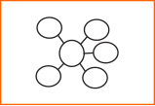
Strategy Review Chart
Name & Primitive | Cognitive Process/ Function | Remember | Best Use (Priming, Processing, Retaining for Mastery) | Source | Connection to HOPs, CLEAR
 | qualities | strengths | priming frame-processing | David Hyerle | Student strengths, cultural responsive

