Slide 1


Belief and Belonging
Virtually and In Person
Palmer Lake Elementary - Fair Oaks Elementary
pre K – 2
28 May 2020
Robert Seth Price
www.eggplant.org
National Urban Alliance
www.nuatc.org

Slide 2

Virtual Housekeeping
Technology
–Video View: your name and school.
–Mute your microphone if not talking.
–Breakout Rooms: Take pictures of the steps involved
before we break away.
–Chat Box.
Materials
–Composition book.
–Paper and pens/pencils.
Books
–Pedagogy of Confidence.
–Critical Thinking Guide.

Slide 3

Community

Slide 4

I know the earth—

Slide 5

Community Building

Slide 6
Always Sharing New Ideas
at school
in your community
favorite game
storytelling
something you enjoy with math
someone you wish to learn.

Slide 7

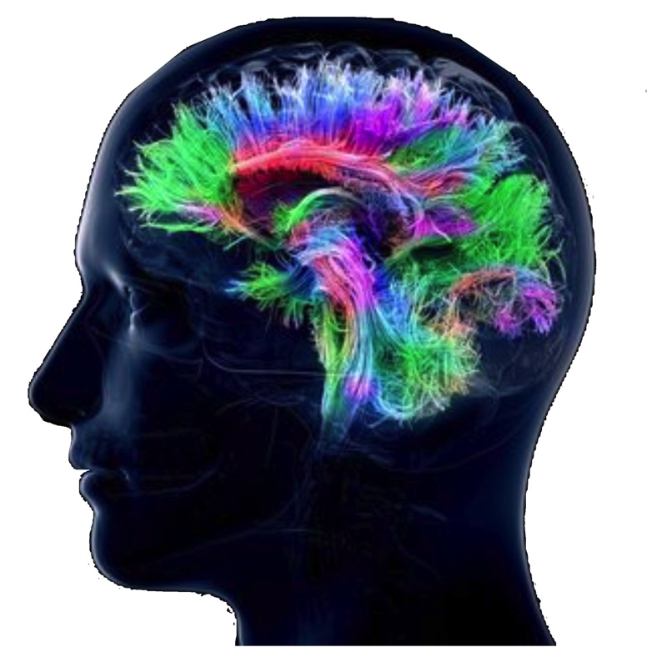
Share on Chat
Your ideas on greetings
with more examples of
community builders virtually.
7

Slide 8
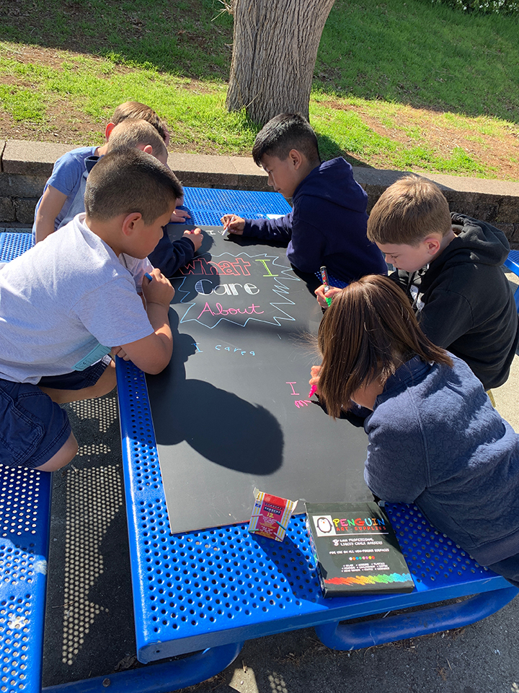


HOPs
High Operational Practices of the Pedagogy of Confidence support and enhance equity:
Identifying and activating student strengths
Eliciting high intellectual performance
Integrating prerequisites for academic learning
Situating learning in the lives of students
^{Building relationships}
^{Providing enrichment}
^{Amplifying student voice}
Belief
Notes:
Understanding from research and data, doing with practical models and strategies by practicing for expertise and mastery

Slide 9
3 Phases of Learning
Retaining for
Understanding
Priming
Processing
Getting
Ready
to Learn
Unpacking
Meaning
Holding on
to Learning
Notes:
2 maps in use — sequencing and categorical
even a cause and effect

Slide 10
Priming
Powerful Questions

Slide 11
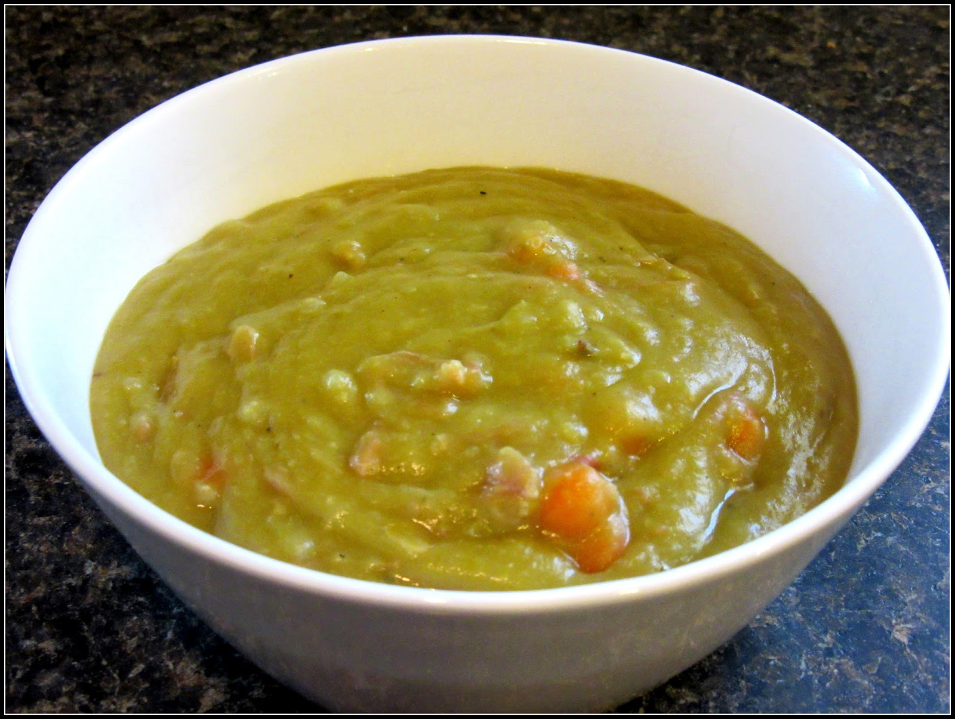

Slide 12
Circle Map
Describing in Context
Brainstorming
Pictures and/or words
an
event
cause
effect
Multi-Flow Map
Cause / Effect
Pictures and/or words

Slide 13

George and Martha
Story Number One: Split Pea Soup
by James Marshall

Slide 14
Martha was very fond of making split pea soup. Sometimes she made it all day long. Pots and pots of split pea soup.
If there was one thing George was not fond of, it was split pea soup.
As a matter of fact, George hated split pea soup more than anything else in the world. But it was so hard to tell Martha.
One day after George had eaten ten bowls of Martha’s soup, he said to himself,
“I just can’t stand another bowl, not even another spoonful.”
So while Martha was out in the kitchen, George carefully poured the rest of his soup into his loafers under the table. “Now she will think I have eaten it.”

Slide 15
cause
effect
prediction
George
puts the
pea soup
in his
shoe

Slide 16
But Martha was watching from the kitchen.
“How do you expect to walk home with your loafers full of split pea soup?” she asked George.
“Oh dear,” said George. “You saw me.”
“And why didn’t you tell me that you hate my split pea soup?”
“I didn’t want to hurt your feelings,” said George.
“That’s silly,” said Martha. “Friends should always tell each other the truth. As a matter of fact, I don’t like split pea soup very much myself. I only like to make it. From now on, you’ll never have to eat that awful soup again.”
“What a relief!” George sighed.

Slide 17
Read — Talk — Map — Write

Slide 18
Martha was very fond of making split pea soup. Sometimes she made it all day long. Pots and pots of split pea soup.
If there was one thing George was not fond of, it was split pea soup.
As a matter of fact, George hated split pea soup more than anything else in the world. But it was so hard to tell Martha.
One day after George had eaten ten bowls of Martha’s soup, he said to himself,
“I just can’t stand another bowl, not even another spoonful.”
So while Martha was out in the kitchen, George carefully poured the rest of his soup into his loafers under the table. “Now she will think I have eaten it.”

Slide 19
cause
effect
George
puts the
pea soup
in his
shoe

Slide 20
But Martha was watching from the kitchen.
“How do you expect to walk home with your loafers full of split pea soup?” she asked George.
“Oh dear,” said George. “You saw me.”
“And why didn’t you tell me that you hate my split pea soup?”
“I didn’t want to hurt your feelings,” said George.
“That’s silly,” said Martha. “Friends should always tell each other the truth. As a matter of fact, I don’t like split pea soup very much myself. I only like to make it. From now on, you’ll never have to eat that awful soup again.”
“What a relief!” George sighed.

Slide 21

Defining in Context - Brainstorming
Circle Map
Describing in Context
Brainstorming
George and Martha
Split Pea Soup.
Pictures and/or words
shoes
pea soup
George &
Martha
Split Pea
Soup
kitchen
Analogies
Relationships
bowl
Describing in Context
Brainstorming
Notes:
All do a circle map.

Slide 22
Martha likes to ______________.
George likes to ______________.
Martha likes to ______________.
George likes to ______________.
Martha likes to ______________.
George likes to ______________.

Slide 23

Martha likes the ________.
George likes the ________.
Martha likes the ________.
George likes the ________.
Martha likes the ________.
George likes the ________.
shoes
pea soup
George &
Martha
Split Pea
Soup
kitchen
bowl

Slide 24
Defining in Context – Brainstorming + Frame
Circle Map
Describing in Context
Brainstorming
George and Martha
Split Pea Soup.
Pictures and/or words
Frame: more about each
thing on the map.
lots of
eat
pots
shoes
pea soup
George &
Martha
Split Pea
Soup
kitchen
Analogies
Relationships
bowl
hot
round
Describing in Context
Brainstorming
Notes:
All do a circle map.

Slide 25
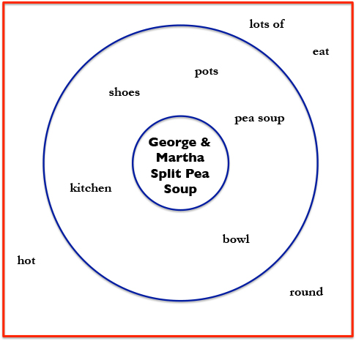
Martha likes the ______ ______.
George likes the ______ ______.
Martha likes the ______ ______.
George likes the ______ ______.
Martha likes the ______ ______.
George likes the ______ ______.

Slide 26
Multi-Flow Map: Cause and Effect
cause
effect
George
puts the
pea soup
in his
shoe

Slide 27
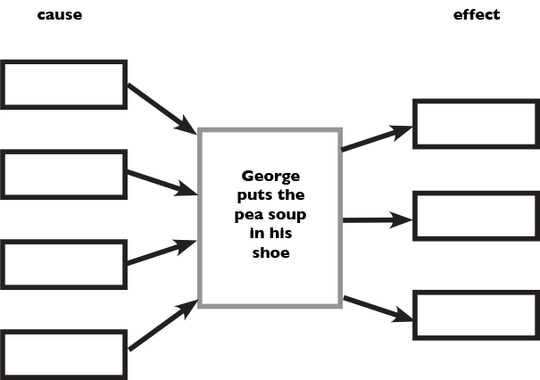
George put pea soup in his shoe
because __________________.
George put pea soup in his shoe
because __________________.
George put pea soup in his shoe
because __________________.
George put pea soup in his shoe
because __________________.
George put pea soup in his shoe
because __________________.

Slide 28
Multi-Flow Map: Cause and Effect
cause
effect
George
puts the
pea soup
in his
shoe
evidences
evidences
Martha’s Feelings
George’s Feelings

Slide 29
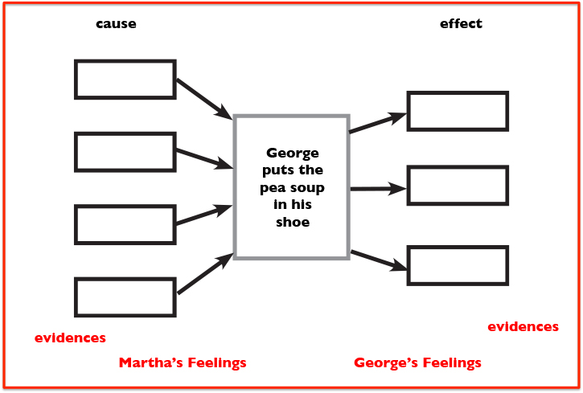
Martha is __________________.
George is ___________________.
Martha is __________________.
George is ___________________.
Martha is __________________.
George is ___________________.
Martha is __________________.
George is ___________________.

Slide 30
More ideas for cause/effect —
Notes:
Have them do

Slide 31
Bubble Map
Descriptive Words,
Adjectives
Pictures and/or words
Double Bubble Map
Compare and Contrast
Pictures and/or words

Slide 32
Bubble Map
Describing / Adjectives / Qualities
descriptive
word
descriptive
word
adjective
Martha
adjective
descriptive
word
adjective

Slide 33
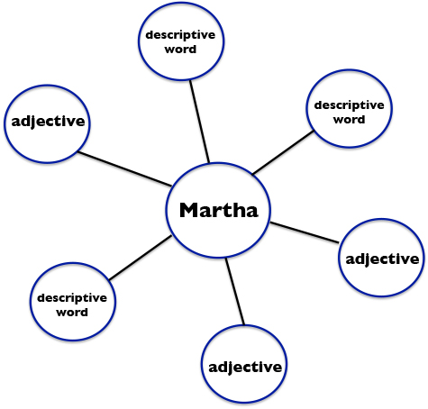
Martha is _________.
Martha is _________.
Martha is _________.
Martha is _________.
Martha is _________.
Martha is _________.
Martha is _________.

Slide 34
descriptive
word
descriptive
word
adjective
Martha
adjective
descriptive
word
adjective
Where, When, How or more about

Slide 35
Martha is ______ ________.
Martha is ______ ________.
Martha is ______ ________.
Martha is ______ ________.
Martha is ______ ________.
Martha is ______ ________.
Martha is ______ ________.
Martha is ______ ________.

Slide 36
Bubble Map
Describing / Adjectives / Qualities
descriptive
word
descriptive
word
adjective
George
adjective
descriptive
word
adjective

Slide 37

George is _________.
George is _________.
George is _________.
George is _________.
George is _________.
George is _________.
George is _________.

Slide 38
Bubble Map
Describing / Adjectives / Qualities
descriptive
word
descriptive
word
adjective
George
adjective
descriptive
word
adjective

Slide 39
George is ____ _____.
George is ____ _____.
George is ____ _____.
George is ____ _____.
George is ____ _____.
George is ____ _____.
George is ____ _____.

Slide 40
reflection

Slide 41
Now
Close the barbeque.
Close the sun.
Close the home-run games we won.
Close the picnic.
Close the pool.
Close the summer.
Open school.
Prince Redcloud

Slide 42
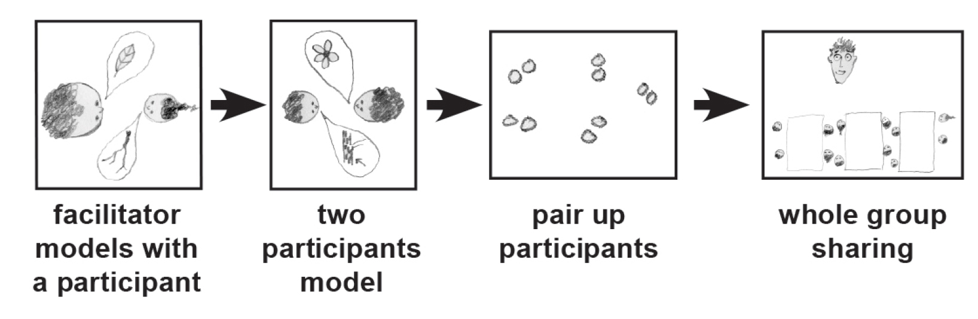
Things I like about summer…
Thinking Collaboratively
Notes:
METHODS

Slide 43
Now
Close the barbeque.
Close the sun.
Close the home-run
games we won.
Close the picnic.
Close the pool.
Close the summer.
Open school.
Prince Redcloud
corn
sprinkler
summer
things
I like
park
pool
baseball
trees

Slide 44
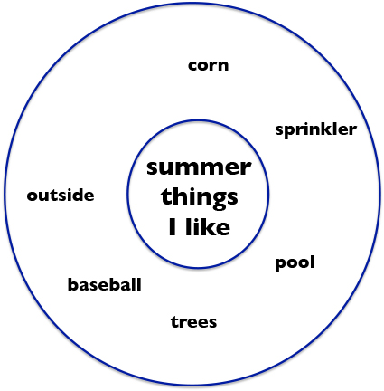
In the summer,
I like the ______________.
I like the ______________.
I like the ______________.
I like the ______________.
I like the ______________.
I like the ______________.
I like the summer.

Slide 45
yummy
Now
Close the barbeque.
Close the sun.
Close the home-run
games we won.
Close the picnic.
Close the pool.
Close the summer.
Open school.
Prince Redcloud
cool
corn
green
sprinkler
summer
things
I like
park
pool
baseball
trees
splashy
green

Slide 46
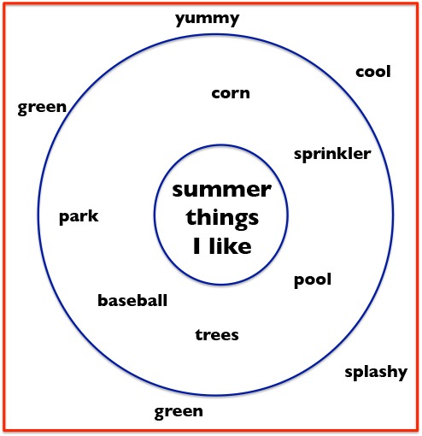
In the summer,
I like the _____ _________.
I like the _____ _________.
I like the _____ _________.
I like the _____ _________.
I like the _____ _________.
I like the _____ _________.
I like the summer.

Slide 47
Now
Close the barbeque.
Close the sun.
Close the home-run
games we won.
Close the picnic.
Close the pool.
Close the summer.
Open school.
Prince Redcloud
yellow
fun
noisy
^
^
^
corn
pool
park

Slide 48
In the summer,
I enjoy the _____ _________.
I enjoy the _____ _________.
I enjoy the _____ _________.
I enjoy the _____ _________.
I enjoy the _____ _________.
I enjoy the _____ _________.
I enjoy the summer.
^
^

Slide 49
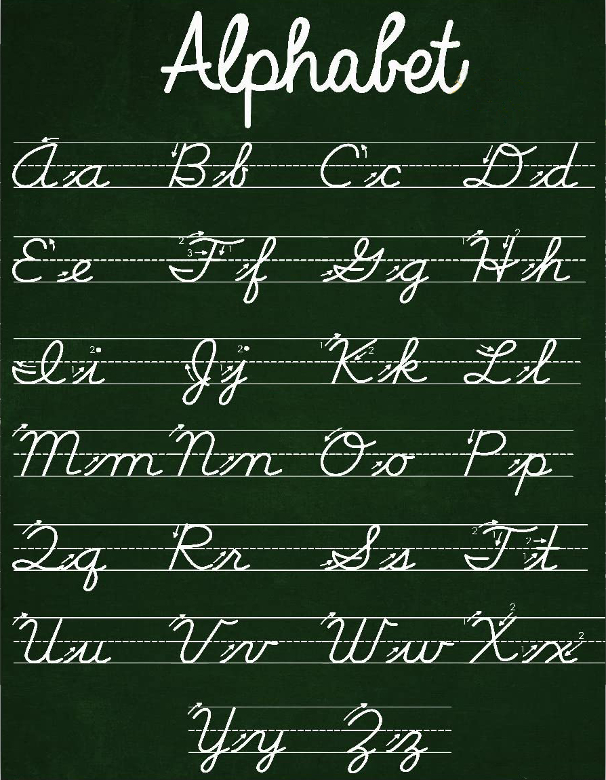
A Language
for
Written
Communication
Notes:
Back to thinking with Thinking Maps — organizing thinking. Circle map for brainstorming — then organize…

Slide 50
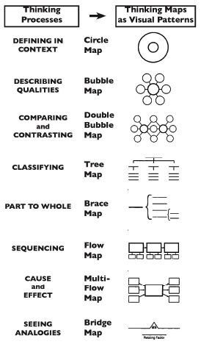
Thinking Maps
Notes:
Back to thinking with Thinking Maps — organizing thinking. Circle map for brainstorming — then organize…

Slide 51
Thinking Maps
A Visual Language
for
Communicating
and
Organizing
Thinking
Notes:
Back to thinking with Thinking Maps — organizing thinking. Circle map for brainstorming — then organize…

Slide 52
Thinking Maps as a Language
Describing in Context
Brainstorming
Comparing
& Contrasting
Categorizing
Describing
Sequencing
Cause and Effect
Whole / Part
Analogies
Relationships
To Organize Thinking – Student Centered
Notes:
Back to thinking with Thinking Maps — organizing thinking. Circle map for brainstorming — then organize…

Slide 53
Thinking Maps as a Language
Visually: a language for organizing thinking, seeing thinking in your brain, and patterns.
To Organize Thinking – Student Centered
Notes:
Back to thinking with Thinking Maps — organizing thinking. Circle map for brainstorming — then organize…

Slide 54
Share on Chat
A shout out to a colleague.
54

Slide 55
Strategy Review Chart
Name & Primitive | Cognitive Process/Function | Remember | Best Use (Priming, Processing, Retaining for Mastery) | Source | Connection to HOPs
Breakout Room for 8 minutes.
Spokesperson for each group is prepared.

Slide 56

Taking Away
methods
concepts
other reflections

Slide 57

Thank You
robert@eggplant.org
www.eggplant.org
www.nuatc.org

