Slide 1
Amplifying Student Voice
Bard High School
February 4, 2021
National Urban Alliance
www.nuatc.org
Robert Seth Price
www.eggplant.org • robert@eggplant.org

Slide 2
Agenda
Introductions – Favorite Class
Exercise
Powerful Questions
Your Voices Amplified
Capturing Your Voices in a Tool
Call to Action

Slide 3
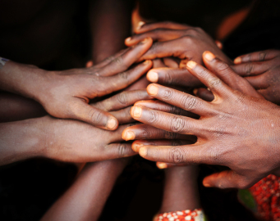
Community Building Exercises

Slide 4
?
Powerful Questions
Object • Concept • Image • Video • Song • Lyrics

Slide 5
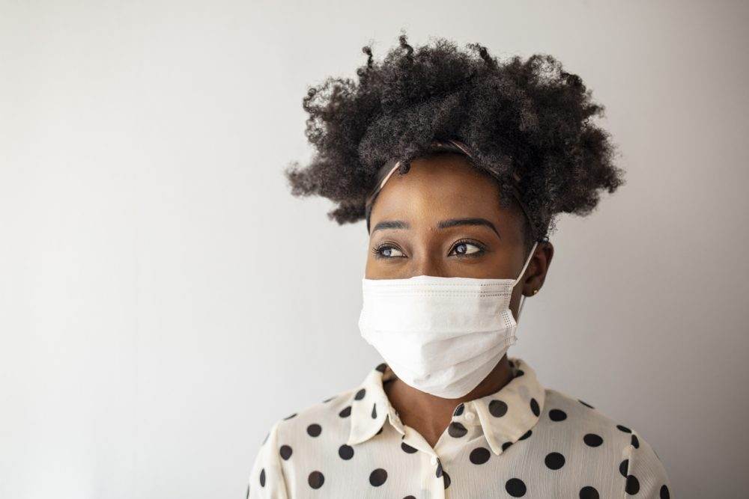
Voice

Slide 6
?
Powerful Questions
Object • Concept • Image • Video • Song • Lyrics

Slide 7
St. Louis, Missouri, October 1918 Pandemic. Underwood Archives/Getty Images

Slide 8
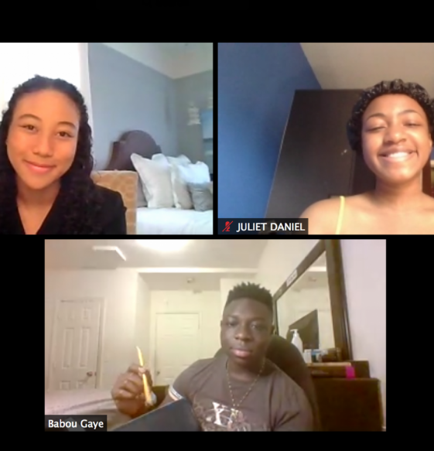
Students enjoy learning from home during COVID.

Slide 9
All students have equal access to the Internet and electronic devices during COVID.

Slide 10
All schools are equally equipped for COVID.

Slide 11
My Turn

Slide 12
My Powerful Questions
Where am I going with this?
Is any of this familiar? What is your source?
Does any of this apply to you?
Why do students need to examine these three specific issues in 2021?
Did I leave out an important Powerful Question? If so, what is it?
How does this all relate to Bard High School?

Slide 13
My Powerful Questions
Where am I going with this?
Is any of this familiar? What is your source?
Does any of this apply to you?
Why do students need to examine these three specific issues in 2021?
Did I leave out an important Powerful Question? If so, what is it?
How does this all relate to Bard High School?

Slide 14
My Powerful Questions
Where am I going with this?
Is any of this familiar? What is your source?
Does any of this apply to you?
Why do students need to examine these three specific issues in 2021?
Did I leave out an important Powerful Question? If so, what is it?
How does this all relate to Bard High School?

Slide 15
My Powerful Questions
Where am I going with this?
Is any of this familiar? What is your source?
Does any of this apply to you?
Why do students need to examine these three specific issues in 2021?
Did I leave out an important Powerful Question? If so, what is it?
How does this all relate to Bard High School?

Slide 16
My Powerful Questions
Where am I going with this?
Is any of this familiar? What is your source?
Does any of this apply to you?
Why do students need to examine these three specific issues in 2021?
Did I leave out an important Powerful Question? If so, what is it?
How does this all relate to Bard High School?

Slide 17
My Powerful Questions
Where am I going with this?
Is any of this familiar? What is your source?
Does any of this apply to you?
Why do students need to examine these three specific issues in 2021?
Did I leave out an important Powerful Question? If so, what is it?
How does this all relate to Bard High School?

Slide 18
Let’s Capture Your Voices Now

Slide 19
How can a survey capture your voices?

Slide 20
What is a survey for?

Slide 21
What is a survey for?
Have you completed
a survey anywhere?

Slide 22
Who is included in developing a survey?

Slide 23
Who is included in developing a survey?
What about the student?

Slide 24
Have you completed
a survey in your school?

Slide 25
Let’s Make a Survey
Mask wearing and students
Access to technology
Equally equipped schools
Demographics

Slide 26
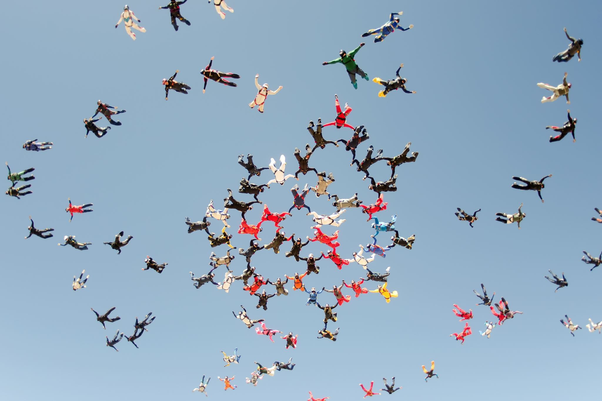
Demographics

Slide 27
Demographics
Age, race / ethnicity, gender, religion
Zip code
Number of people in household age 5-18
Number of electronic devices (excluding cellphones)
Speed of internet
Private space to be online
Job status (part time or ?)
Computer labs in your local libraries

Slide 28
Let’s Make a Survey
Mask wearing and students
Access to technology
Equally equipped schools
Demographics

Slide 29
Let’s Make a Survey
Mask wearing and students
Access to technology
Equally equipped schools
Demographics

Slide 30
Let’s Make a Survey
Mask wearing and students
Access to technology
Equally equipped schools
Demographics

Slide 31
Let’s Make a Survey
Mask wearing and students
Access to technology
Equally equipped schools
Demographics

Slide 32
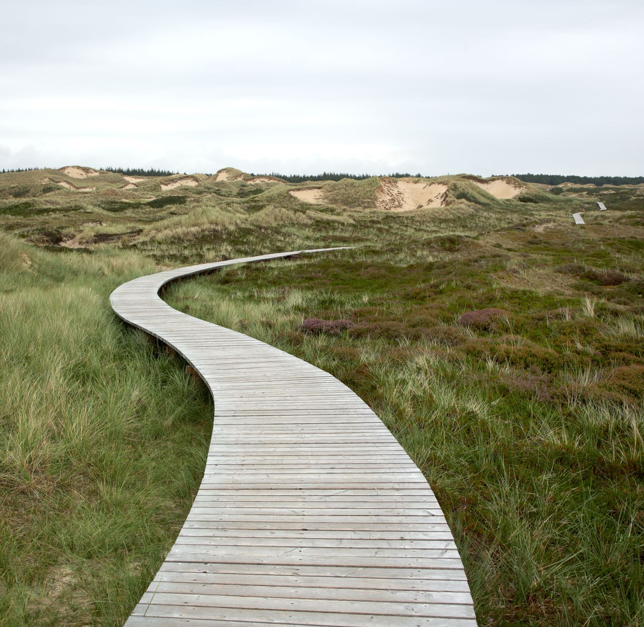
Next Steps
What do we do now?

Slide 33
How do we get the survey out to students at your school?
When and how often?

Slide 34
Amplifying Student Voices
Your takeaways? Why did we do this exercise today?

Slide 35
Congratulations
You just Amplified your Student Voice developing a school survey.

