Slide 1


Belief and Belonging
Virtually and In Person
Palmer Lake Elementary - Fair Oaks Elementary
3-5
15 May 2020
Robert Seth Price
www.eggplant.org
National Urban Alliance
www.nuatc.org

Slide 2

Virtual Housekeeping
Technology
–Video View: your name and school.
–Mute your microphone if not talking.
–Breakout Rooms: Take pictures of the steps involved
before we break away.
–Chat Box.
Materials
–Composition book.
–Paper and pens/pencils.
Books
–Pedagogy of Confidence.
–Critical Thinking Guide.

Slide 3

Priming
The
Community

Slide 4
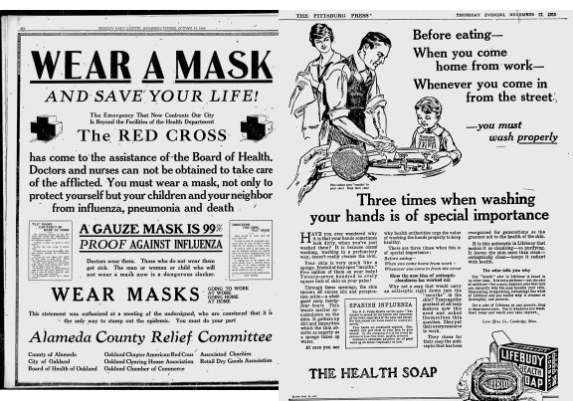
Headline in
September 2020?

Slide 5
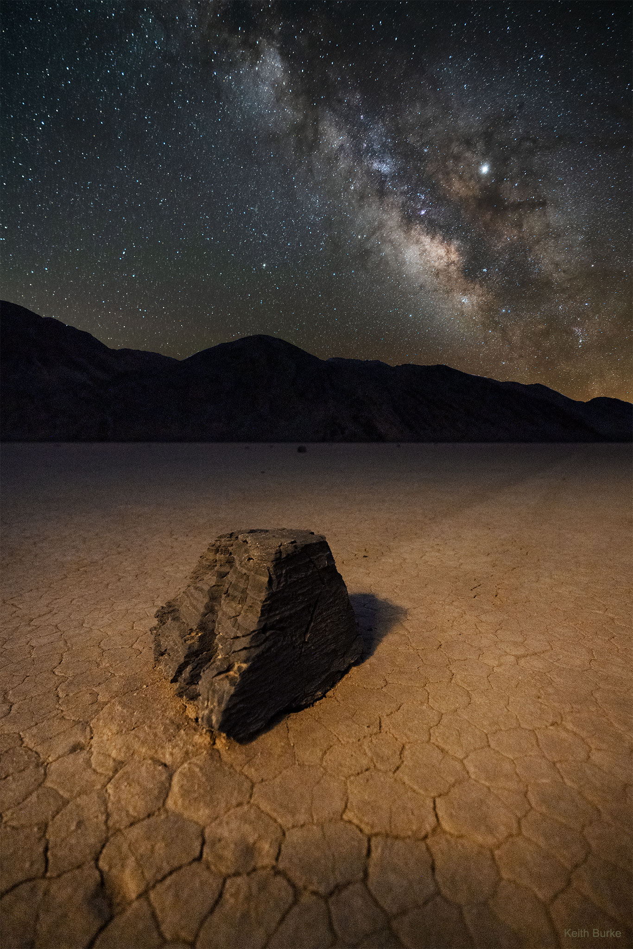
Visitor from Space
Recommendations on 2020 Pandemic

Slide 6
Powerful Questions

Slide 7
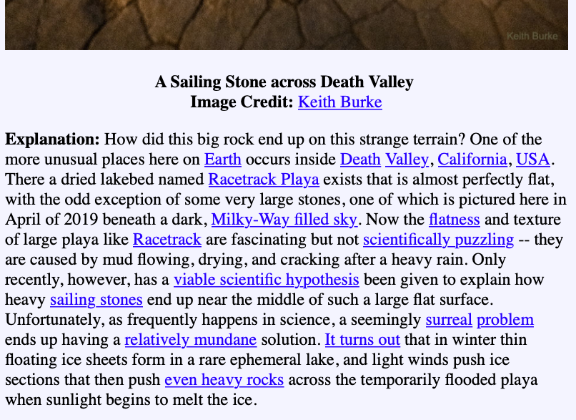
https://apod.nasa.gov/

Slide 8

Community Building
Headline
Visitor from Space
School at Home
Hello Campaign
?? More Ideas !!

Slide 9

Other Ideas
mathematics
music
science
storytelling
someone you miss
something you miss

Slide 10

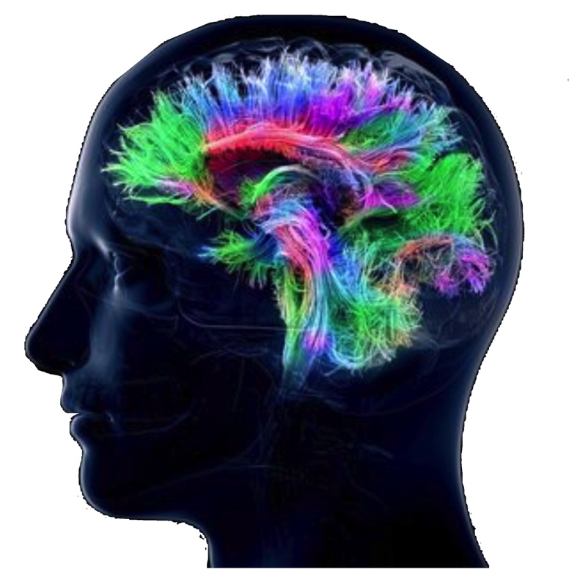
Share on Chat
Your ideas on greetings
with more examples of
community builders virtually.
10

Slide 11
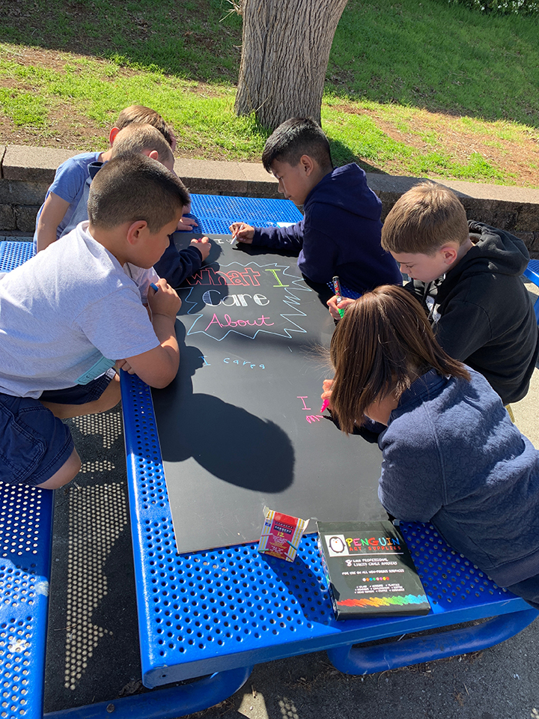


HOPs
High Operational Practices of the Pedagogy of Confidence support and enhance equity:
Identifying and activating student strengths
Eliciting high intellectual performance
Integrating prerequisites for academic learning
Situating learning in the lives of students
^{Building relationships}
^{Providing enrichment}
^{Amplifying student voice}
Belief
Notes:
Understanding from research and data, doing with practical models and strategies by practicing for expertise and mastery

Slide 12
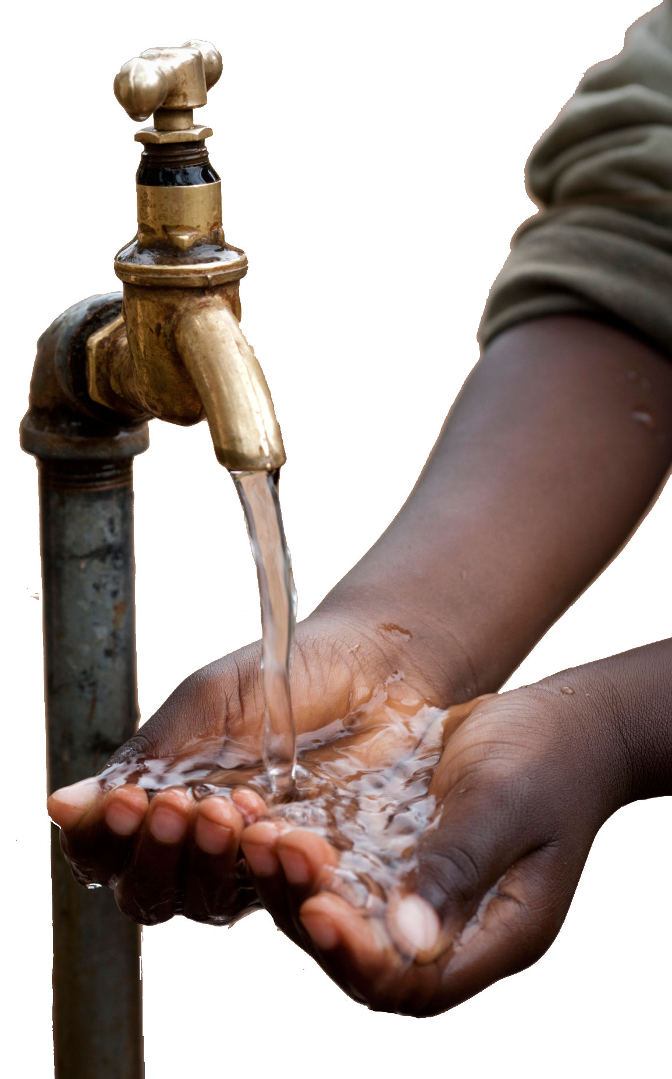
Practical
High
Operational
Practices
virtually,
in the classroom,
and for life.
Notes:
Children and youth are brilliant. The subject was deforestation — in a rural area in Ethiopia — inquiry, visual tools on the ground using slate and limestone.

Slide 13
Culturally Responsive Teaching Practices
The
4
Cs

Slide 14
Culturally Responsive Teaching Practices
The
4
Cs
Communication
Collaboration
Creativity
Critical Thinking

Slide 15
3 Phases of Learning
Retaining for
Understanding
Priming
Processing
Getting
Ready
to Learn
Unpacking
Meaning
Holding on
to Learning
Notes:
2 maps in use — sequencing and categorical
even a cause and effect

Slide 16
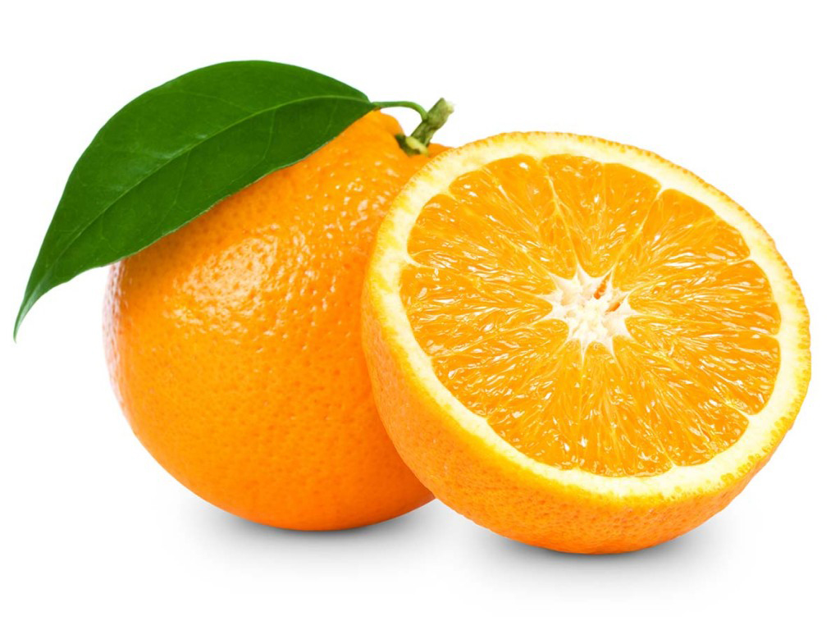

Defining in Context - Brainstorming
Circle Map
Describing in Context
Brainstorming
Things you do during
the day at home.
Pictures and/or words
wake up
school
work
eat lunch
Your Day
Analogies
Relationships
brush teeth
eat breakfast
Describing in Context
Brainstorming
Notes:
All do a circle map.

Slide 17

The important thing about my day is ________.
It is true _______________.
I look forward to ________________________.
I appreciate ___________
because ________________.
And ____________________.
But the important thing about my day is ________.
wake up
school
work
eat lunch
Your Day
brush teeth
eat breakfast

Slide 18
Circle Map
Describing in Context
Brainstorming
Things you do during
the day at home.
Add the frame of reference.
where
in my bed
wake up
eat lunch
Your Day
I__in my__
Analogies
Relationships
brush teeth
eat breakfast
in the bathroom
Describing in Context
Brainstorming
in the kitchen
Notes:
All do a circle map.

Slide 19
in my bed
wake up
school
work
eat lunch
Your Day
brush teeth
eat breakfast
in the kitchen
in the bathroom

Slide 20
Sequencing
school
work
eat breakfast
wake up
eat lunch
brush teeth
Notes:
Have them do

Slide 21
Sequencing
wake up
brush teeth
school
work
eat lunch
eat breakfast

Slide 22
Sequencing
wake up
brush teeth
school
work
eat lunch
eat breakfast

Slide 23
Sequencing
wake up
brush teeth
school
work
eat lunch
eat breakfast
alarm
wash
face

Slide 24
Sequencing
wake up
brush teeth
school
work
eat lunch
eat breakfast
alarm
wash
face

Slide 25
Sequencing
wake up
brush teeth
school
work
eat lunch
eat breakfast
More ideas for sequencing —
Notes:
Share in the chat room

Slide 26
Covers
Glass covers windows
to keep the cold away
Clouds cover the sky
to make a rainy day
Nighttime covers
all the things that creep
Blankets cover me
when I’m asleep
Nikki Giovanni

Slide 27
books
glass jar
Things in
your house
curtains
oven
shoes

Slide 28
shelf
pickles
books
glass jar
Things in
your house
curtains
windows
oven
shoes
socks
cookies
cooking

Slide 29
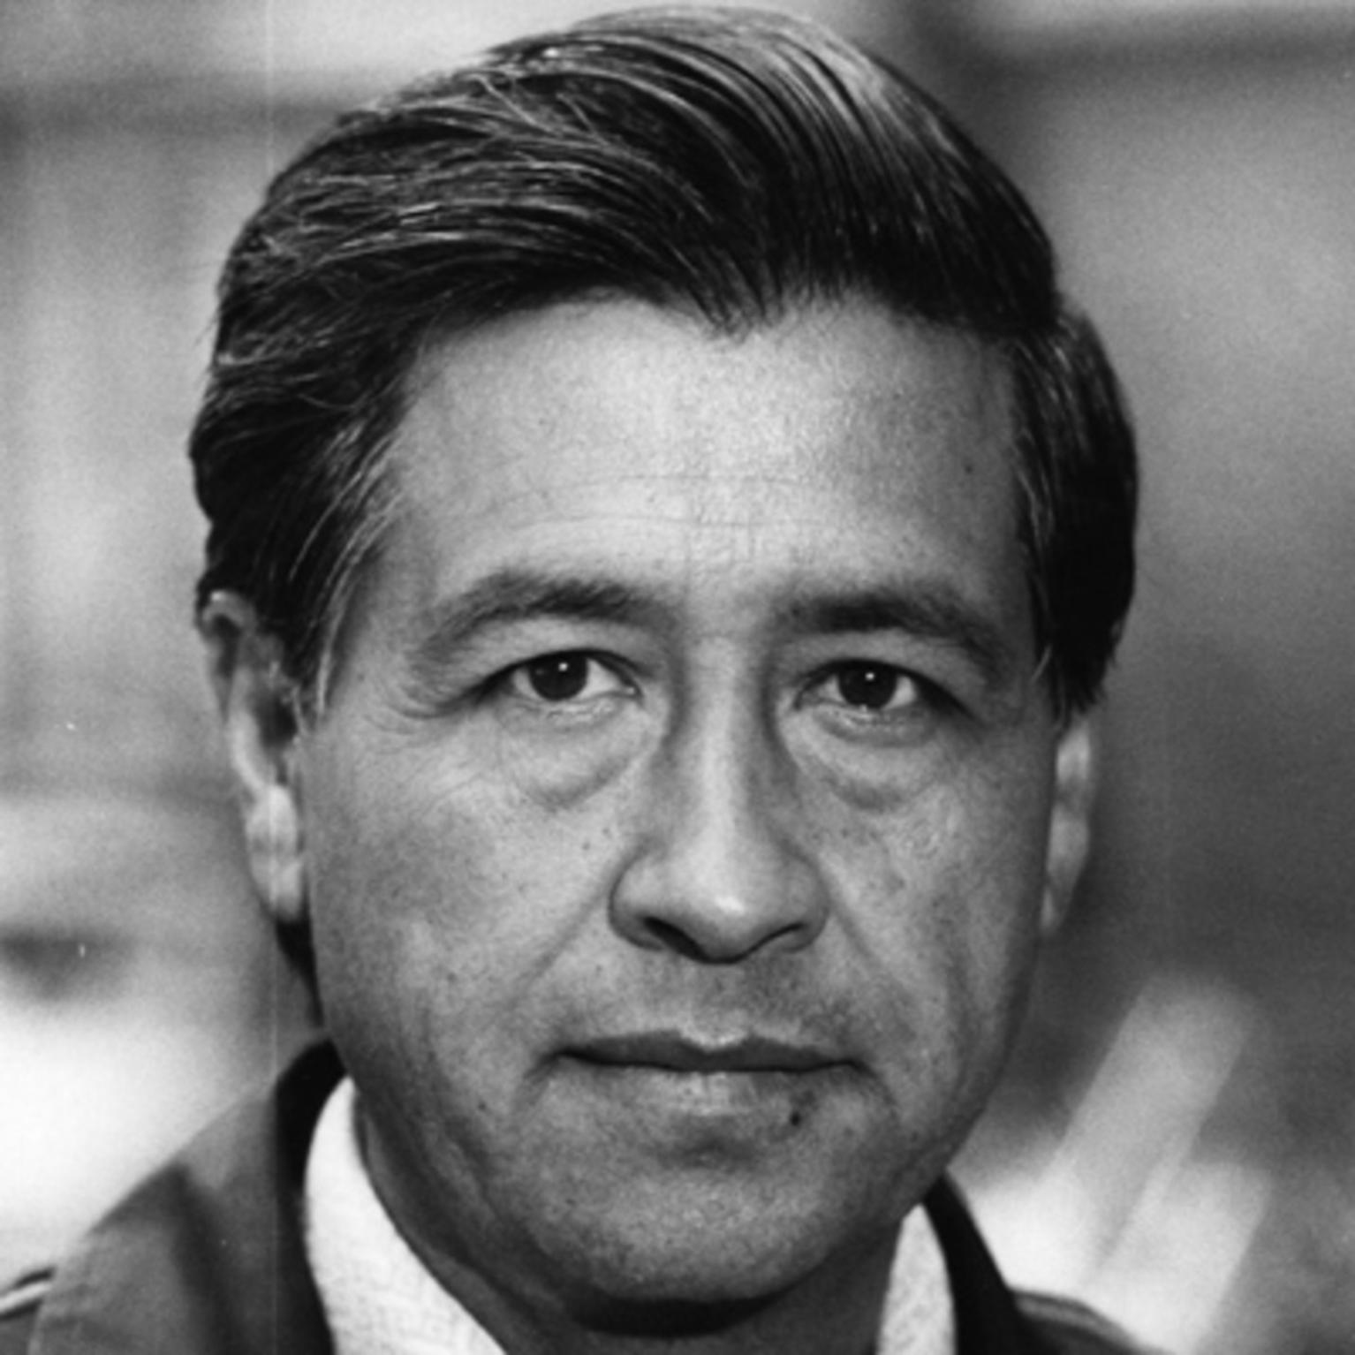
“Students must have initiative; they should not be mere imitators. They must learn to think and act for themselves, and be free.”
—Caesar Chavez
Notes:
Chat response to the quote: what does it have you thinking about

Slide 30
glass jar
curtains
shoes
oven
^
^
^
^
^
^
pickles
windows
socks
cookies
cooking
to keep them fresh
to keep the
sun away
to keep my
feet safe
bringing good smells to my nose
Covers
Glass covers windows
to keep the cold away
Clouds cover the sky
to make a rainy day
Nighttime covers
all the things that creep
Blankets cover me
when I’m asleep
Nikki Giovanni

Slide 31
Covers
Glass covers windows
to keep the cold away
Clouds cover the sky
to make a rainy day
Nighttime covers
all the things that creep
Blankets cover me
when I’m asleep
Nikki Giovanni
_____covers _______
to ________________
_____covers _______
to ________________
_____covers _______
___________________
_____covers _______
___________________

Slide 32
Phonics
tion
tion
tion
tion
^
^
^
solution
potion
motion
rotation
RF: tion common phonic element
red
sale
in
see
^
^
^
read
sail
inn
sea
RF: homophones
large
tiny
fabulous
^
^
^
huge
miniscule
superb
RF: synonyms

Slide 33
Phonics
The flower is
a bright red.
The skateboard
is on sale.
red
sale
in
see
^
^
^
^
^
^
read
sail
inn
sea
I read the
mystery book.
Have you ever
sailed on the
ocean?
RF: homophones

Slide 34
Math
.1
^
.2
^
.3
^
10%
20%
30%
^
^
^
^
^
^

Slide 35
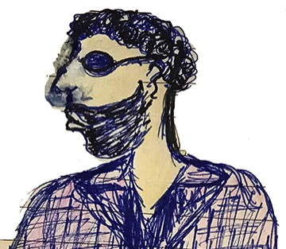
Qualities
adjective
adjective
adjective
adjective
adjective
adjective
Notes:
Paper — all do.

Slide 36
Student
adjective
adjective
adjective
Student
adjective
adjective
adjective
Notes:
Paper — all do.

Slide 37
Student
examples
adjective
examples
adjective
adjective
examples
Student
examples
adjective
adjective
examples
adjective
examples
Notes:
Paper — all do.

Slide 38
Family Member
adjective
adjective
adjective
adjective
adjective
adjective
Notes:
Paper — all do.

Slide 39
Family Member
examples
adjective
examples
adjective
adjective
examples
family
member
examples
adjective
adjective
examples
adjective
examples
Notes:
Paper — all do.

Slide 40
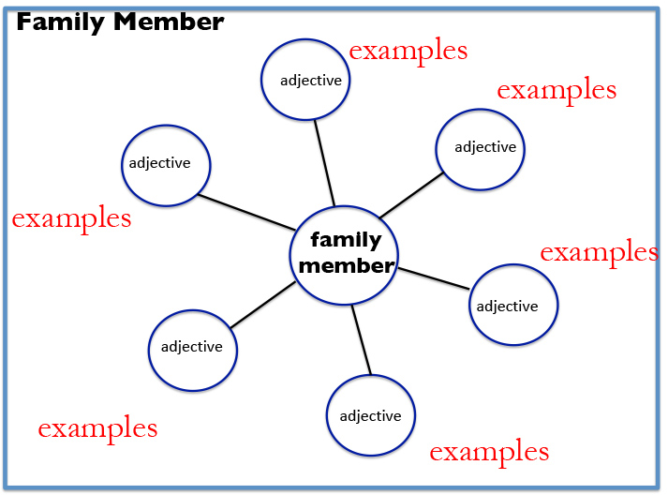
I know I know something about ___________________.
First, ________________________________________.
Second, ______________________________________.
In addition, ___________________________________.
Finally, _______________________________________.
Now you know something that I know about _____________.

Slide 41
Share on Chat
Who Else?
41

Slide 42
Strategy Review Chart
Name & Primitive | Cognitive Process/Function | Remember | Best Use (Priming, Processing, Retaining for Mastery) | Source | Connection to HOPs
Breakout Room for 8 minutes.
Spokesperson for each group is prepared.

Slide 43

Shout Out
to a colleague
to a person

Slide 44

Thank You
robert@eggplant.org
www.eggplant.org
www.nuatc.org

