Slide 1


Belief and Belonging
Virtually and In Person
Palmer Lake Elementary - Fair Oaks Elementary
pre K – 2
21 May 2020
Robert Seth Price
www.eggplant.org
National Urban Alliance
www.nuatc.org

Slide 2

Virtual Housekeeping
Technology
–Video View: your name and school.
–Mute your microphone if not talking.
–Breakout Rooms: Take pictures of the steps involved
before we break away.
–Chat Box.
Materials
–Composition book.
–Paper and pens/pencils.
Books
–Pedagogy of Confidence.
–Critical Thinking Guide.

Slide 3

Community

Slide 4

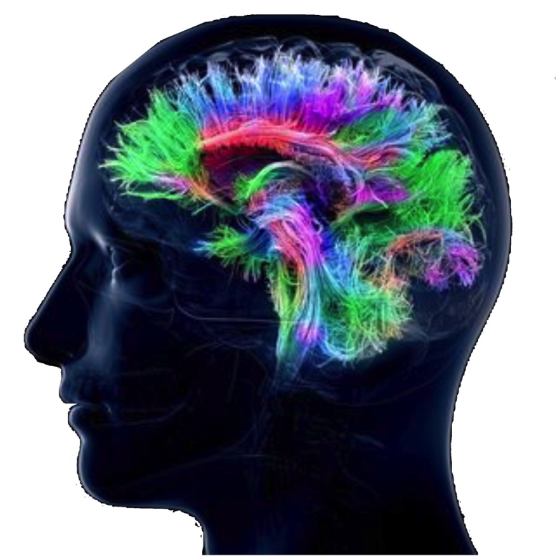
Questions about school next year.
? ? ? ? ?

Slide 5
Who Inspires You!
Who are they?
Why do they?
How that impacts you!

Slide 6

Community Building
Who Inspires You. Why?
Food You Like. Why?
Chores You Do. When?
Movie You Like. Why?
?? More Ideas !!

Slide 7

Other Ideas
outdoors
indoors
favorite song
storytelling
something you miss about school
someone you miss from school

Slide 8
Share on Chat
Your ideas on greetings
with more examples of
community builders virtually.
8

Slide 9
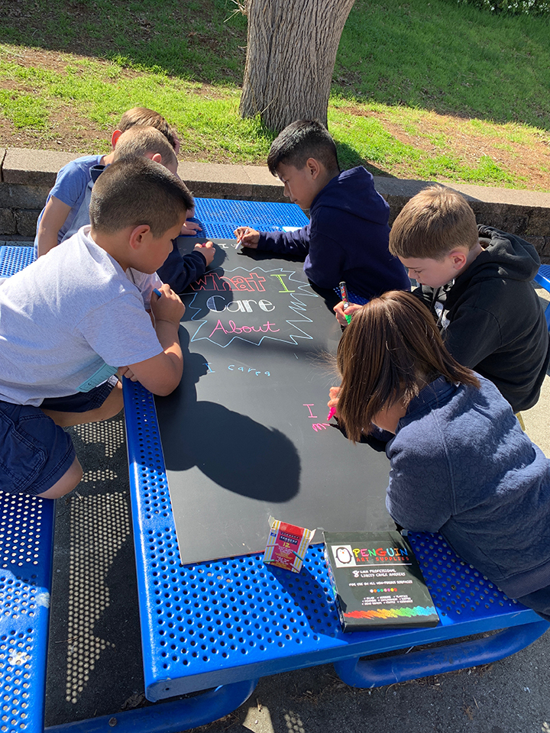


HOPs
High Operational Practices of the Pedagogy of Confidence support and enhance equity:
Identifying and activating student strengths
Eliciting high intellectual performance
Integrating prerequisites for academic learning
Situating learning in the lives of students
^{Building relationships}
^{Providing enrichment}
^{Amplifying student voice}
Belief
Notes:
Understanding from research and data, doing with practical models and strategies by practicing for expertise and mastery

Slide 10
3 Phases of Learning
Retaining for
Understanding
Priming
Processing
Getting
Ready
to Learn
Unpacking
Meaning
Holding on
to Learning
Notes:
2 maps in use — sequencing and categorical
even a cause and effect

Slide 11
Circle Map
Describing in Context
Brainstorming
Pictures and/or words
Tree Map
Categorization
Pictures and/or words

Slide 12
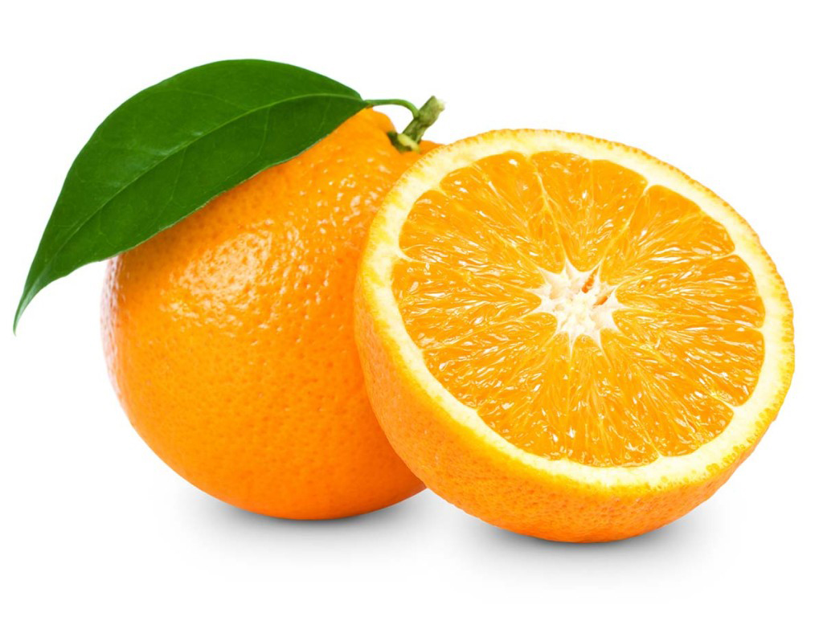

Defining in Context - Brainstorming
Circle Map
Describing in Context
Brainstorming
Food in your home.
Pictures and/or words
apples
beans
juice
food in
your home
Analogies
Relationships
bread
Describing in Context
Brainstorming
Notes:
All do a circle map.

Slide 13
One food in my house is __________ .
Another food is __________ .
Another food is __________ .
Another food is __________ .
Another food is __________ .
Another food is __________ .
Another food is __________ .

Slide 14
One food in my house is __________ .
A second food is __________ .
A third food is __________ .
A fourth food is __________ .
A fifth food is __________ .
A sixth food is __________ .
A seventh food is __________ .

Slide 15

One food in my house is __________ .
Another food is __________ .
Another food is __________ .
Another food is __________ .
Another food is __________ .
Another food is __________ .
Another food is __________ .
Another food is __________ .
apple
beans
juice
food in
your home
bread

Slide 16
Every day I enjoy__________ .
Every day I like __________ .
Every day I eat __________ .
Every day I eat __________ .
Every day I ___ __________ .
Every day I ___ __________ .

Slide 17
Categorizing
bread
sticks
kale
apple
juice
spinach
Frosted
Flakes
bread
Notes:
Have them do

Slide 18
Categorizing
apple
kale
bread
sticks
juice
spinach
bread
Frosted
Flakes
Notes:
Have them do

Slide 19
Categorizing
fruit
vegetable
grain
apple
kale
bread
sticks
juice
spinach
bread
Frosted
Flakes
Notes:
Have them do

Slide 20
Categorizing
food
fruit
vegetable
grain
apple
kale
bread
sticks
juice
spinach
bread
Frosted
Flakes
Notes:
Have them do

Slide 21
Categorizing
food
fruit
vegetable
grain
apple
kale
bread
sticks
juice
spinach
bread
Frosted
Flakes
More ideas for categorizing —
Notes:
Have them do

Slide 22
in my bed
Circle Map
Describing in Context
Brainstorming
Food in your home.
Pictures and/or words.
Frame: where
where
on a table
in a glass
apples
beans
juice
food in
your home
Analogies
Relationships
bread
on a plate
Describing in Context
Brainstorming
in the kitchen
Notes:
All do a circle map.

Slide 23
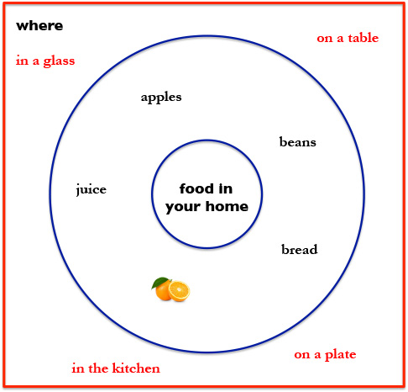
I eat _______ on my ________.
I eat _______ in my ________.
I eat _______ in my ________.
I eat _______ on my ________.
I eat _______ in my ________.
I eat _______ in my ________.
I eat _______ in my ________.

Slide 24

Circle Map
Describing in Context
Brainstorming
Pictures and/or words
Brace Map
Whole Part relationship
Pictures and/or words

Slide 25
Tree Map
Categorization
Pictures and/or words
Brace Map
Whole Part relationship
Pictures and/or words

Slide 26
Circle Map
Describing in Context
Brainstorming
Pictures and/or words
Brace Map
Whole Part relationship
Pictures and/or words

Slide 27
stem
leaf
parts of
a plant
root
petal
flower

Slide 28
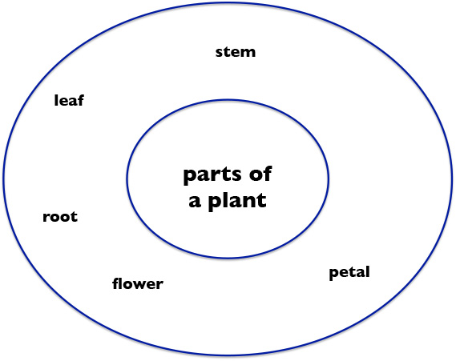
A plant has a _________.
A plant has a _________.
A plant has a _________.
A plant has a _________.
A plant has a _________.
A plant has a _________.
A plant has a _________.

Slide 29
shape
green
leaf
stem
parts of
a plant
root
in the
ground
petal
flower
part of
the flower
is colorful

Slide 30
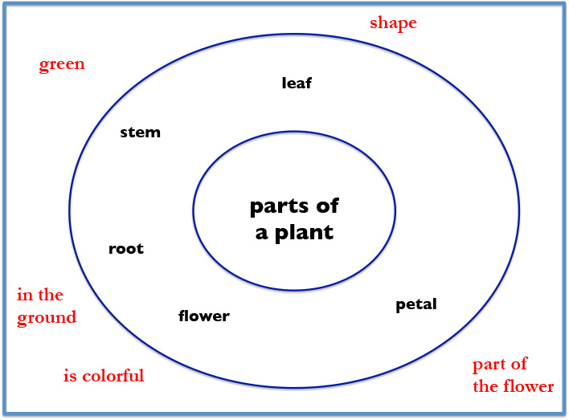
A _______ is ________.
A _______ is ________.
A _______ is ________.
A _______ is ________.
A _______ is ________.
A _______ is ________.

Slide 32
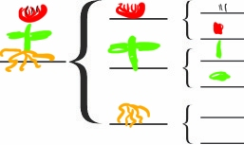
plant
roots

Slide 33
Other objects we can use a
Brace Map
for whole / part
Create an example to share with everyone.

Slide 34
By Myself
When I’m by myself
And I close my eyes
I’m a twin
I’m a dimple in a chin
I’m a room full of toys
I’m a squeaky noise
I’m a gospel song
I’m a gong
I’m a leaf turning red
I’m a loaf of brown bread
I’m a whatever I want to be
An anything I care to be
And when I open my eyes
What I care to be
Is me.
Eloise Greenfield

Slide 35
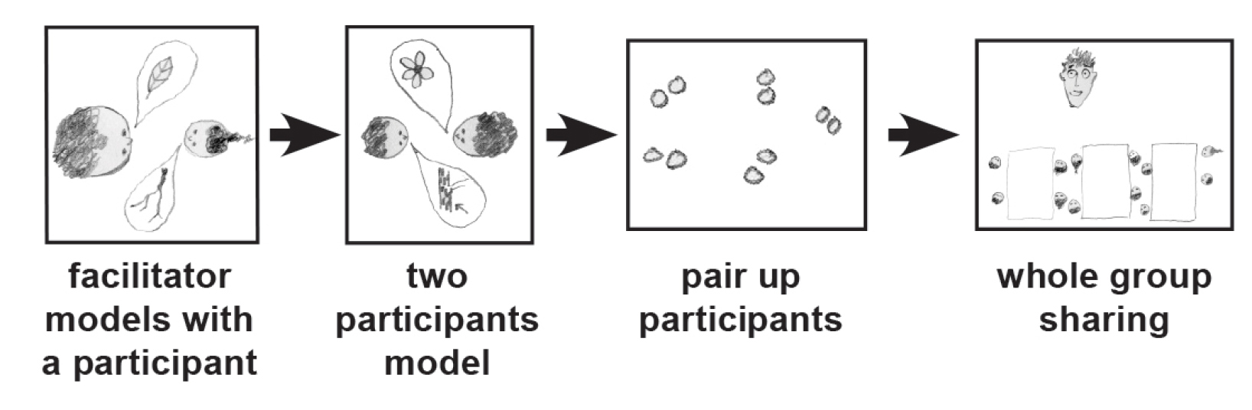
Things I like…
Thinking Collaboratively
Notes:
METHODS

Slide 36
By Myself
When I’m by myself
And I close my eyes
I’m a twin
I’m a dimple in a chin
I’m a room full of toys
I’m a squeaky noise
I’m a gospel song
I’m a gong
I’m a leaf turning red
I’m a loaf of brown bread
I’m a whatever I want to be
An anything I care to be
And when I open my eyes
What I care to be
Is me.
Eloise Greenfield
nose
things
I like
playhouse
pizza
hip hop song

Slide 37
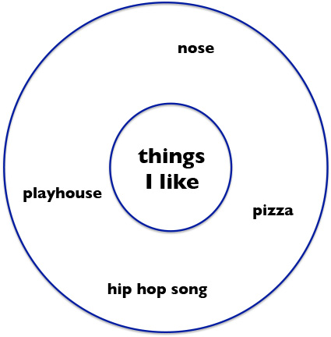
When I’m by myself,
And I close my eyes,
I’m a ______________
I’m a ______________
I’m a ______________
I’m a ______________
I’m a ______________
I’m a ______________
What I care to be
Is me.

Slide 38
By Myself
When I’m by myself
And I close my eyes
I’m a twin
I’m a dimple in a chin
I’m a room full of toys
I’m a squeaky noise
I’m a gospel song
I’m a gong
I’m a leaf turning red
I’m a loaf of brown bread
I’m a whatever I want to be
An anything I care to be
And when I open my eyes
What I care to be
Is me.
Eloise Greenfield
When I’m by myself,
And I close my eyes,
I’m a ______________
I’m a ______________
I’m a ______________
I’m a ______________
I’m a ______________
I’m a ______________
What I care to be
Is me.

Slide 39
By Myself
When I’m by myself
And I close my eyes
I’m a twin
I’m a dimple in a chin
I’m a room full of toys
I’m a squeaky noise
I’m a gospel song
I’m a gong
I’m a leaf turning red
I’m a loaf of brown bread
I’m a whatever I want to be
An anything I care to be
And when I open my eyes
What I care to be
Is me.
Eloise Greenfield
hip hop
story
round
^
^
^
song
television
pizza

Slide 40
When I’m by myself,
And I close my eyes,
I’m a ______ ________
I’m a ______ ________
I’m a ______ ________
I’m a ______ ________
I’m a ______ ________
I’m a ______________
What I care to be
Is me.
^
^

Slide 41

A Language
for
Written
Communication
Notes:
Back to thinking with Thinking Maps — organizing thinking. Circle map for brainstorming — then organize…

Slide 42
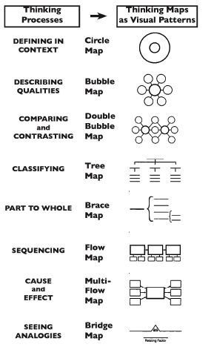
Thinking Maps
Notes:
Back to thinking with Thinking Maps — organizing thinking. Circle map for brainstorming — then organize…

Slide 43
Thinking Maps
A Visual Language
for
Communicating
and
Organizing
Thinking
Notes:
Back to thinking with Thinking Maps — organizing thinking. Circle map for brainstorming — then organize…

Slide 44
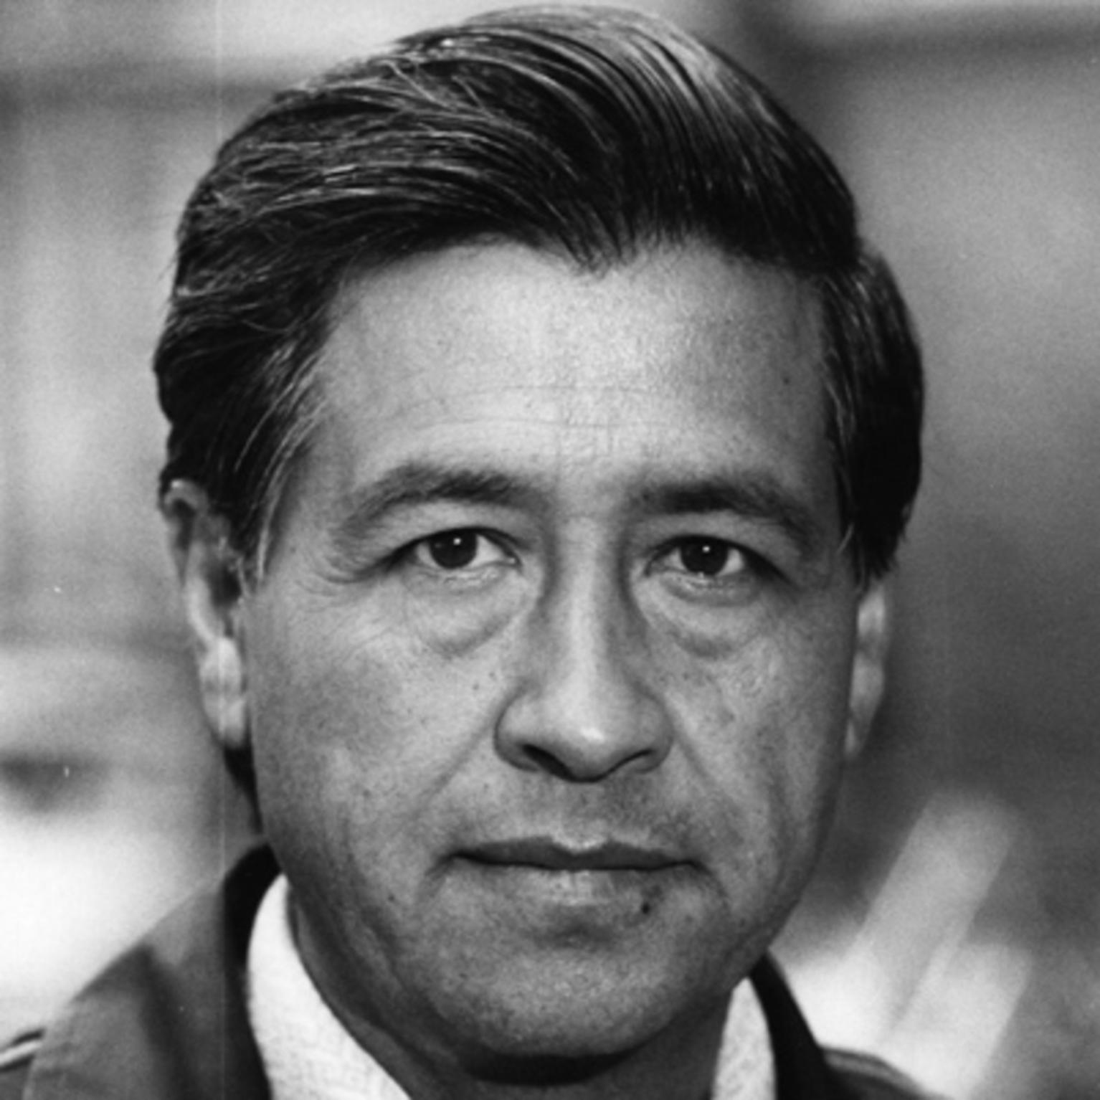
“Students must have initiative; they should not be mere imitators. They must learn to think and act for themselves, and be free.”
—Caesar Chavez
Notes:
Chat response to the quote: what does it have you thinking about

Slide 45
“Students must have initiative; they should not be mere imitators. They must learn to think and act for themselves, and be free.”
—Caesar Chavez
Notes:
Chat response to the quote: what does it have you thinking about

Slide 46
Thinking Maps as a Language
Describing in Context
Brainstorming
Comparing
& Contrasting
Categorizing
Describing
Sequencing
Cause and Effect
Whole / Part
Analogies
Relationships
To Organize Thinking – Student Centered
Notes:
Back to thinking with Thinking Maps — organizing thinking. Circle map for brainstorming — then organize…

Slide 47
Thinking Maps as a Language
Visually: a language for organizing thinking, seeing thinking in your brain, and patterns.
To Organize Thinking – Student Centered
Notes:
Back to thinking with Thinking Maps — organizing thinking. Circle map for brainstorming — then organize…

Slide 48
Share on Chat
A shout out to a colleague.
48

Slide 49
Strategy Review Chart
Name & Primitive | Cognitive Process/Function | Remember | Best Use (Priming, Processing, Retaining for Mastery) | Source | Connection to HOPs
Breakout Room for 8 minutes.
Spokesperson for each group is prepared.

Slide 50

Shout Out
to a colleague
to a person

Slide 51

Thank You
robert@eggplant.org
www.eggplant.org
www.nuatc.org

