Slide 1


Belief and Belonging
Virtually and In Person
Palmer Lake Elementary - Fair Oaks Elementary
pre K – 2
14 May 2020
Robert Seth Price
www.eggplant.org
National Urban Alliance
www.nuatc.org

Slide 2

Virtual Housekeeping
Technology
–Video View: your name and school.
–Mute your microphone if not talking.
–Breakout Rooms: Take pictures of the steps involved
before we break away.
–Chat Box.
Materials
–Composition book.
–Paper and pens/pencils.
Books
–Pedagogy of Confidence.
–Critical Thinking Guide.

Slide 3

Priming
The
Community

Slide 4
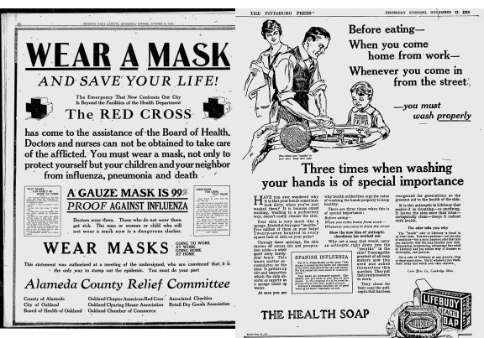
Headline in
September 2020?

Slide 5

Visitor from Space
Recommendations on 2020 Pandemic

Slide 6
School at Home
carpet
photos
School
at home
raisins
soap

Slide 7

Community Building
Headline
Visitor from Space
School at Home
Hello Campaign
?? More Ideas !!

Slide 8

Other Ideas
mathematics
music
science
storytelling
someone you miss
something you miss

Slide 9


Share on Chat
Your ideas on greetings
with more examples of
community builders virtually.
9

Slide 10
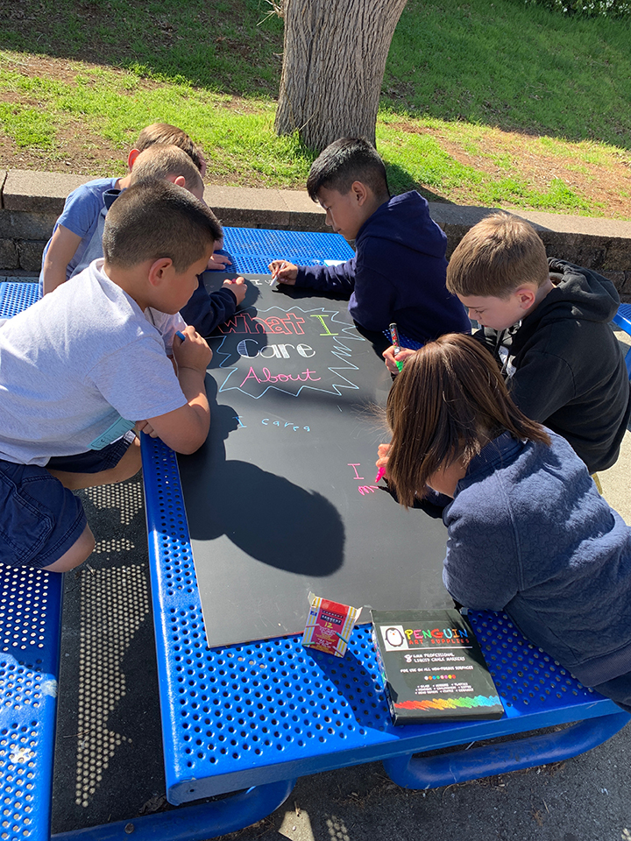


HOPs
High Operational Practices of the Pedagogy of Confidence support and enhance equity:
Identifying and activating student strengths
Eliciting high intellectual performance
Integrating prerequisites for academic learning
Situating learning in the lives of students
^{Building relationships}
^{Providing enrichment}
^{Amplifying student voice}
Belief
Notes:
Understanding from research and data, doing with practical models and strategies by practicing for expertise and mastery

Slide 11
3 Phases of Learning
Retaining for
Understanding
Priming
Processing
Getting
Ready
to Learn
Unpacking
Meaning
Holding on
to Learning
Notes:
2 maps in use — sequencing and categorical
even a cause and effect

Slide 12


Defining in Context - Brainstorming
Circle Map
Describing in Context
Brainstorming
Things you do during
the day at home.
Pictures and/or words
wake up
school
work
eat lunch
Your Day
Analogies
Relationships
brush teeth
eat breakfast
Describing in Context
Brainstorming
Notes:
All do a circle map.

Slide 13
Every day I __________ .
Every day I __________ .
Every day I __________ .
Every day I __________ .
Every day I __________ .
Every day I __________ .
Every day I __________ .

Slide 14

Every day I __________ .
Every day I __________ .
Every day I __________ .
Every day I __________ .
Every day I __________ .
Every day I __________ .
Every day I __________ .
wake up
school
work
eat lunch
Your Day
brush teeth
eat breakfast

Slide 15
Every day first I __________ .
Every day second I __________ .
Every day third I __________ .
Every day fourth I __________ .
Every day fifth I __________ .
Every day sixth I __________ .
Every day seventh I __________ .

Slide 16
Sequencing
school
work
eat breakfast
wake up
eat lunch
brush teeth
Notes:
Have them do

Slide 17
Sequencing
wake up
brush teeth
school
work
eat lunch
eat breakfast

Slide 18
Sequencing
wake up
brush teeth
school
work
eat lunch
eat breakfast
More ideas for sequencing —
Notes:
Share in the chat room

Slide 19
Circle Map
Describing in Context
Brainstorming
Things you do during
the day at home.
Pictures and/or words
where
in my bed
wake up
eat lunch
Your Day
I__in my__
Analogies
Relationships
brush teeth
eat breakfast
in the bathroom
Describing in Context
Brainstorming
in the kitchen
Notes:
All do a circle map.

Slide 20
I __________ in my ________.
I __________ in my ________.
I __________ in my ________.
I __________ in my ________.
I __________ in my ________.
I __________ in my ________.
I __________ in my ________.

Slide 21
I __________ in my ________.
I __________ in my ________.
I __________ in my ________.
I __________ in my ________.
I __________ in my ________.
I __________ in my ________.
I __________ in my ________.
in my bed
wake up
school
work
eat lunch
Your Day
brush teeth
eat breakfast
in the kitchen
in the bathroom

Slide 22
Covers
Glass covers windows
to keep the cold away
Clouds cover the sky
to make a rainy day
Nighttime covers
all the things that creep
Blankets cover me
when I’m asleep
Nikki Giovanni

Slide 23
books
glass jar
Things in
your house
curtains
oven
shoes

Slide 24
shelf
pickles
books
glass jar
Things in
your house
curtains
windows
oven
shoes
socks
cookies
cooking

Slide 25
Covers
Glass covers windows
to keep the cold away
Clouds cover the sky
to make a rainy day
Nighttime covers
all the things that creep
Blankets cover me
when I’m asleep
Nikki Giovanni
glass jar
curtains
shoes
oven
^
^
^
^
^
^
pickles
windows
socks
cookies
cooking

Slide 26
Covers
Glass covers windows
to keep the cold away
Clouds cover the sky
to make a rainy day
Nighttime covers
all the things that creep
Blankets cover me
when I’m asleep
Nikki Giovanni
_____covers _______
to keep ___________
_____covers _______
to make ___________
_____covers _______
to help ___________

Slide 27
Phonics
p
p
p
p
^
^
^
park
peach
pot
plop
ai
ai
ai
ai
^
^
^
tail
braid
paid
paint
^
^
^

Slide 28
Math
4
4
4
4
^
^
^
0 + 4
1 + 3
2 + 2
3 + 1
1
2
3
4
^
^
^
1
11
111
1111
^
^
^

Slide 29
Relationships
Relating factor____________________
Share + add to chat box:
a/A as b/B as c/C [rf: lower case to upper]

Slide 30
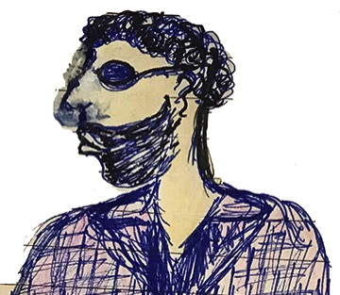
Qualities
adjective
adjective
adjective
adjective
adjective
adjective
Notes:
Paper — all do.

Slide 31
Student
adjective
adjective
adjective
Student
adjective
adjective
adjective
Notes:
Paper — all do.

Slide 32
Student
examples
adjective
examples
adjective
adjective
examples
Student
examples
adjective
adjective
examples
adjective
examples
Notes:
Paper — all do.

Slide 33
Family Member
adjective
adjective
adjective
adjective
adjective
adjective
Notes:
Paper — all do.

Slide 34
Family Member
examples
adjective
examples
adjective
adjective
examples
family
member
examples
adjective
adjective
examples
adjective
examples
Notes:
Paper — all do.

Slide 36
Share on Chat
Who Else?
36

Slide 37
Share on Chat
A shout out to a colleague.
37

Slide 38
Strategy Review Chart
Name & Primitive | Cognitive Process/Function | Remember | Best Use (Priming, Processing, Retaining for Mastery) | Source | Connection to HOPs
Breakout Room for 8 minutes.
Spokesperson for each group is prepared.

Slide 39

Shout Out
to a colleague
to a person

Slide 40

Thank You
robert@eggplant.org
www.eggplant.org
www.nuatc.org

