Slide 1


Belief and Belonging
Virtually and In Person
Palmer Lake Elementary - Fair Oaks Elementary
3-5
22 May 2020
Robert Seth Price
www.eggplant.org
National Urban Alliance
www.nuatc.org

Slide 2

Virtual Housekeeping
Technology
–Video View: your name and school.
–Mute your microphone if not talking.
–Breakout Rooms: Take pictures of the steps involved
before we break away.
–Chat Box.
Materials
–Composition book.
–Paper and pens/pencils.
Books
–Pedagogy of Confidence.
–Critical Thinking Guide.

Slide 3

Community

Slide 4


Questions about school next year.
? ? ? ? ?

Slide 5
Who Inspires You!
Who are they?
Why do they?
How that impacts you!

Slide 6

Community Building
Who Inspires You. Why?
Food You Like. Why?
Chores You Do. When?
Movie You Like. Why?
?? More Ideas !!

Slide 7

Other Ideas
outdoors
indoors
favorite song
storytelling
something you miss about school
someone you miss from school

Slide 8
Share on Chat
Your ideas on greetings
with more examples of
community builders virtually.
8

Slide 9


HOPs
High Operational Practices of the Pedagogy of Confidence support and enhance equity:
Identifying and activating student strengths
Eliciting high intellectual performance
Integrating prerequisites for academic learning
Situating learning in the lives of students
^{Building relationships}
^{Providing enrichment}
^{Amplifying student voice}
Belief
Notes:
Understanding from research and data, doing with practical models and strategies by practicing for expertise and mastery

Slide 10
3 Phases of Learning
Retaining for
Understanding
Priming
Processing
Getting
Ready
to Learn
Unpacking
Meaning
Holding on
to Learning
Notes:
2 maps in use — sequencing and categorical
even a cause and effect

Slide 11
Circle Map
Describing in Context
Brainstorming
Pictures and/or words
Tree Map
Categorization
Pictures and/or words

Slide 12

Defining in Context - Brainstorming
Circle Map
Describing in Context
Brainstorming
Foods in your home.
Pictures and/or words
mustard
curry
Frosted
Flakes
kale
orange
juice
food in
your home
kale
Analogies
Relationships
sourdough
bread
grits
pepper
spinach
Describing in Context
Brainstorming
Notes:
All do a circle map.

Slide 13
in my bed
Circle Map
Describing in Context
Brainstorming
Food in your home.
Pictures and/or words.
Frame: where
where and/or
how it is used
in a sandwich
in a bowl
mustard
curry
Frosted
Flakes
kale
orange
juice
food in
your home
artichoke
Analogies
Relationships
injera
sourdough
bread
grits
pepper
spinach
on a plate
Describing in Context
Brainstorming
in the kitchen
Notes:
All do a circle map.

Slide 14

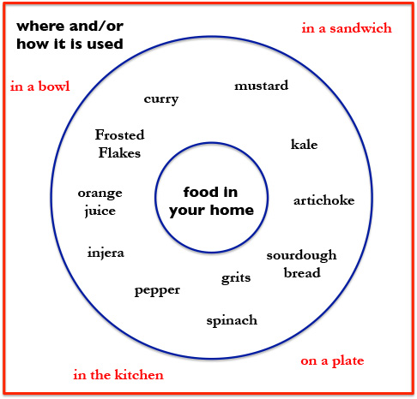
Food in my Home
There are many types of food in
my home that we eat.
________________________________
________________________________
________________________________
________________________________
________________________________
________________________________
We have many types of food in
my home.

Slide 15
Categorizing
artichoke
Frosted
Flakes
curry
kale
mustard
pepper
orange
juice
sourdough
bread
spinach
grits
Notes:
Have them do

Slide 16
Categorizing
curry
sourdough
bread
kale
orange
juice
mustard
grits
spinach
pepper
Frosted
Flakes
artichoke
injera
Notes:
Have them do

Slide 17
Categorizing
spice
grain
vegetable
fruit
curry
sourdough
bread
kale
orange
juice
mustard
grits
spinach
pepper
Frosted
Flakes
artichoke
injera
Notes:
Have them do

Slide 18
Categorizing
food
spice
grain
vegetable
fruit
curry
sourdough
bread
kale
orange
juice
mustard
grits
spinach
pepper
Frosted
Flakes
artichoke
injera
Notes:
Have them do

Slide 19
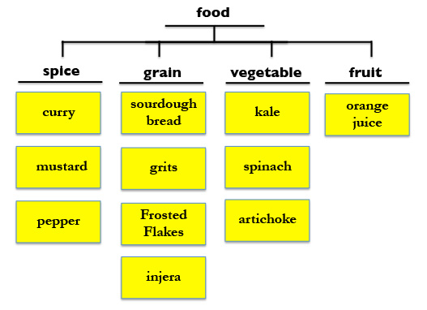
Food at my Home
Spices
Grains
Vegetables
Fruit

Slide 20
Categorizing
food
spice
grain
vegetable
fruit
curry
sourdough
bread
kale
orange
juice
mustard
grits
spinach
pepper
Frosted
Flakes
artichoke
injera
Favorites. Why?
Nutrition?
Least favorite. Why?
Notes:
Have them do

Slide 21
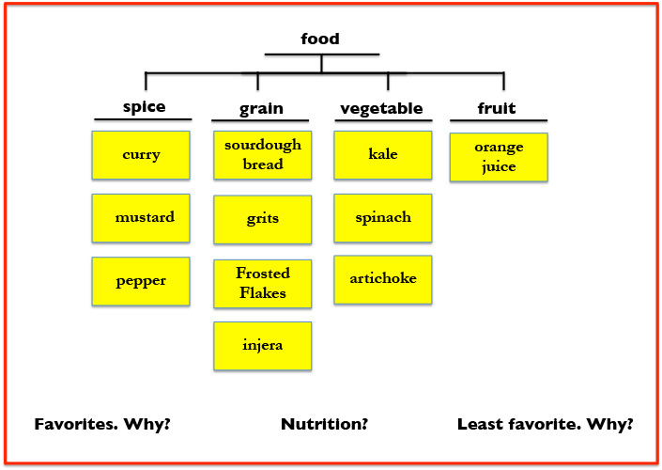
My favorite foods are
__________________________
__________________________
__________________________
The most nutritional foods I eat are___________
__________________________
__________________________
__________________________
My least favorite foods are _____________________
__________________________
__________________________

Slide 22
Categorizing
food
spice
grain
vegetable
fruit
curry
sourdough
bread
kale
orange
juice
mustard
grits
spinach
pepper
Frosted
Flakes
artichoke
injera
More ideas for categorizing —
Notes:
Have them do

Slide 23
zingy
buttery
crispy
green
^
^
^
pepper
sourdough
bread
kale
spinach

Slide 24
The spicy pepper
added flavor to
the soup.
My soup was
complimented
with buttery
sourdough bread.
spicy
buttery
crispy
green
^
^
^
pepper
sourdough
bread
kale
spinach

Slide 25
spices
grains
vegetables

Slide 26
opening paragraph
spices
grains
vegetables
closing
paragraph

Slide 27
spices
grains
vegetables

Slide 28
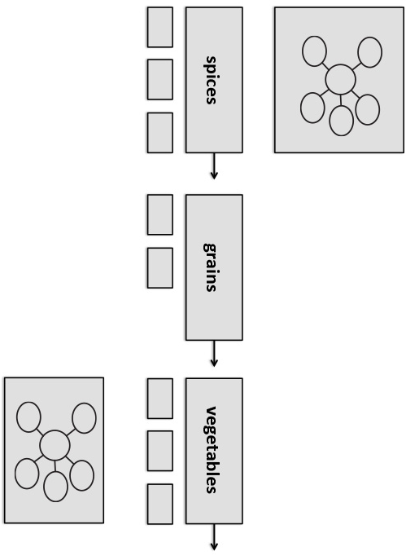
opening
__________________________
spices
__________________________
__________________________
grains
__________________________
__________________________
vegetables
__________________________
__________________________
closing
__________________________

Slide 29

Circle Map
Describing in Context
Brainstorming
Pictures and/or words
Brace Map
Whole Part relationship
Pictures and/or words

Slide 30
Tree Map
Categorization
Pictures and/or words
Brace Map
Whole Part relationship
Pictures and/or words

Slide 31
Circle Map
Describing in Context
Brainstorming
Pictures and/or words
Brace Map
Whole Part relationship
Pictures and/or words

Slide 32
stem
leaf
parts of
a plant
root
petal
flower

Slide 33
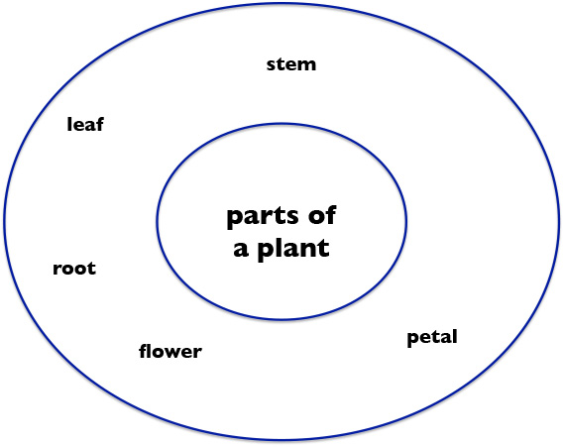
A plant has a _________.
A plant has a _________.
A plant has a _________.
A plant has a _________.
A plant has a _________.
A plant has a _________.
A plant has a _________.

Slide 34
shape
green
leaf
stem
parts of
a plant
root
in the
ground
petal
flower
part of
the flower
is colorful

Slide 35
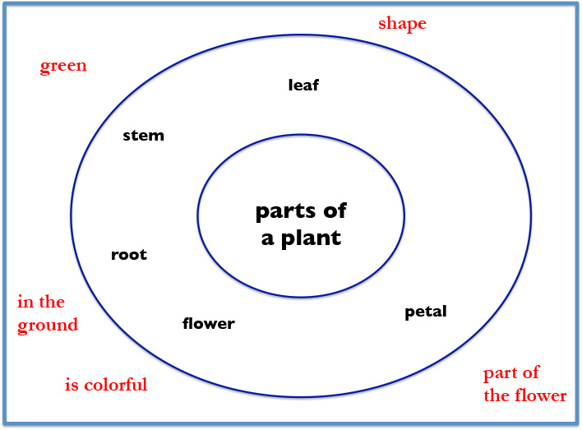

Slide 36
Brace Map: Whole / Part

Slide 37
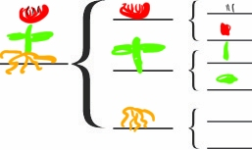
flower
pistil
petal
stem
stem
plant
leaf
roots

Slide 38
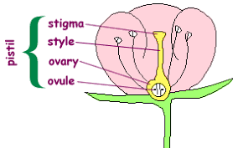
flower
pistil
petal
stem
stem
plant
leaf
roots

Slide 39
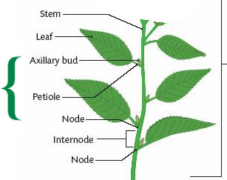
flower
pistil
petal
stem
stem
plant
leaf
roots

Slide 40
flower
pistil
petal
stem
stem
plant
leaf
roots
research
where found

Slide 41
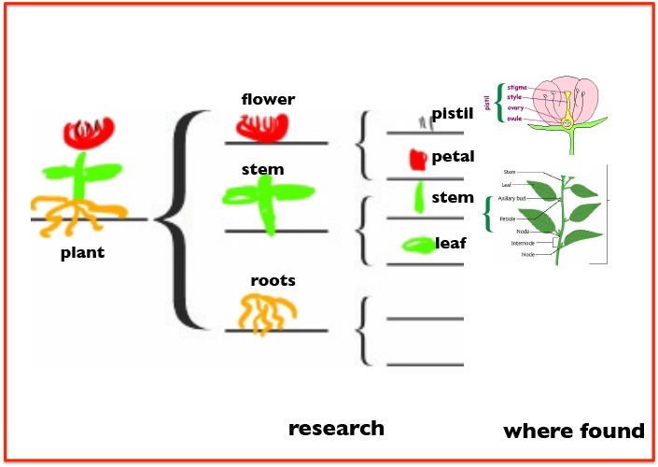
opening
adjectives
flower
stem
root
closing
adjectives

Slide 42
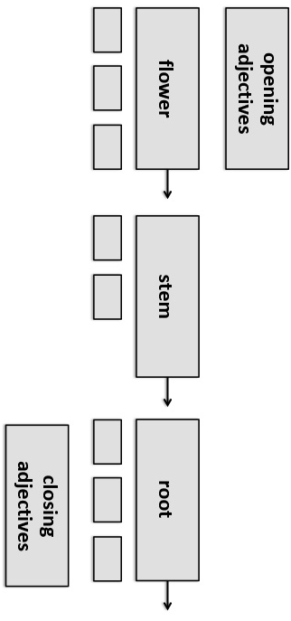
opening
__________________________
flower
__________________________
__________________________
stem
__________________________
__________________________
root
__________________________
__________________________
closing
__________________________

Slide 43
Other objects we can use a
Brace Map
for whole / part
Create an example to share with everyone.

Slide 44
By Myself
When I’m by myself
And I close my eyes
I’m a twin
I’m a dimple in a chin
I’m a room full of toys
I’m a squeaky noise
I’m a gospel song
I’m a gong
I’m a leaf turning red
I’m a loaf of brown bread
I’m a whatever I want to be
An anything I care to be
And when I open my eyes
What I care to be
Is me.
Eloise Greenfield

Slide 45
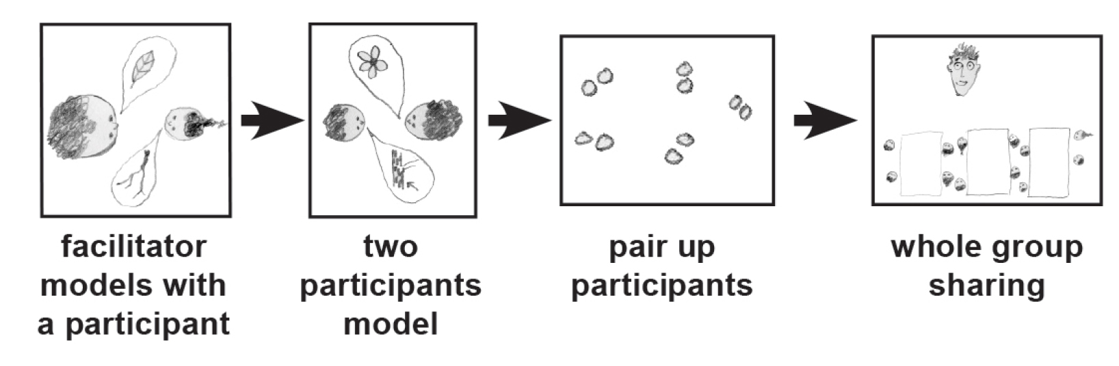
Things I like…
Thinking Collaboratively
Notes:
METHODS

Slide 46
By Myself
When I’m by myself
And I close my eyes
I’m a twin
I’m a dimple in a chin
I’m a room full of toys
I’m a squeaky noise
I’m a gospel song
I’m a gong
I’m a leaf turning red
I’m a loaf of brown bread
I’m a whatever I want to be
An anything I care to be
And when I open my eyes
What I care to be
Is me.
Eloise Greenfield
violin
android
jeans
things
I like
iphone
drums
hip hop song

Slide 47
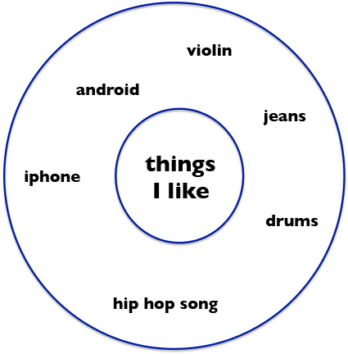
When I’m by myself,
And I close my eyes,
I’m a ______________
I’m a ______________
I’m a ______________
I’m a ______________
I’m a ______________
I’m a ______________
What I care to be
Is me.

Slide 48
By Myself
When I’m by myself
And I close my eyes
I’m a twin
I’m a dimple in a chin
I’m a room full of toys
I’m a squeaky noise
I’m a gospel song
I’m a gong
I’m a leaf turning red
I’m a loaf of brown bread
I’m a whatever I want to be
An anything I care to be
And when I open my eyes
What I care to be
Is me.
Eloise Greenfield
When I’m by myself,
And I close my eyes,
I’m a ______________
I’m a ______________
I’m a ______________
I’m a ______________
I’m a ______________
I’m a ______________
What I care to be
Is me.

Slide 49
By Myself
When I’m by myself
And I close my eyes
I’m a twin
I’m a dimple in a chin
I’m a room full of toys
I’m a squeaky noise
I’m a gospel song
I’m a gong
I’m a leaf turning red
I’m a loaf of brown bread
I’m a whatever I want to be
An anything I care to be
And when I open my eyes
What I care to be
Is me.
Eloise Greenfield
social
media
hip hop
in place
^
^
^
song
iphone
hair gel

Slide 50
When I’m by myself,
And I close my eyes,
I’m a ______ ________
I’m a ______ ________
I’m a ______ ________
I’m a ______ ________
I’m a ______ ________
I’m a ______________
What I care to be
Is me.
^
^

Slide 51

A Language
for
Written
Communication
Notes:
Back to thinking with Thinking Maps — organizing thinking. Circle map for brainstorming — then organize…

Slide 52
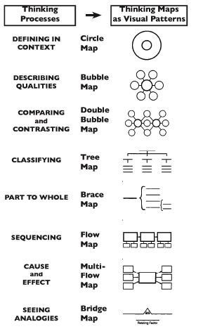
Thinking Maps
Notes:
Back to thinking with Thinking Maps — organizing thinking. Circle map for brainstorming — then organize…

Slide 53
Thinking Maps
A Visual Language
for
Communicating
and
Organizing
Thinking
Notes:
Back to thinking with Thinking Maps — organizing thinking. Circle map for brainstorming — then organize…

Slide 54
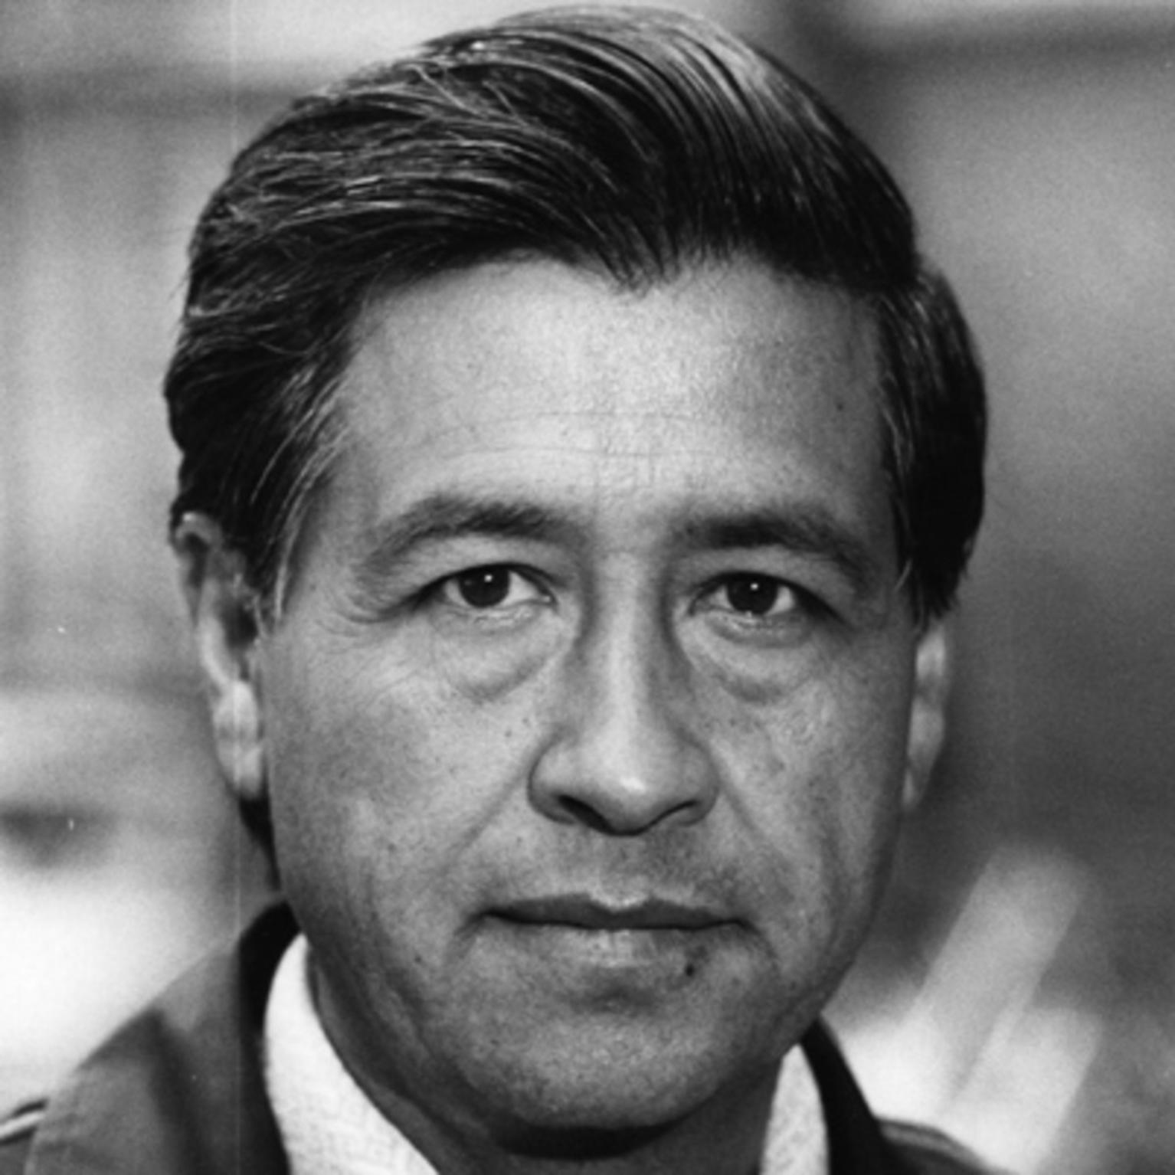
“Students must have initiative; they should not be mere imitators. They must learn to think and act for themselves, and be free.”
—Caesar Chavez
Notes:
Chat response to the quote: what does it have you thinking about

Slide 55
“Students must have initiative; they should not be mere imitators. They must learn to think and act for themselves, and be free.”
—Caesar Chavez
Notes:
Chat response to the quote: what does it have you thinking about

Slide 56
Thinking Maps as a Language
Describing in Context
Brainstorming
Comparing
& Contrasting
Categorizing
Describing
Sequencing
Cause and Effect
Whole / Part
Analogies
Relationships
To Organize Thinking – Student Centered
Notes:
Back to thinking with Thinking Maps — organizing thinking. Circle map for brainstorming — then organize…

Slide 57
Thinking Maps as a Language
Visually: a language for organizing thinking, seeing thinking in your brain, and patterns.
To Organize Thinking – Student Centered
Notes:
Back to thinking with Thinking Maps — organizing thinking. Circle map for brainstorming — then organize…

Slide 58

Mind Math

Slide 59
Strategy Review Chart
Name & Primitive | Cognitive Process/Function | Remember | Best Use (Priming, Processing, Retaining for Mastery) | Source | Connection to HOPs
Breakout Room for 8 minutes.
Spokesperson for each group is prepared.

Slide 60

Take Away
Reflection
strategy
systems view
and/or ?

Slide 61

Thank You
robert@eggplant.org
www.eggplant.org
www.nuatc.org

