Slide 1


Amplifying Student Voice
through
Mobile Critical Thinking Tools
Robert Seth Price, Senior Mentor
National Urban Alliance

Slide 2
The NUA’s mission is to substantiate an irrefutable belief in the capacity of all public school children to achieve the high intellectual performances demanded by our ever changing global community.

Slide 3
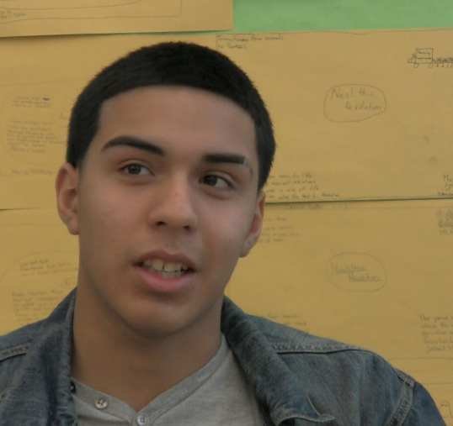
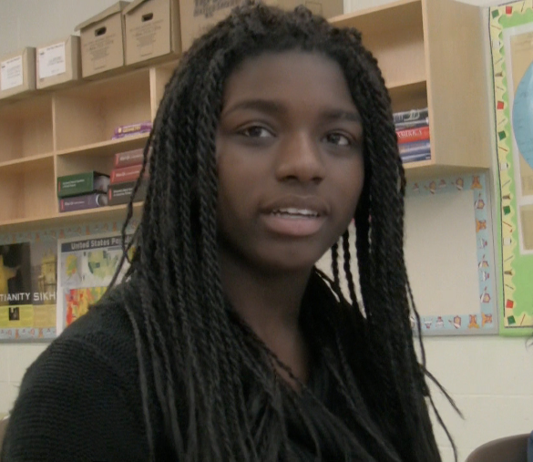
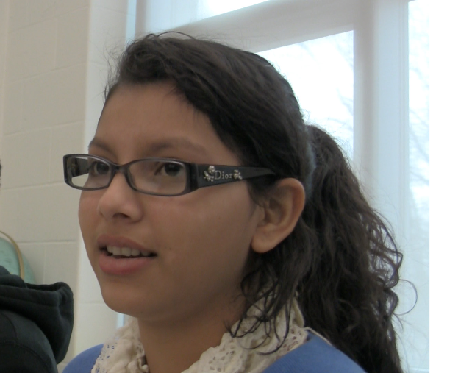
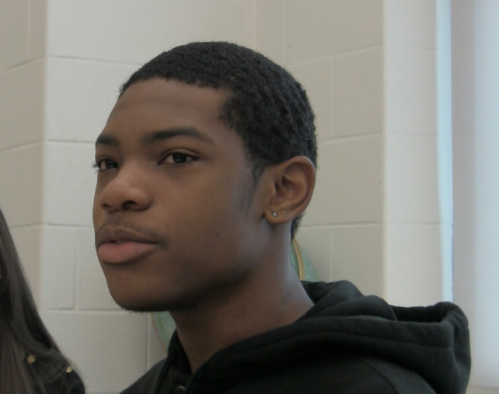
Today’s collaboration focuses on informing your lesson planning
by amplifying student voice.

Slide 4
“In order for this to happen, your entire frame of reference will have to change, and you will be forced to surrender many things that you now scarcely know you have.”
― James Baldwin, The Fire Next Time

Slide 5
High Operational Practices
Pedagogy of Confidence
Support & Enhance Equity

Slide 6
Participant Centered

Slide 7
Student Centered

Slide 8
Lesson Planning – Student Voice
Critical Thinking Tools
Community
Frame of Reference
Organizing Thinking for Understanding
Priming
Content of Interest
Our Gifts and the Gift Cycle of Sharing
AGENDA

Slide 9
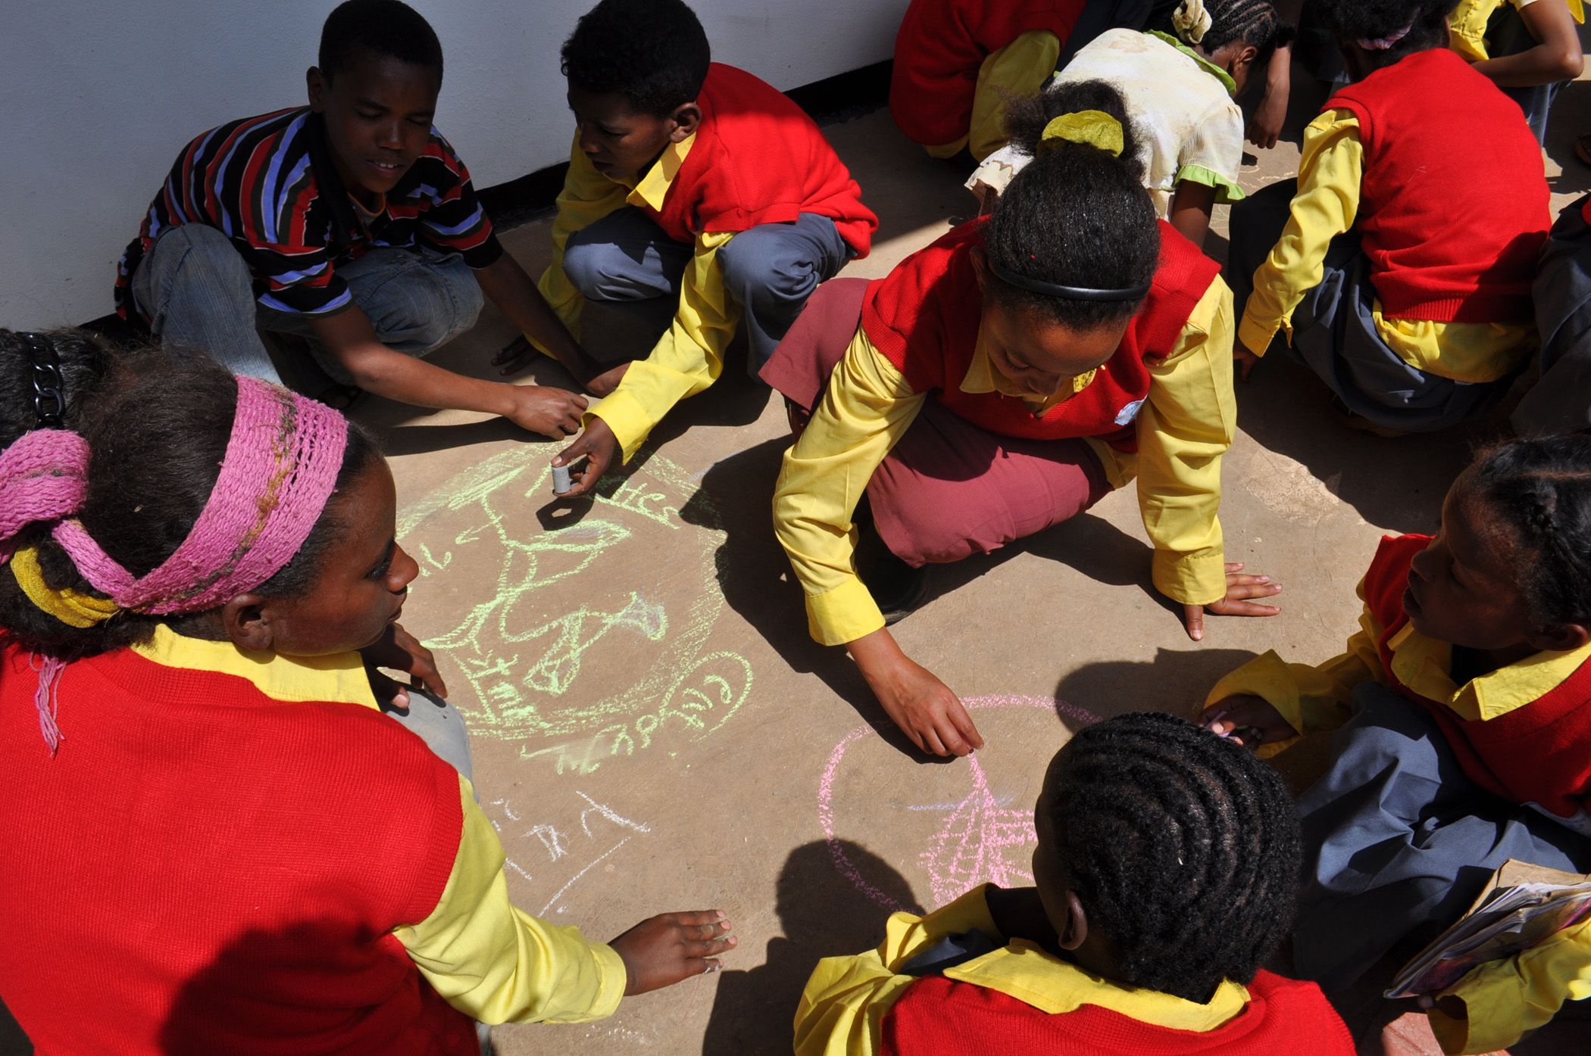
Collaborative
Communities

Slide 10
Community Building Exercises
Collaborative Learning Methods
Peer-to-Peer Coaching

Slide 11
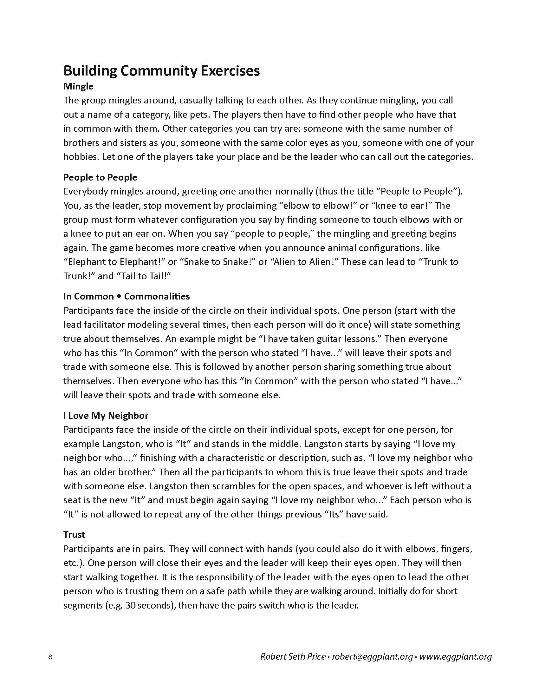
Community Building
Exercises
Commonalities
Trust
Machine
Hello

Slide 12
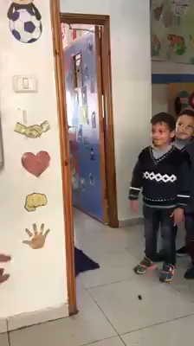

Slide 13
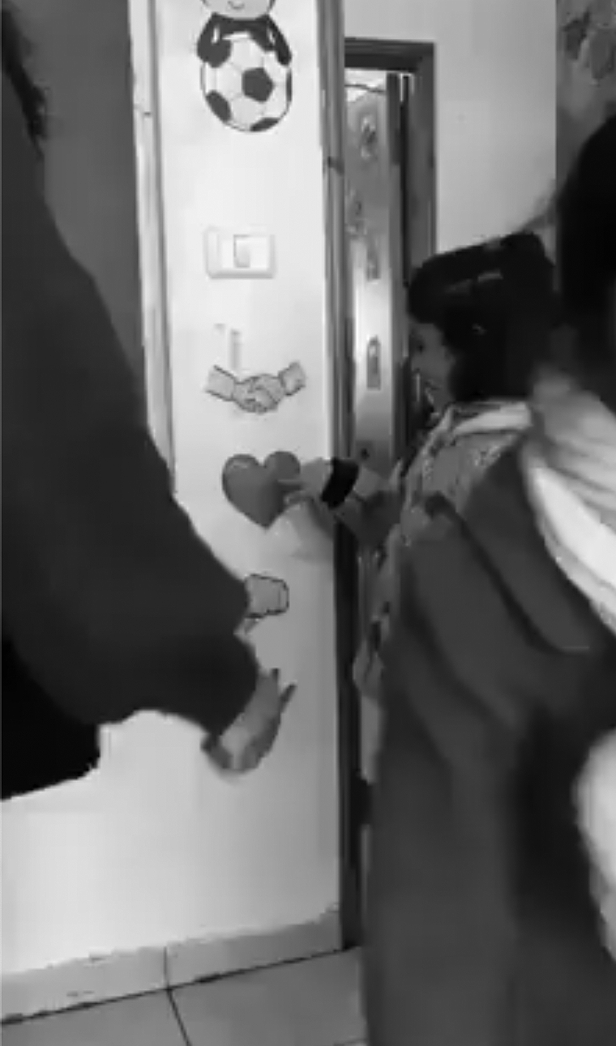
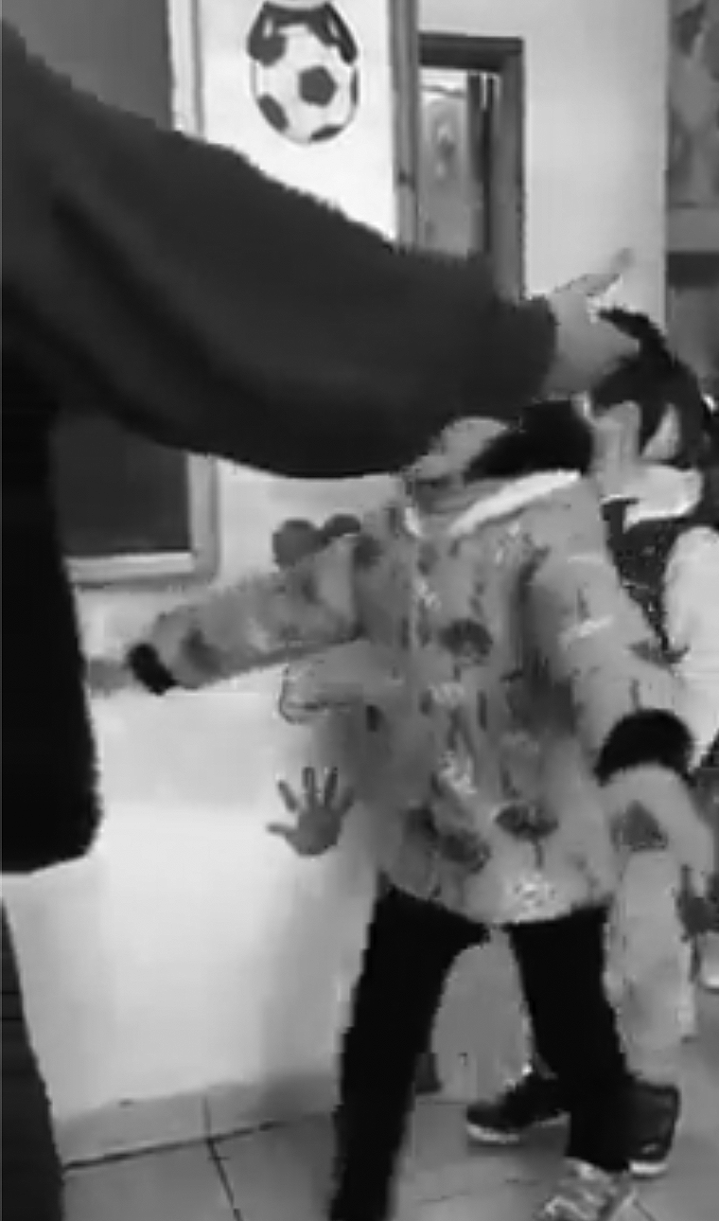

Slide 14
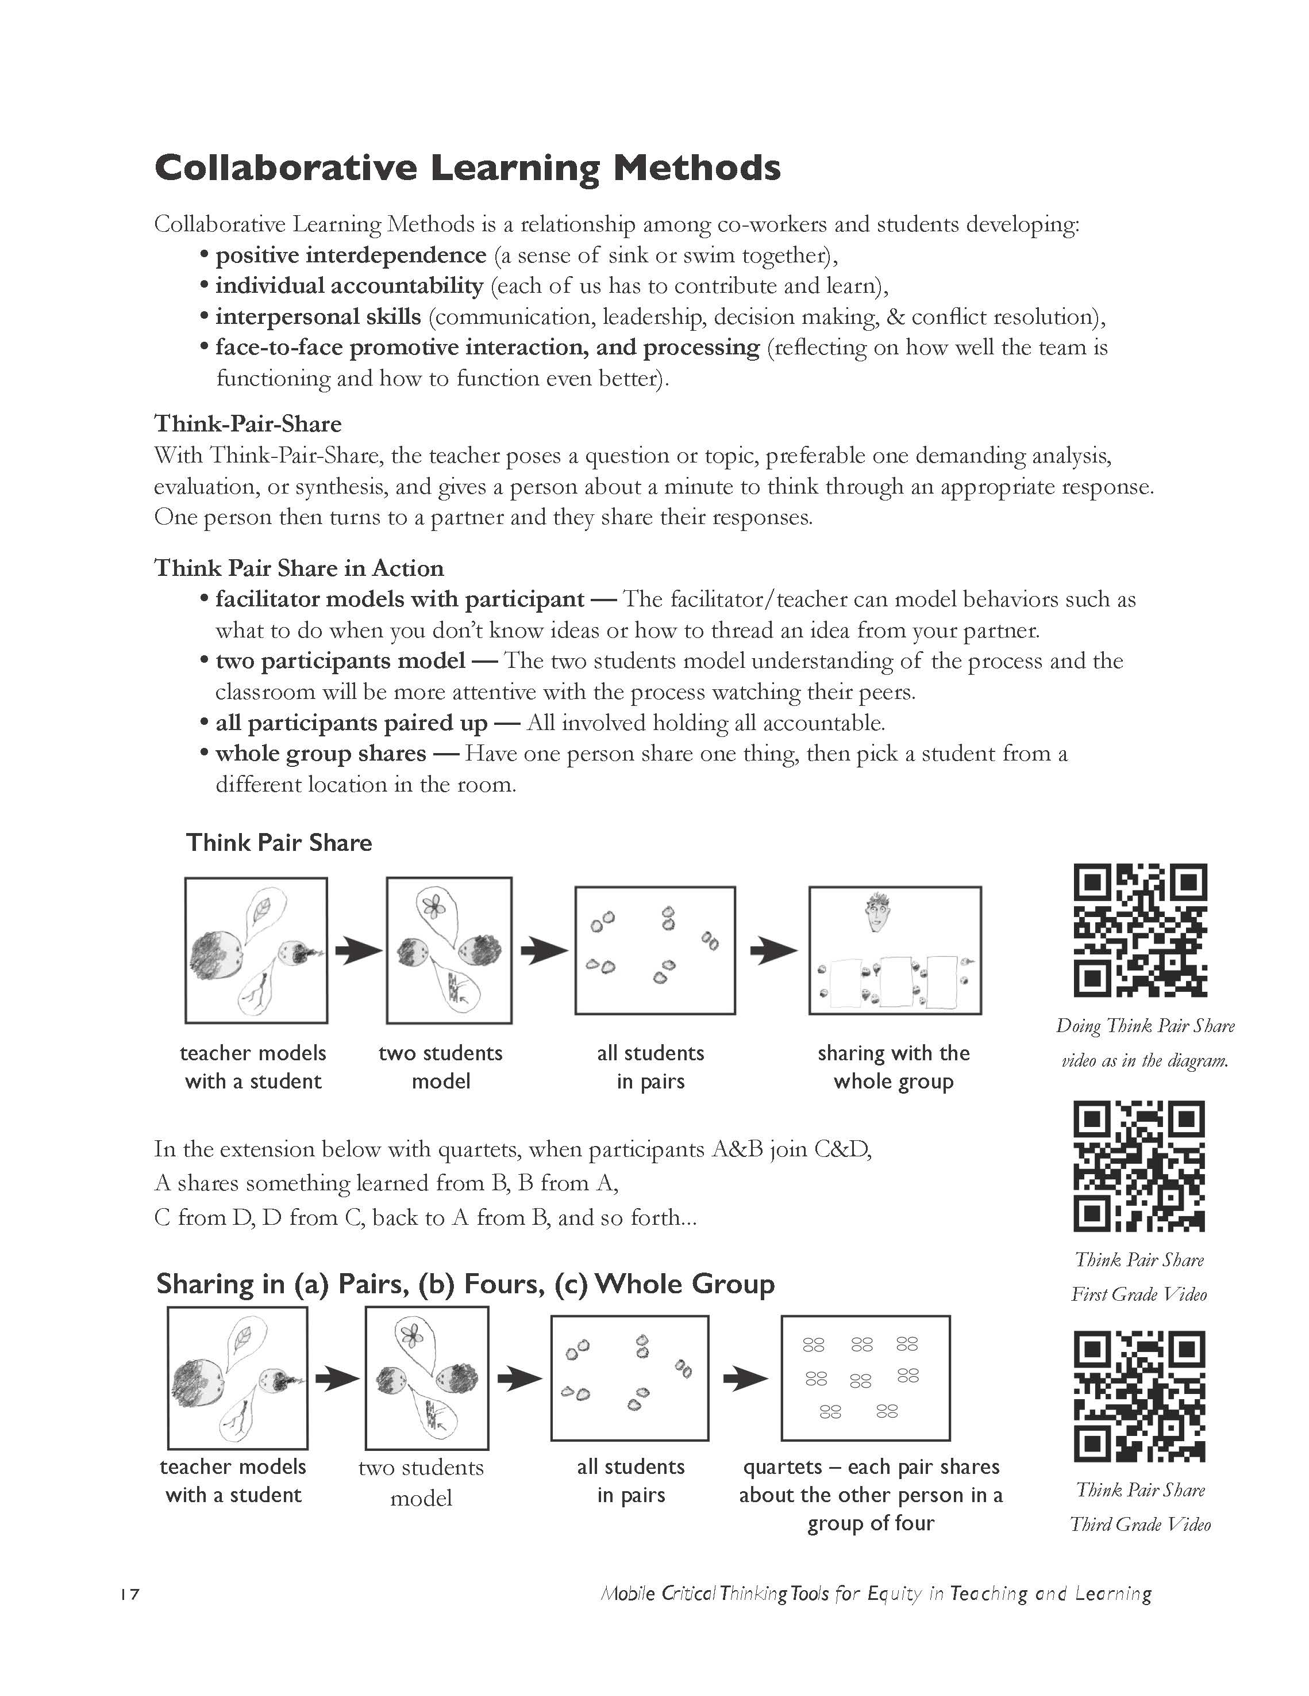
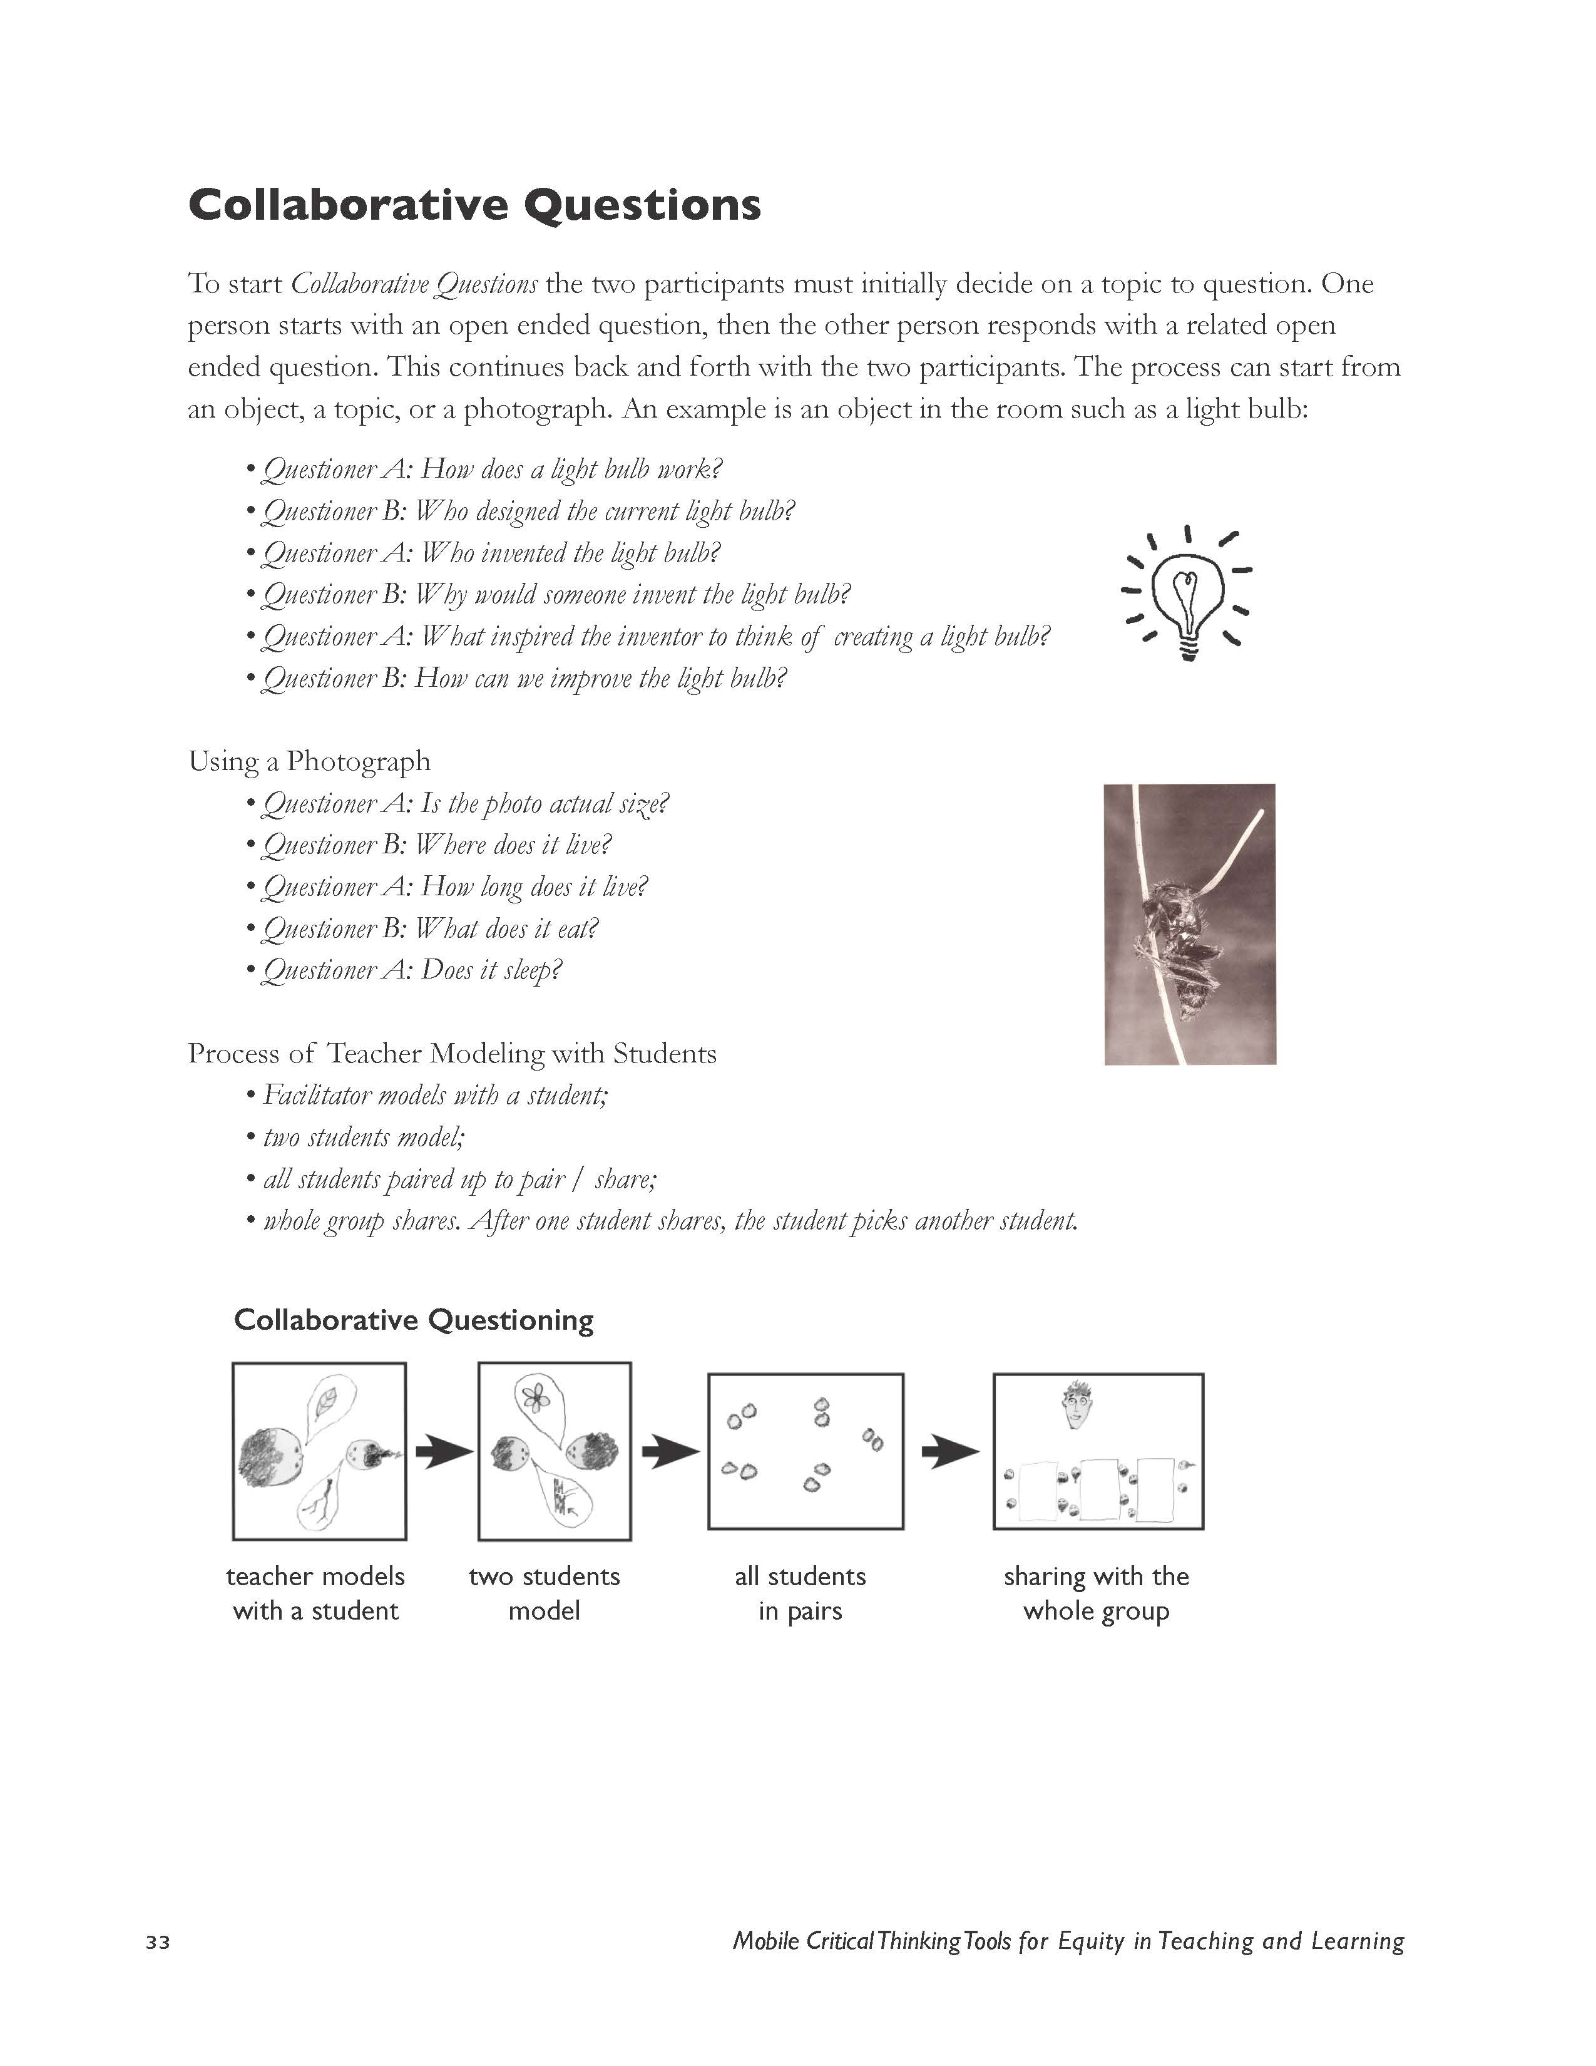
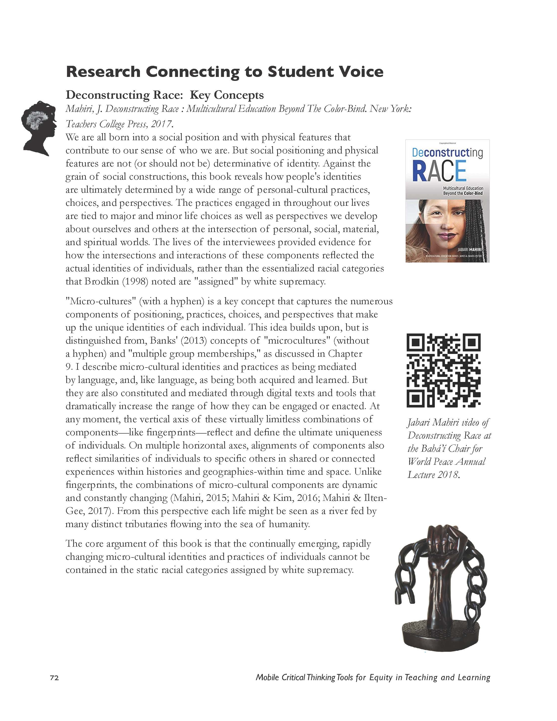
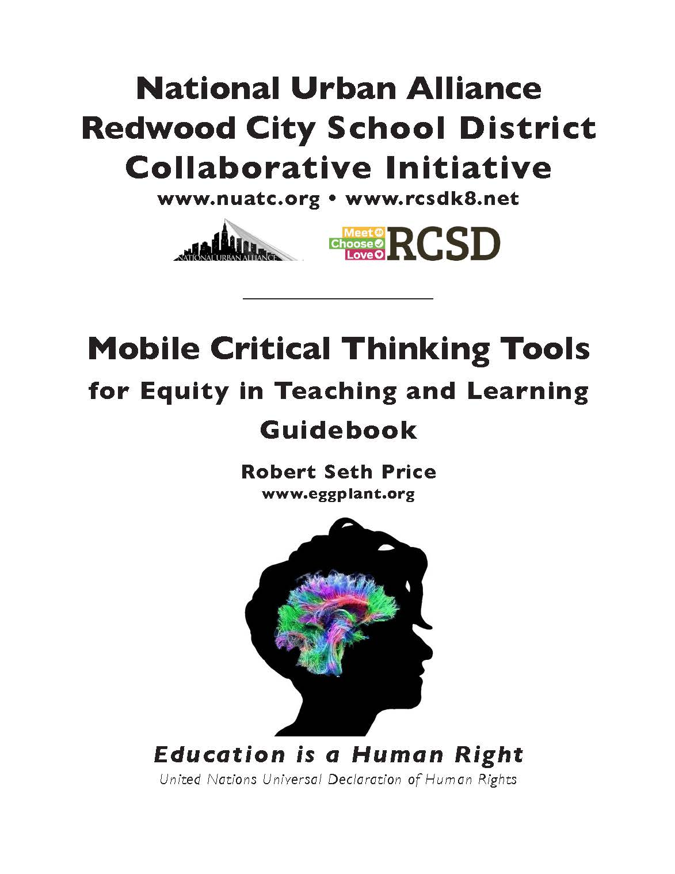
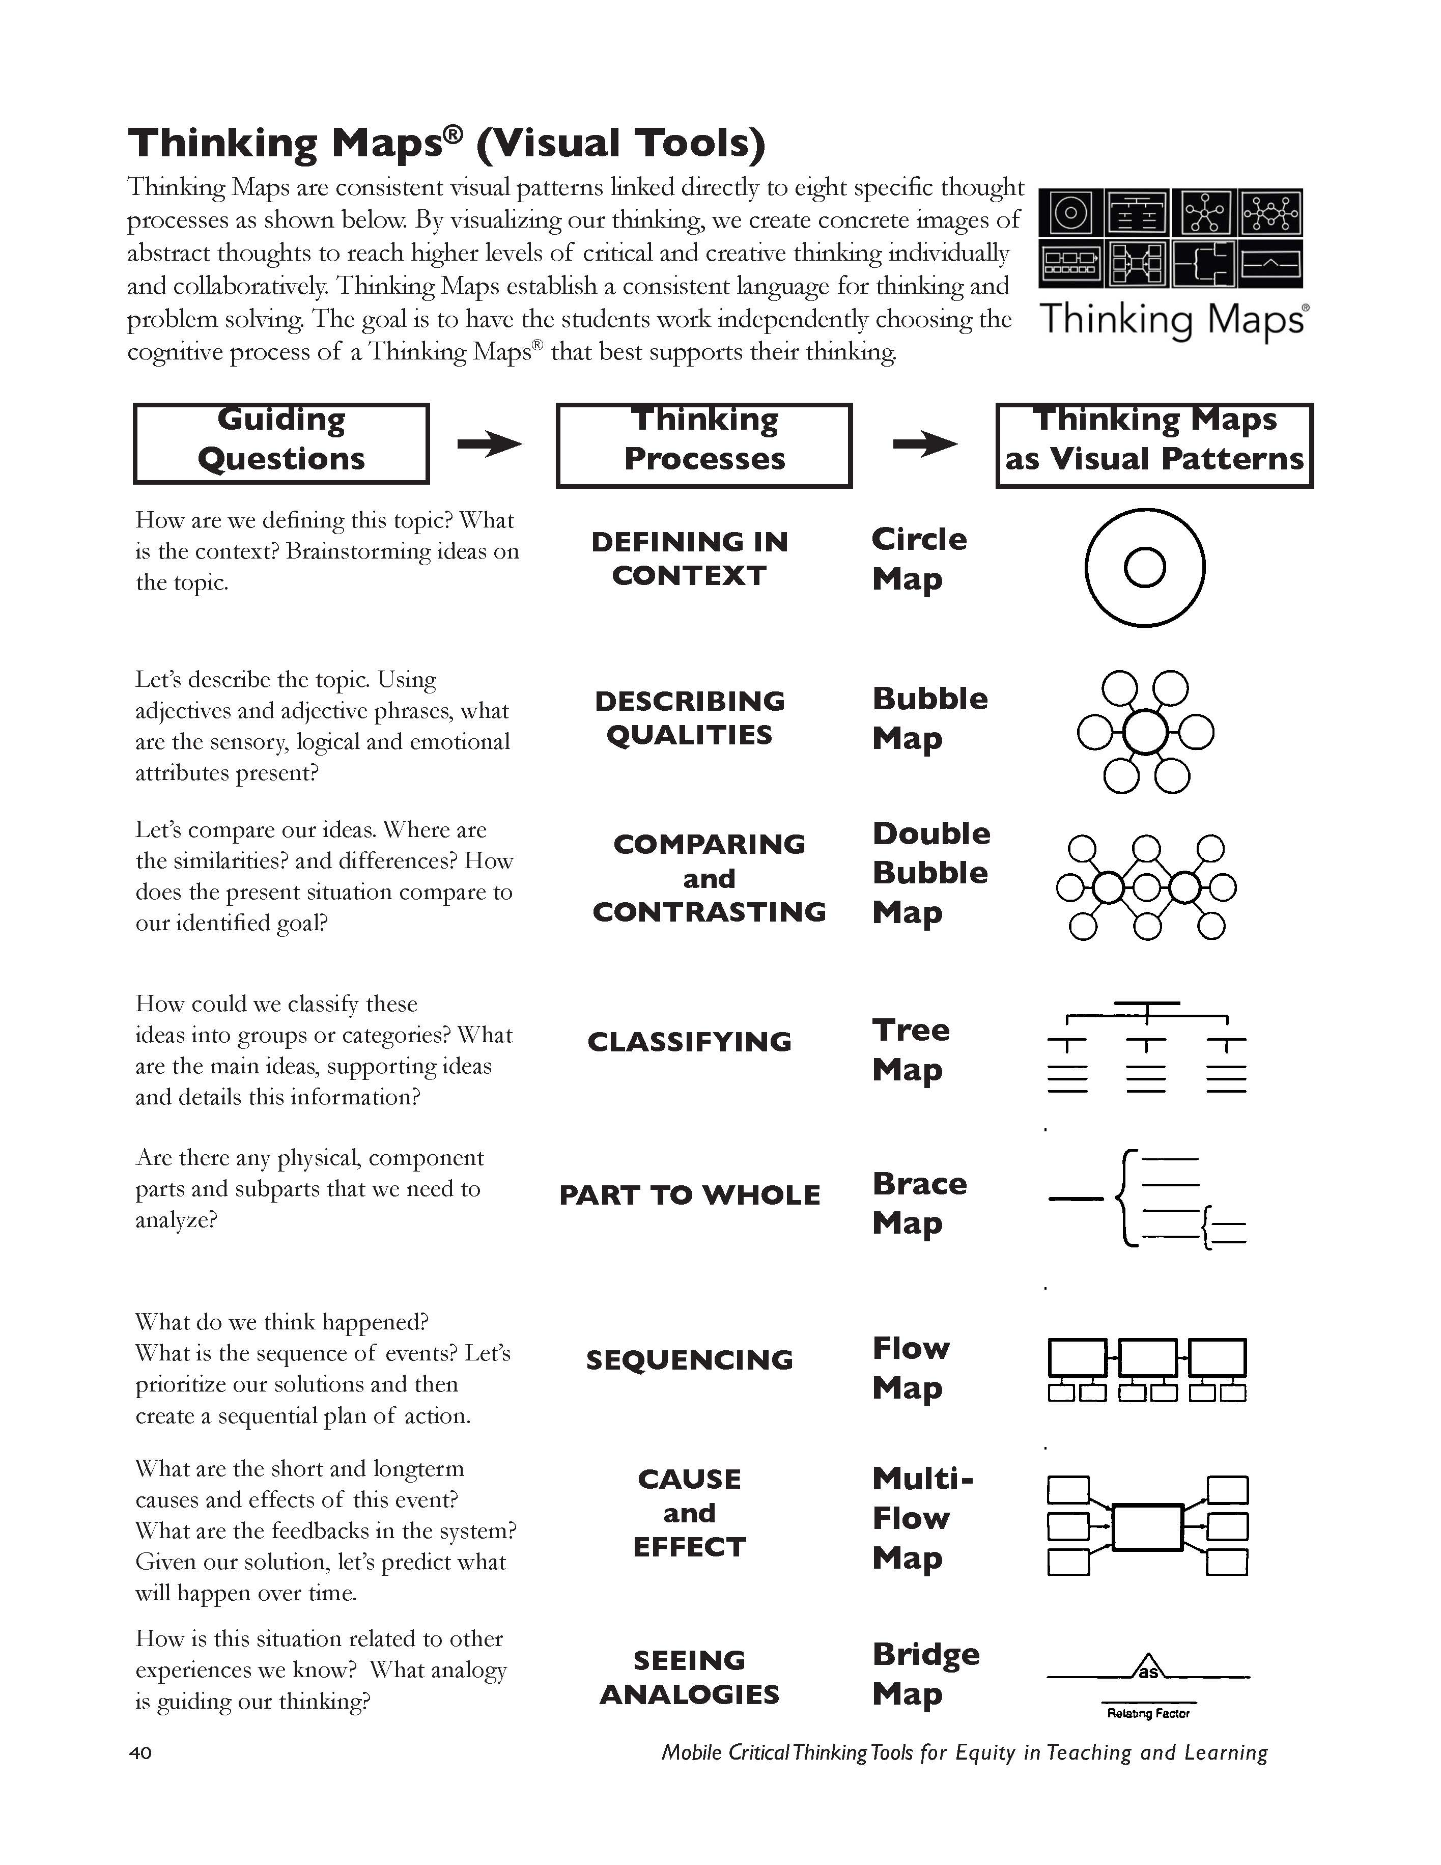
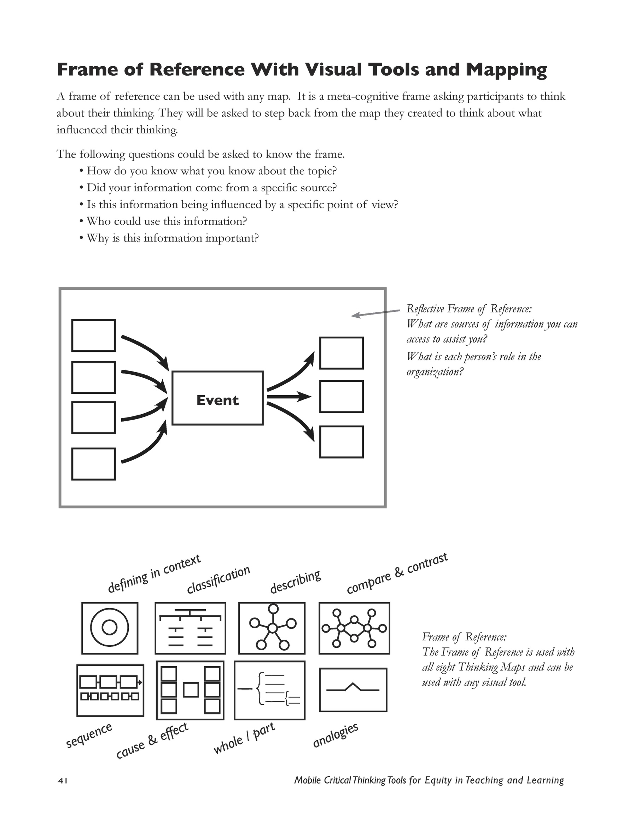
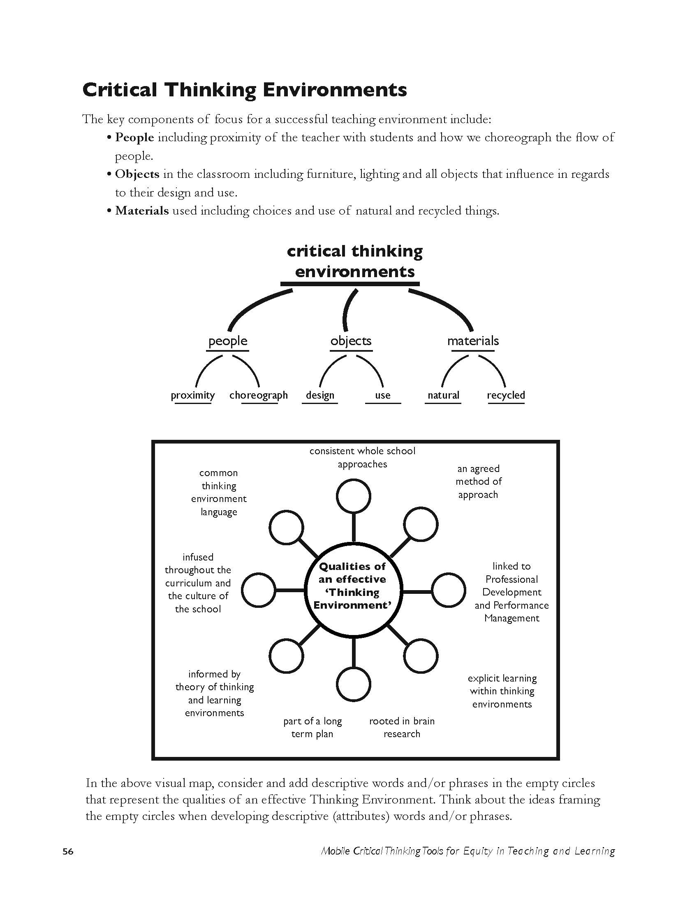
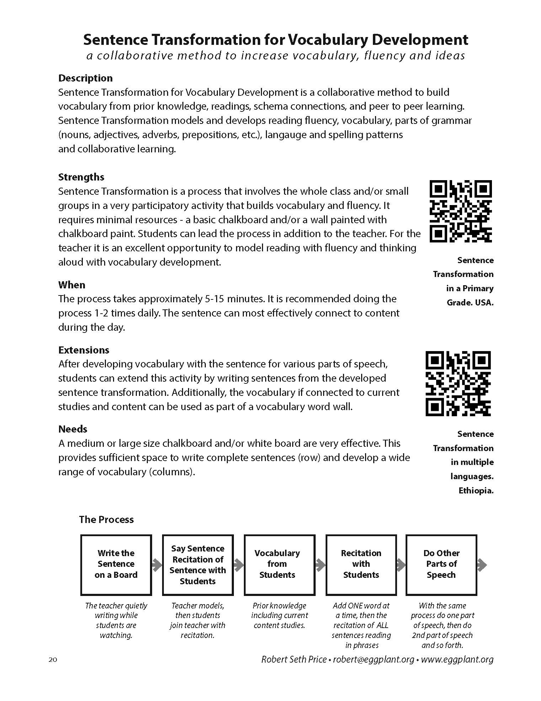
Training Guide
Collaborative
Communities
Questioning
and Inquiry
Research
Visual Tools
Frame of Reference
Thinking Environments

Slide 15

Personal Frame of Reference
Given your experiences,
where are you now in our collaboration?

Slide 16
Personal Frame of Reference
Given your experiences,
where are you now in our collaboration?
Person You Personally Know Who is an Important Influence
Guiding Principles as a Person
Books
Films
Music
Person You Do Not Personally Know Who is Significant
Food
Events That Are Important to Your Education Practice and Your Life
Impactful Places

Slide 17
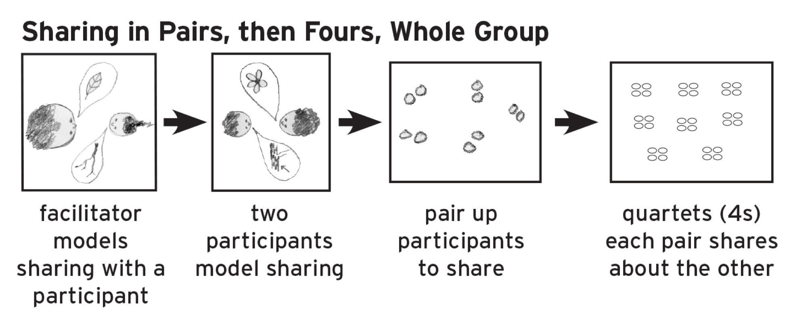
Collaborative Learning

Slide 18


Slide 19
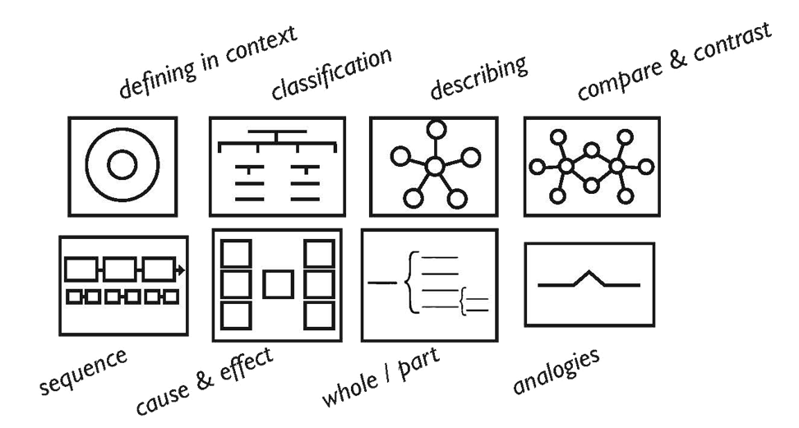

Slide 20

Sequencing
Categorizing
Cause - Effect
Defining In Context (Brainstorming)
Relationships
Whole - Part
Qualities
Compare / Contrast

Slide 21
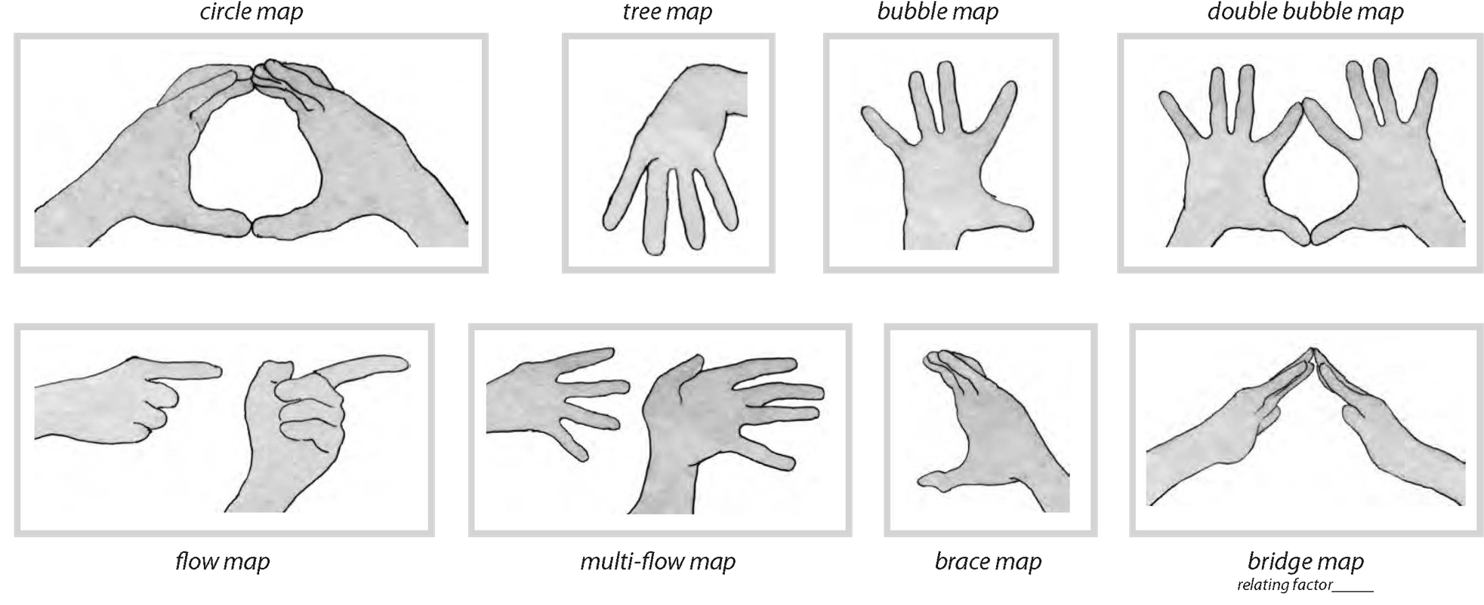
A Language of Thinking

Slide 22
Eight Cognitive Processes
One Topic

Slide 23
Priming
Audio, Video, Text, Personal Frames
Collaborative Communities
Cognitive Mapping and Frame
Questions and Inquiry
Still Images
Organizing Thinking
Performance with Presenting
LESSON

Slide 24
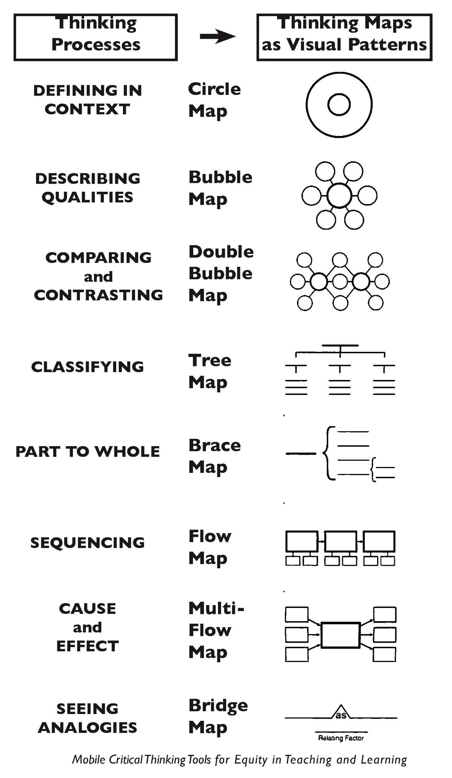
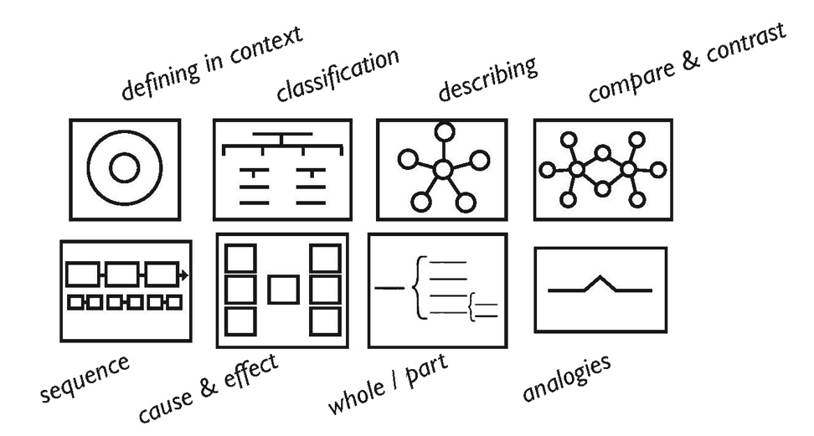
Guide Page 41
Guide Page 40

Slide 25

Stereotypes
Stereotypes
by Black Violin

Slide 26
causes
event
effects

Slide 27
causes
event
effects
what guides one’s thinking
personal experiences

Slide 28
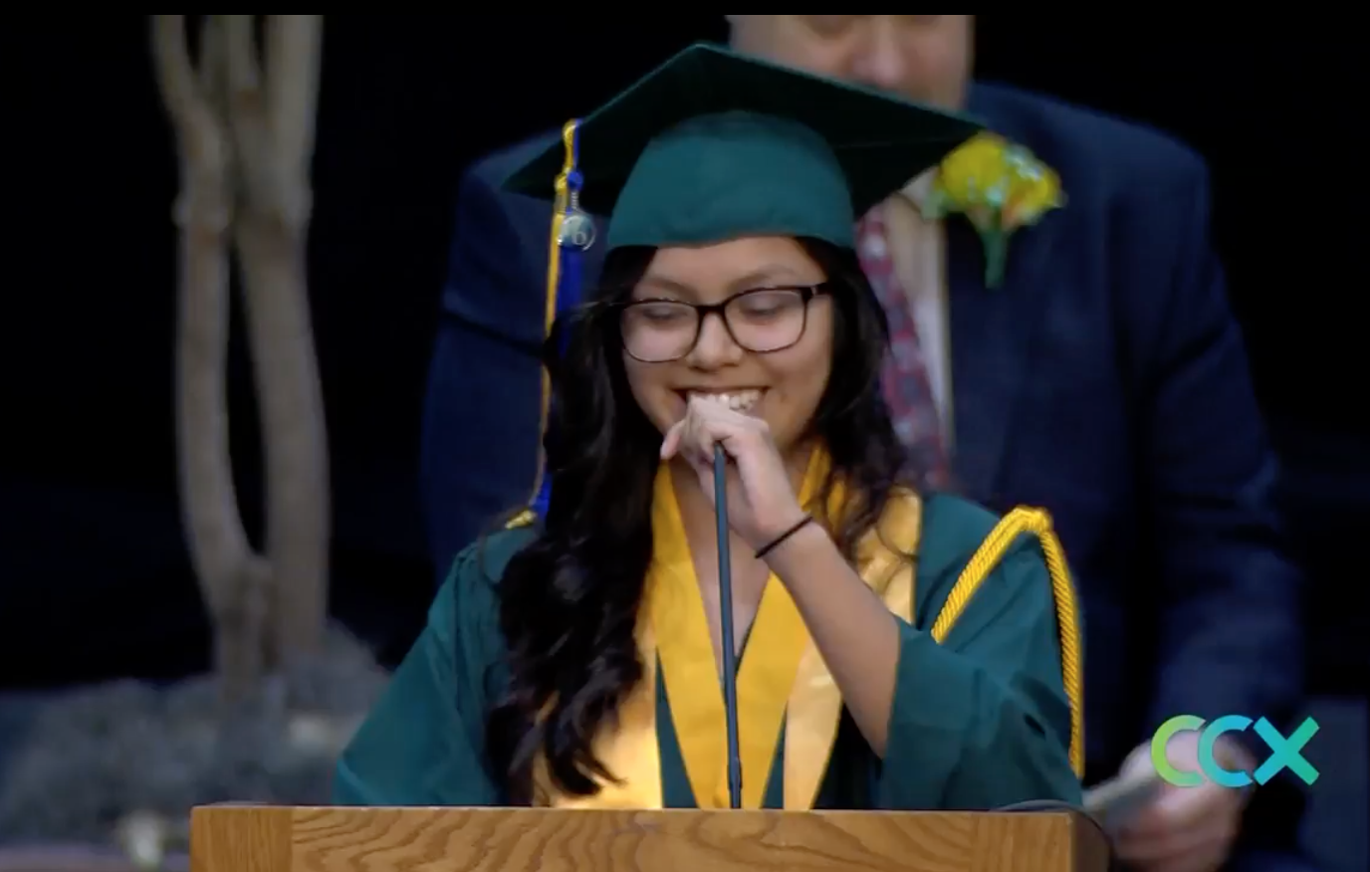
What are your questions in regards to this photo?

Slide 29
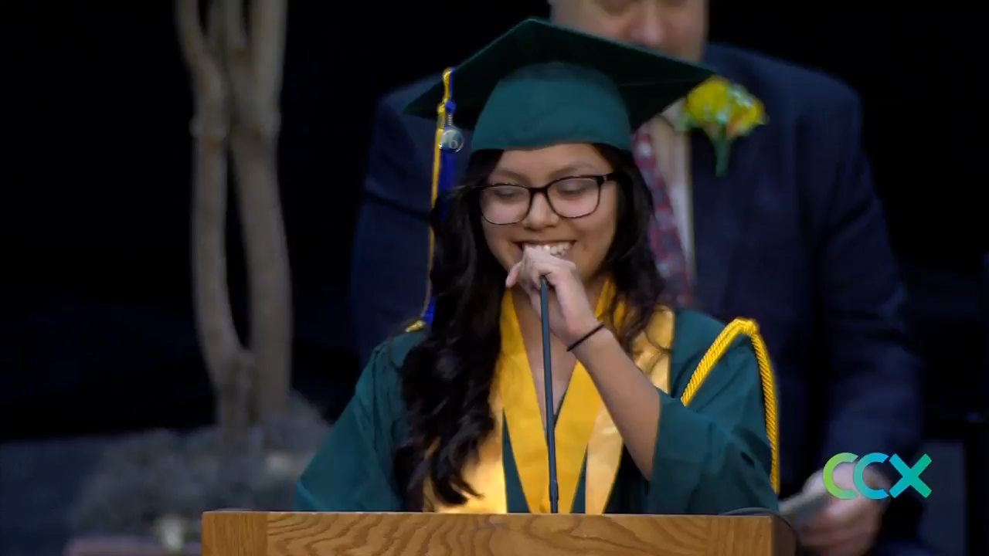
Park Center High School Graduation • Brooklyn Park, MN • 2017

Slide 30
causes
event
effects
How does one evolve their thinking?
positive actions

Slide 31
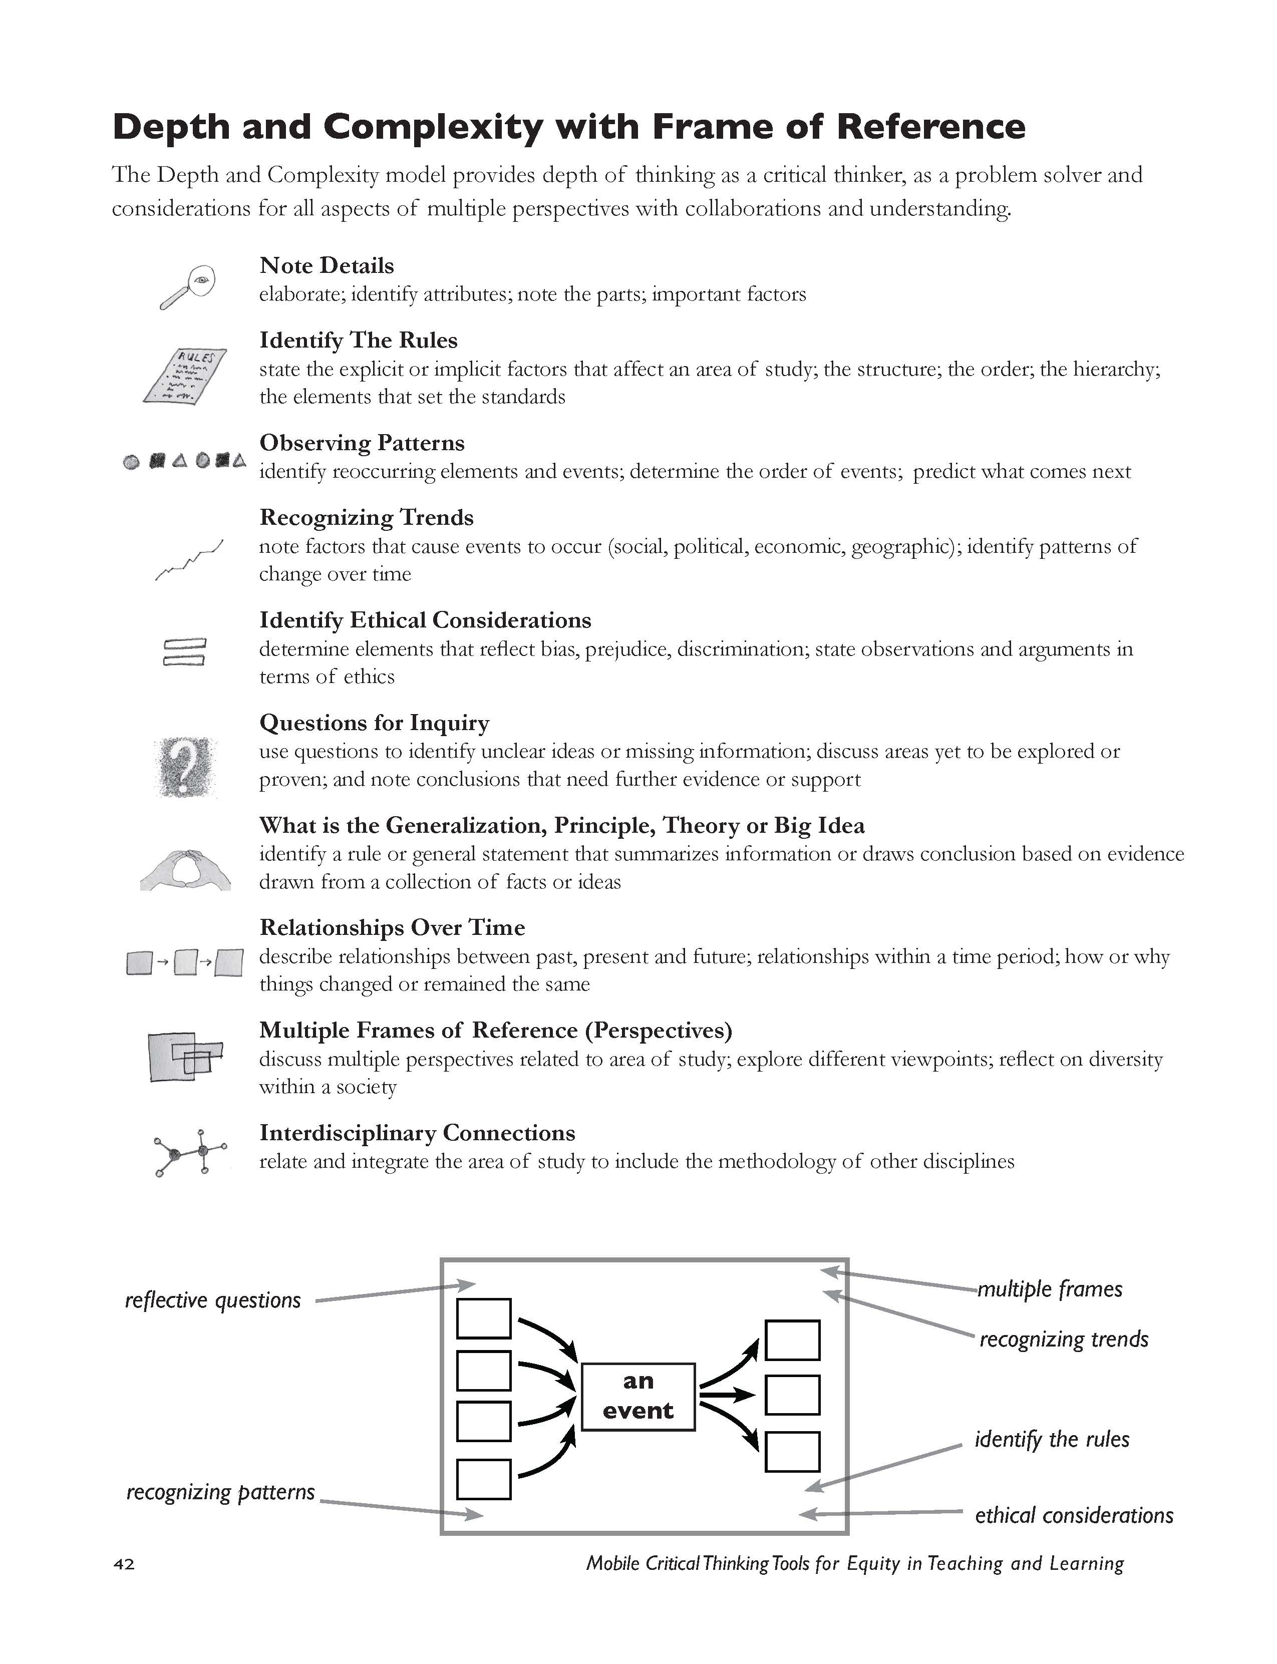
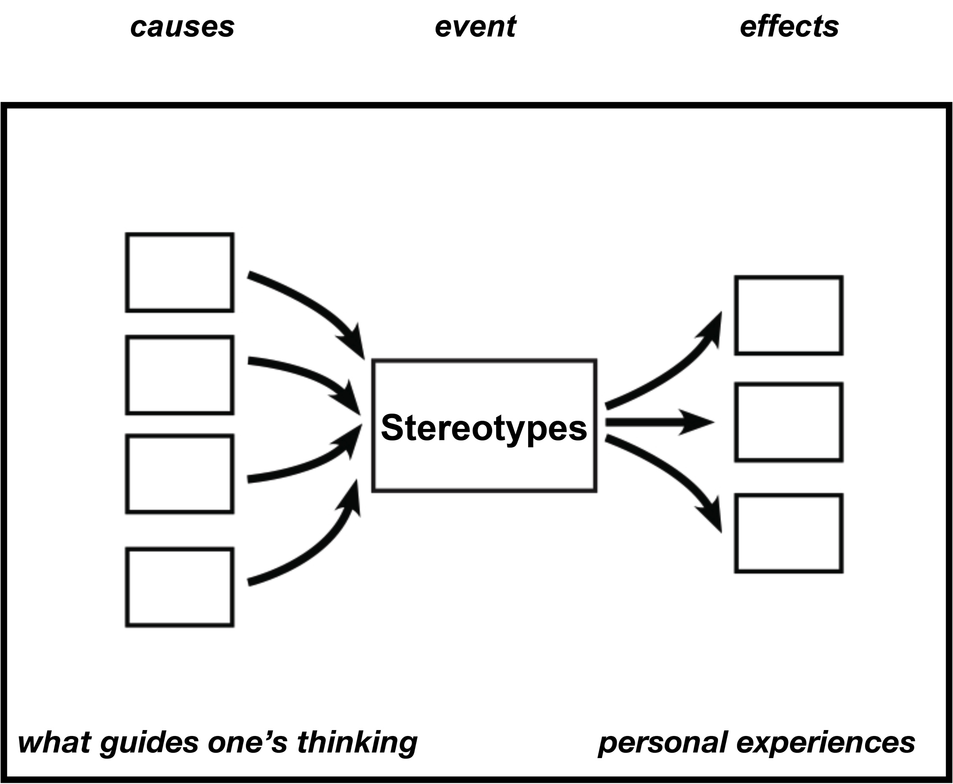
Guide Page 42

Slide 32
Powerful Questions

Slide 33

Powerful Questions

Slide 34
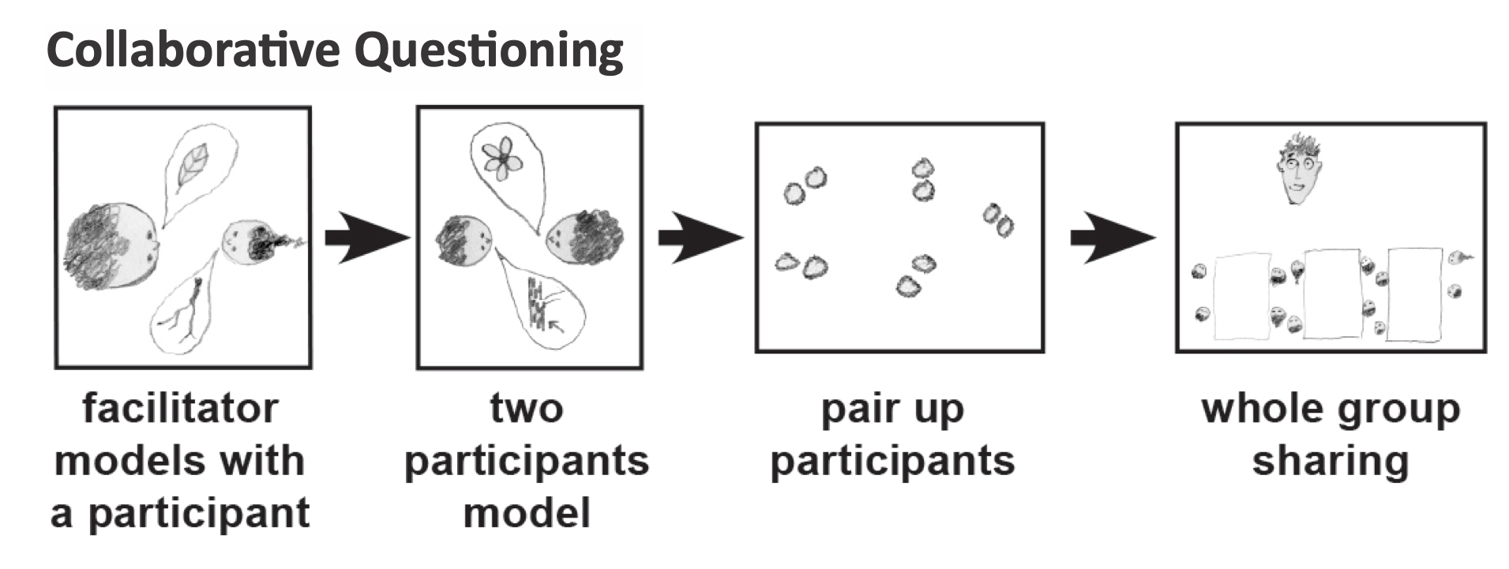
Guide Page 33

Slide 35
printing plant
manufactured
stacked seven feet high
brushed red glue
No gloves: fingertips required
perfection
sluggish
crevices
hands oozing
punch clock
law school
legal pad
.
VOCABULARY

Slide 36
Who Burns for the Perfection of Paper
Martín Espada
from City of Coughing and Dead Radiators, 1993 W.W. Norton & Company, Inc., New York, NY

Slide 37
causes
event
effects

Slide 38
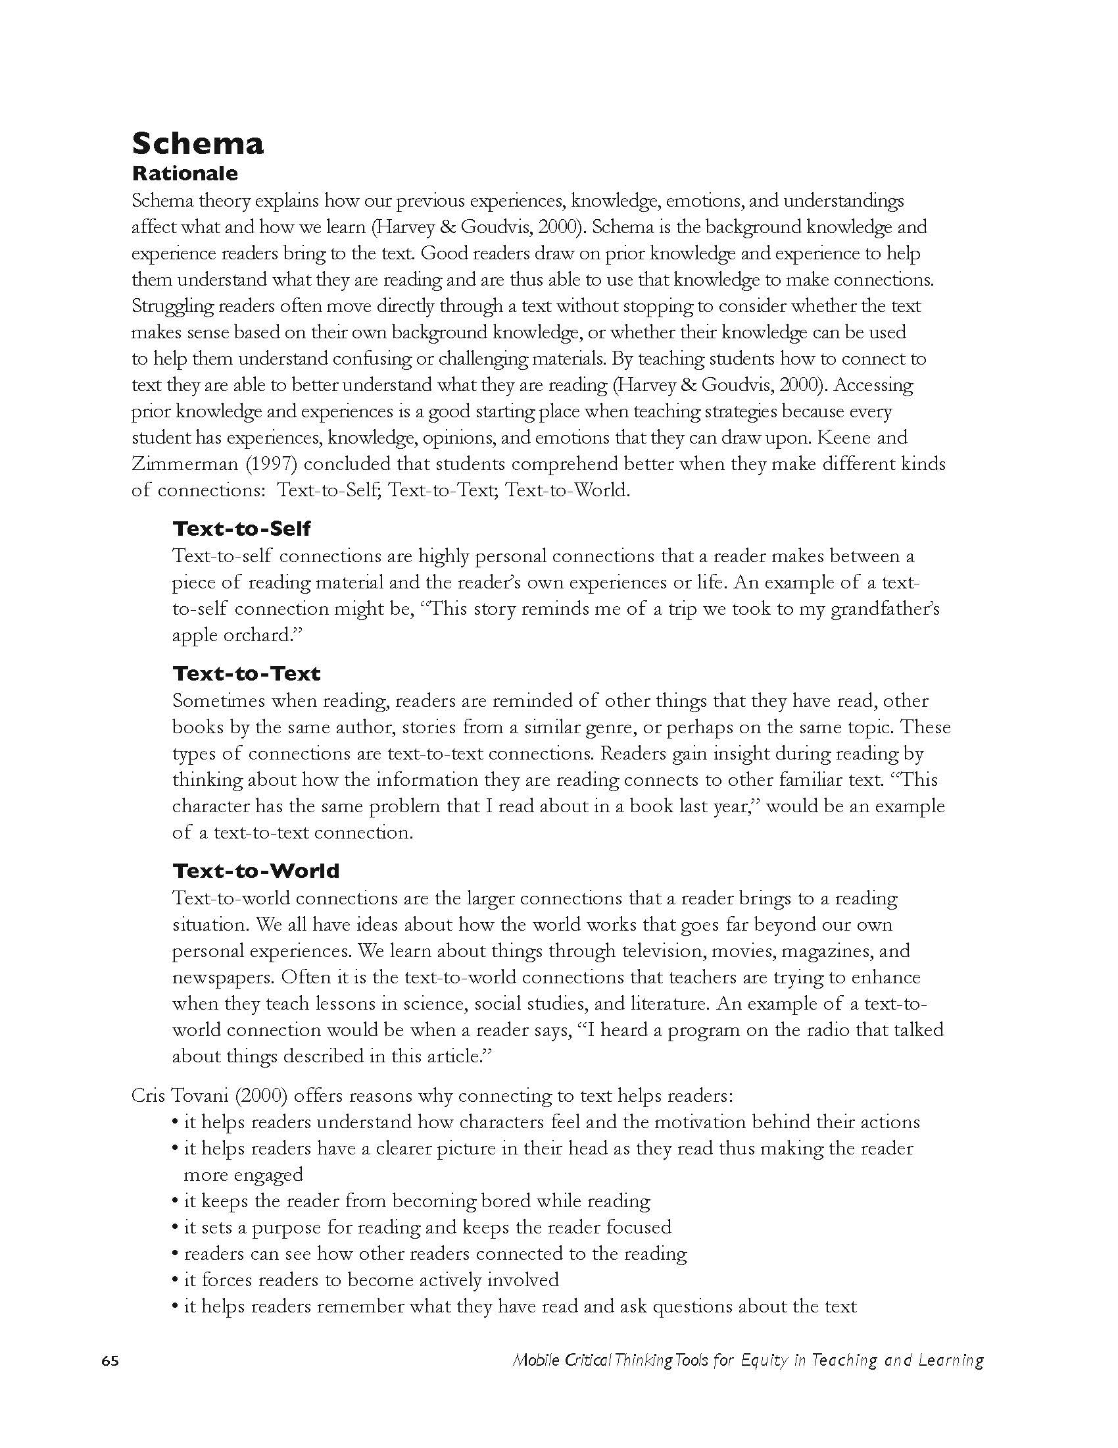
Schema
Text to Self
Text to Text
Text to World
Guide Page 65

Slide 39
causes
event
effects
Schema connections

Slide 40
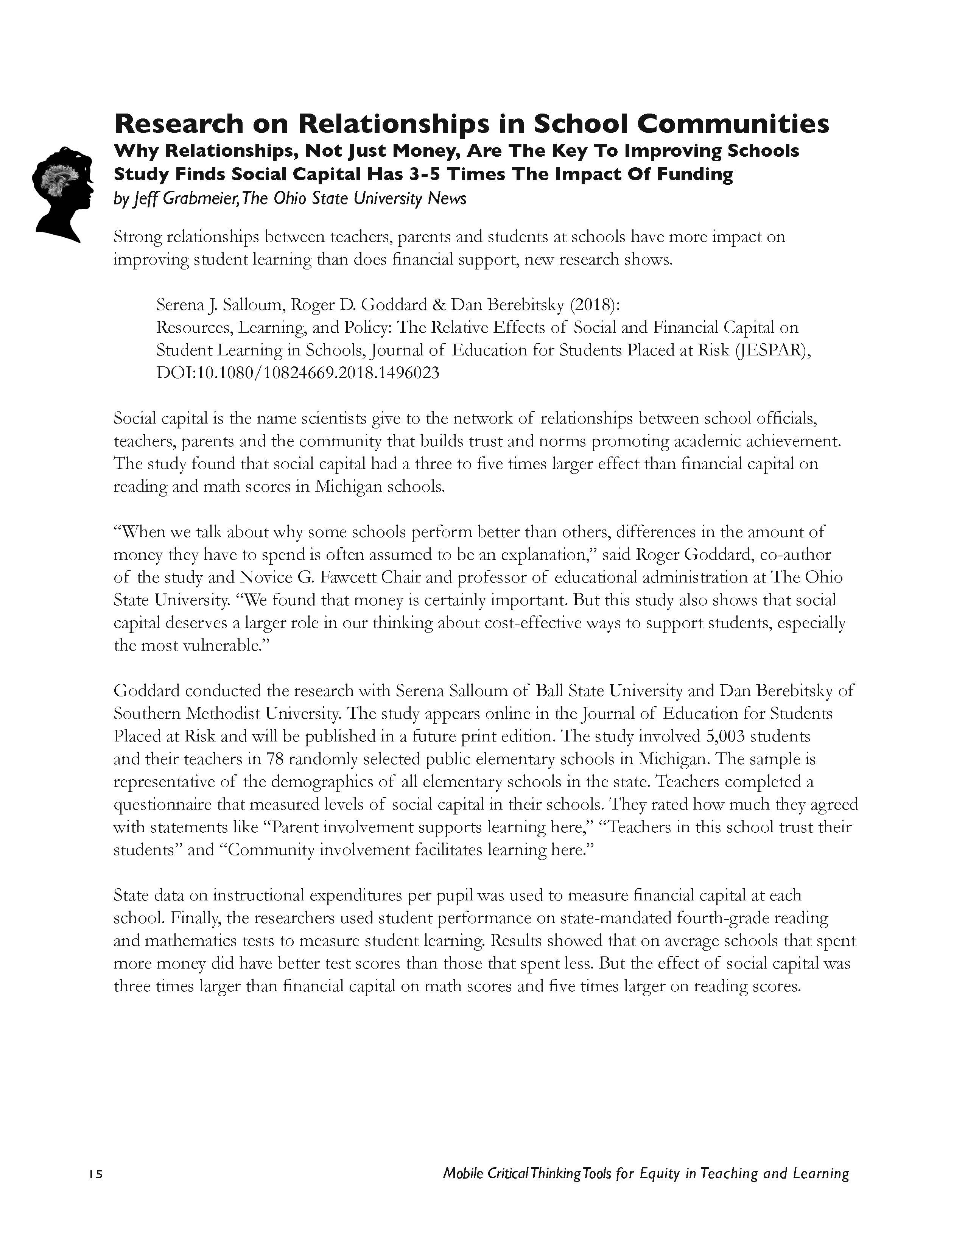
Research
A researcher at The Ohio State University found in 2018 that social capital (community) had a 3-5 times greater impact on student test outcomes than monies.
Resources, Learning, and Policy: The Relative Effects of Social and Financial Capital on Student Learning in Schools
Serena J. Salloum, Roger D. Goddard & Dan Berebitsky
Published online: October 15, 2018.
Guide Page 15

Slide 41
How does this research connect with stereotypes
in regards to amplifying student voice?

Slide 42

Powerful Questions

Slide 43
Panoramic Book
Cultural Connections
Process

Slide 44
What are the Qualities
of a
Collaborative Community?
Bubble map to organize thinking.

Slide 45
Campaign
for
Community
(The Hello Campaign)

Slide 46
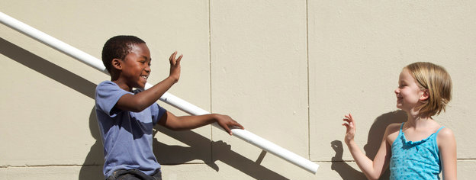
The Hello Campaign

Slide 47

The Hello Campaign
Being Strategic with a Plan

Slide 48
PRESENTATION
Each group will convincingly present:
A campaign for building a community of critical thinkers with a focus on amplifying student voice.
You have 7 minutes to decide, design and then present your ‘campaign’ convincingly.

Slide 49
Commonalities
Reflections
Key takeaway

Slide 50
NUA Strategy Review Chart
The strategy and the structure— | The strategy develops— | This is important for our pedagogy because— | This connects to the principle, practice, and belief of— | I will introduce and use it with my teachers and students by—

Slide 51
Thank You
robert@eggplant.org
www.eggplant.org
www.nuatc.org

